Slide 1


Welcome to
Nursery
www.llanganschool.co.uk llangan_primary_school

Slide 2
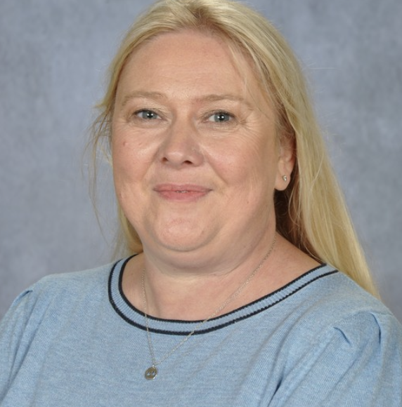
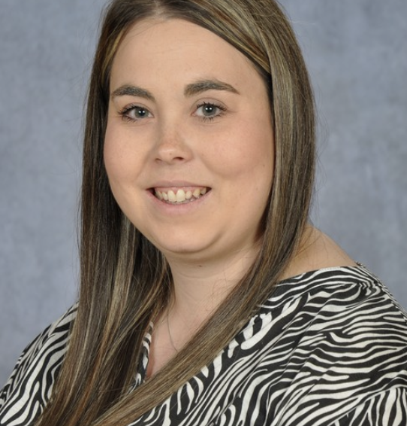
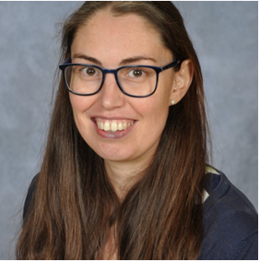
Meet the staff
Mrs Stevens
Miss Davies
Class LSA
Miss Llewellyn

Slide 3
Nursery Weekly Timetable
Pupils access outdoor learning everyday.
Literacy and Numeracy through Inquiry | Literacy and Numeracy through Inquiry | Welly Wednesday Inquiry learning through the outdoors | Literacy and Numeracy through Inquiry | Health and Well being PE

Slide 4
Structure of the day
Breakfast Club
Gates open at 8:05am and 8:25am is last entry. Pupils must be registered to use our breakfast club provision.
AM
Gates open at 08:45am and close at 08:55am. You can come to the top or bottom gate.
Lessons begin at 09:00am
Snack time is at 10:10am – 10:30am - pupils to bring in a healthy snack.
Hometime is at 11:30am for pupils not attending Llangan wraparound/childcare provision. Pupils attending Llangan Childcare will remain in the cwtch with a member of staff while the children not attending are being dismissed.

Slide 5
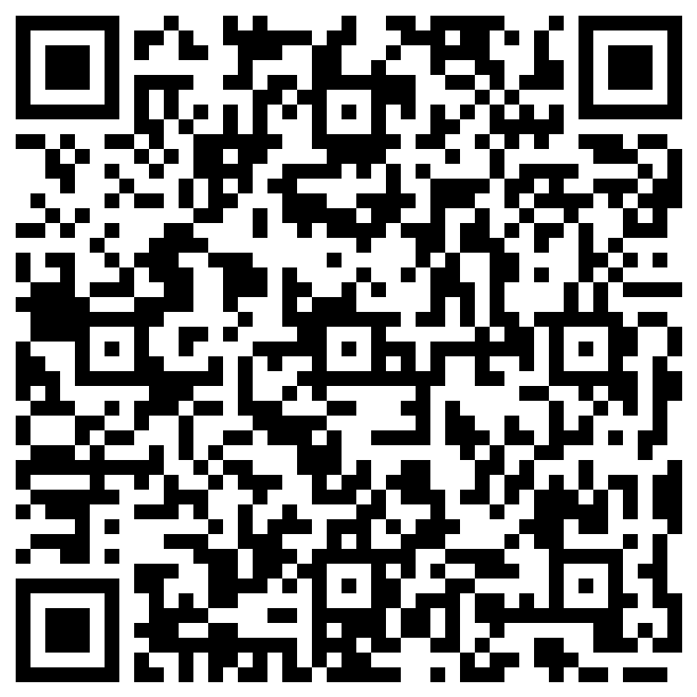
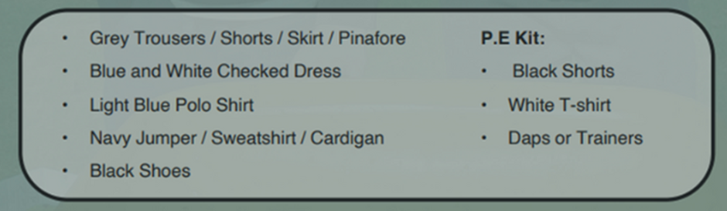

School Uniform
At Llangan primary school we strongly encourage pupils to wear school uniform. It encourages a sense of equality, pride and belonging in our school and local community. Please could parents ensure all children’s belongings are clearly labelled. Our uniform consists of:
Parents can purchase uniform items embroidered with the school’s logo at the following outlets:
• The Pencil Case (Cowbridge)
• Uniform to go (Online)
• My Uniform (Online)

Slide 6
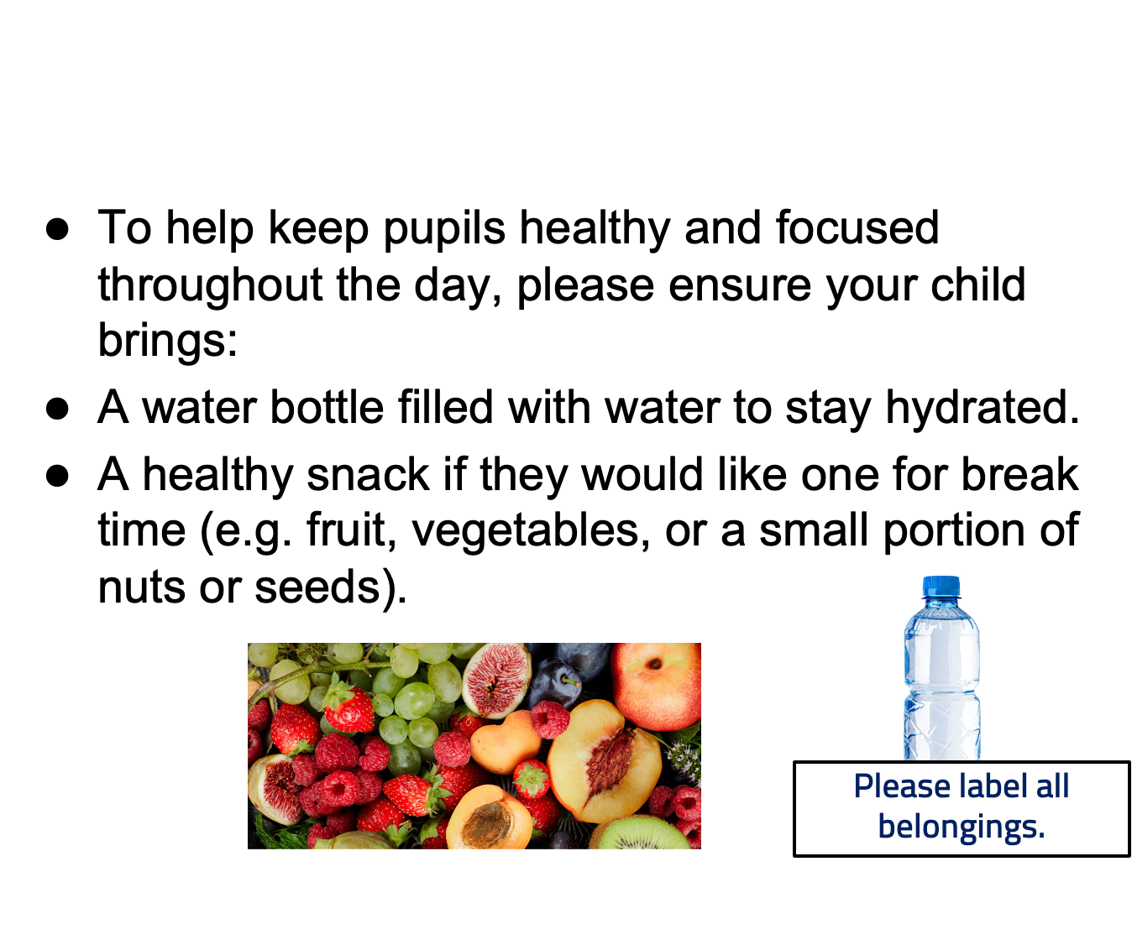

Slide 7
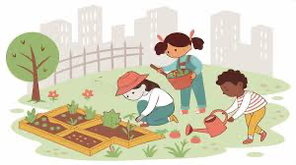
Outdoor Learning
We access Outdoor Learning every day. Outdoor experiences are meaningful part of your child’s learning journey. Children may get muddy, wet, or sandy – and that’s part of the fun!
We will also be doing Welly Wednesday every Wednesday morning. Please help us by providing a suitable pair of wellies so that they can fully embrace these experiences in comfort and safety. Please don’t forget to label these! Please could you also provide your child with a waterproof coat on this day as the autumn & winter approaches.

Slide 8
Dates for your Diaries
●Harvest Festival – 26th September 2025
●INSET Day – 20th October 2025
●Half term – 27th – 31st October 2025
●School Photos – 3rd November 2025
●Christmas Concert – 11th December 2025
Please check the School news App for up-to-date events that will be happening in school.

Slide 9
Maths
Recognising numbers, reading and writing them
Counting aloud
Pointing to objects one at a time while counting
Understanding quantity: Knowing that "3" means three things
Comparing quantities - More/less, same/different
Beginning to understand adding and subtracting using objects
Simple mental addition and subtraction within 5 using visuals or fingers
Recognising and creating simple patterns
Sorting objects by colour, shape, size, or type
Recognising and naming basic 2D shapes
Beginning to talk about 3D shapes (cube, ball/sphere)
Exploring position and direction: in, on, under, next to, behind, in front
Using language of size: big/small, tall/short
Understanding length, weight, and volume through play (e.g., pouring water, using scales)
Comparing objects: heavier/lighter, longer/shorter
Sequencing events - what happens first, next, last
Understanding daily routines: morning, lunchtime and bedtime
Beginning to recognise days of the week
Continue to use maths in everyday situations. This could include: using coins when shopping or measuring ingredients when cooking

Slide 10
Literacy
In the early years, literacy is about so much more than learning to read and write—it’s about developing a love of language. Children build the foundations for literacy through talking, listening, singing, mark-making, and playing with sounds and words. Everyday experiences such as sharing stories, noticing print in the environment, and enjoying rhymes all help children develop the skills they need to become confident communicators.
At this stage, we focus on fostering curiosity, imagination, and enjoyment, while gradually introducing the building blocks of reading and writing in meaningful and playful ways.
When pupils are ready we will be learning a sound per week following our school phonics scheme RWI. This sound will be sent home along with a small activity you may wish and be encouraged to do with your child.

Slide 11
Weekly events for Nursery
Our PE day is on a Friday. As always, please send your child in wearing the appropriate PE kit.
Homework will be issued every two weeks, on a Friday. Homework is to be handed in a week and a half later, on a Wednesday, so it can be marked. Homework will be explained to the children and will be explained on the class page on our school website.
Each child will have a Home Learning Log Book, however they may record these activities on Seesaw. Please support us in our quest for excellence in presentation by insisting your child completes their learning to the highest standards.
Welly Wednesday is on a Wednesday. Please provide your child with a pair of wellies which we can keep in school for these sessions. Also, please provide your child with an appropriate coat on this day according to the weather.

Slide 12
Attendance
Pupils should be aiming for 100% attendance!
Research consistently shows a direct link between attainment and attendance.
Communication with parents if attendance levels become a concern.
Term-time holidays are recorded as unauthorised absences in line with Vale of Glamorgan expectations.
If your child is unable to attend school, the school office needs to be notified either through email or phone call.

Slide 13
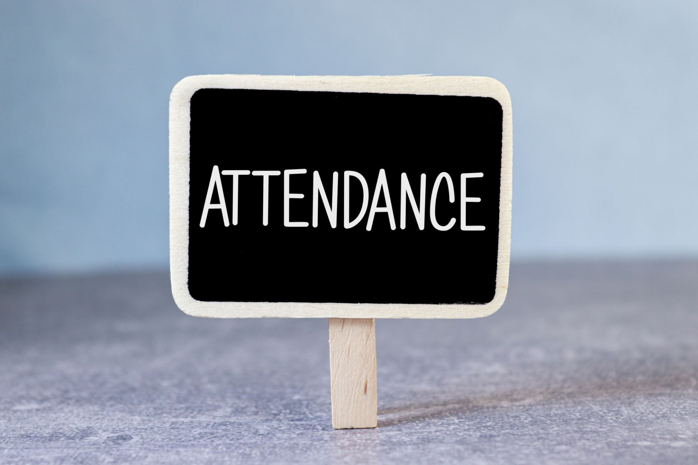
Punctuality
Registration closes at 9:00am.
Please aim for your child to be in by this time in order to avoid your child missing out on learning time.

Slide 14
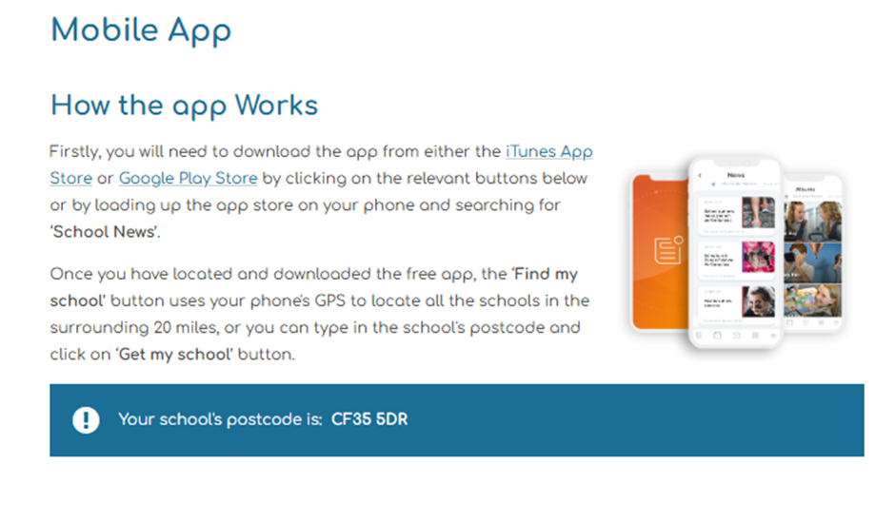
School App

Slide 15
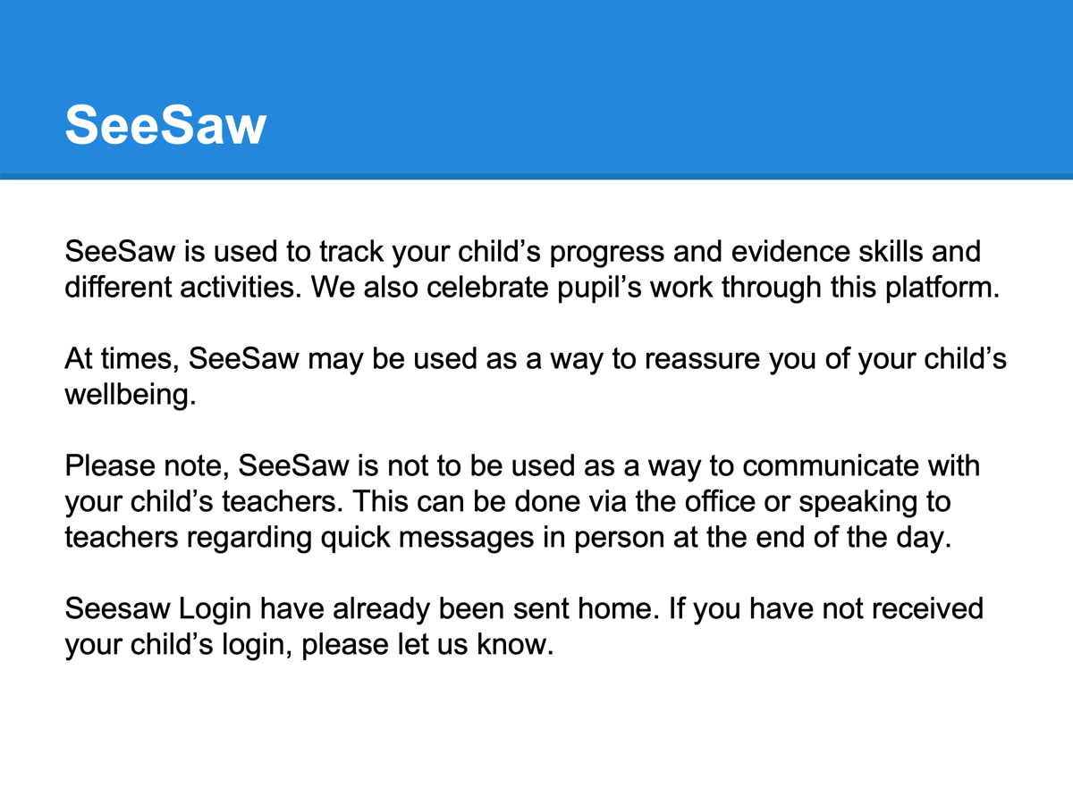
Keeping in Touch
Staff are working in their classrooms at the start of each day.
Staff are available at the end of each day (except Wednesdays) to chat through informal and brief issues.
Please contact office or chat to staff for longer appointments.
Weekly newsletter via the school website.
For urgent issues, please don’t hesitate to contact the office.
Download School News App

Slide 16
Wraparound / Llangan Childcare
School Lunches
●School meals can be purchased through Parent Pay if they are staying for wraparound.
●They may be pre-ordered via your ParentPay account or if not a member of staff will order the hot meal of the day for them.
●The menu is set by Big Fresh. As a school, we are unable to change the choices provided each day. If your child does not like anything on the menu, please ensure you provide a packed lunch for your child or choose an alternative meal on parent pay.
Wraparound staff will always keep you informed if your child is not enjoying the school meals so an alternative can be considered.

Slide 17
Wraparound / Llangan Childcare
Snack
Please send in an additional snack for the afternoon.
Communication
Seesaw is used to share images from the afternoon. Please continue to use the school email address to contact wraparound staff and we will get back to you asap.
Home time for wraparound is 3.20pm.

Slide 18
Keeping in touch
If you need to speak to a member of staff, please contact the school office via phone or email and we will get back to you as soon as possible.
Please do not pass on messages at the school gate; all absences and messages must be reported to the school office.
Staff are available at the end of each day (except Wednesdays) to chat through informal and brief issues.
Weekly newsletter is issued every Friday via the school website.
Please download the School News App

Slide 19
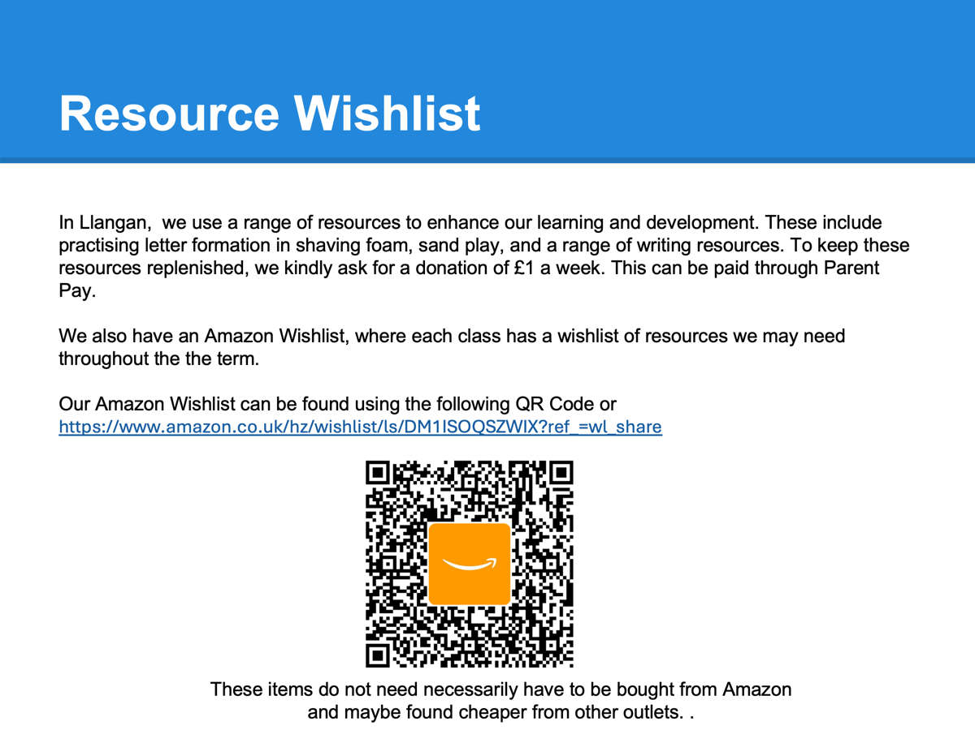

Slide 20
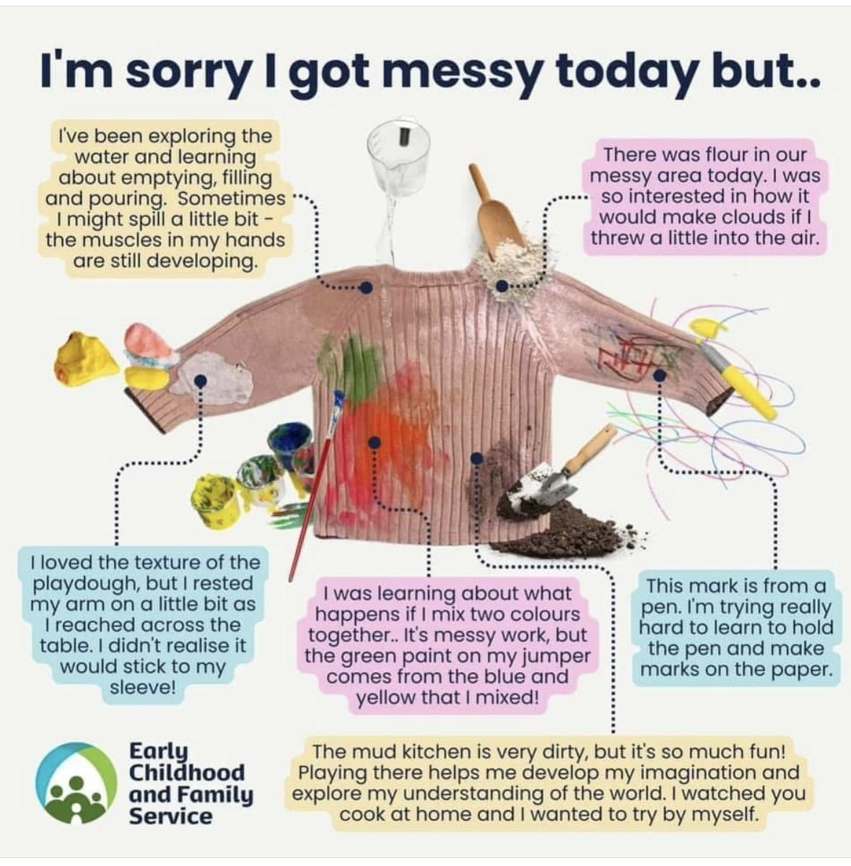
Questions…
Please feel free to look around our classroom where we will be available to answer any questions you might have about life in Nursery.

