Slide 1


Welcome to
Reception & Year 1
www.llanganschool.co.uk llangan_primary_school

Slide 2
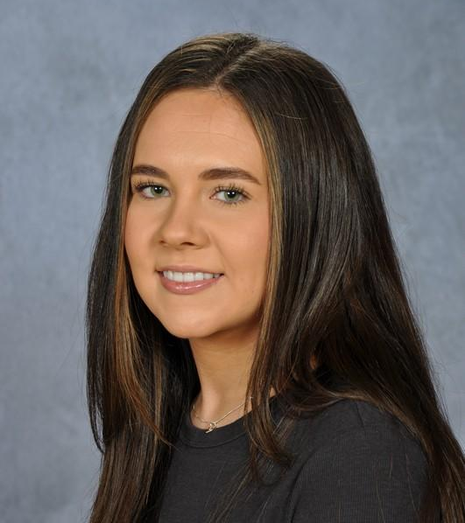
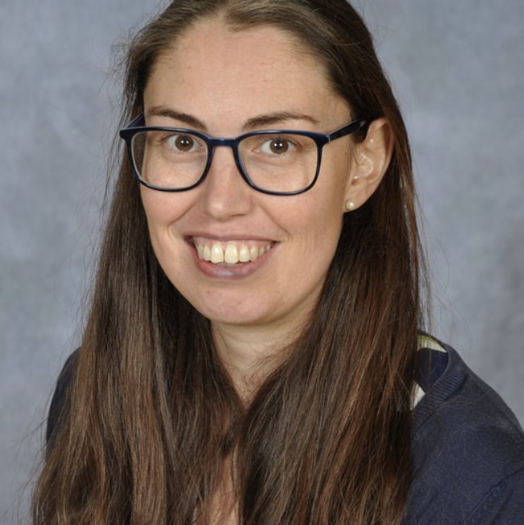
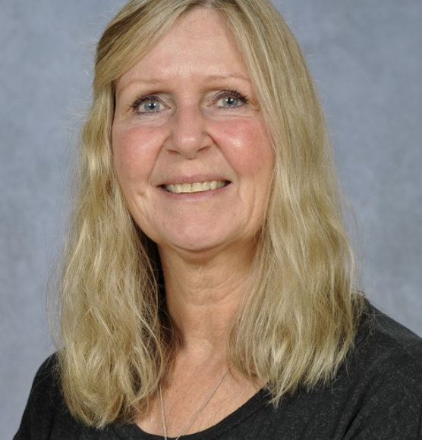
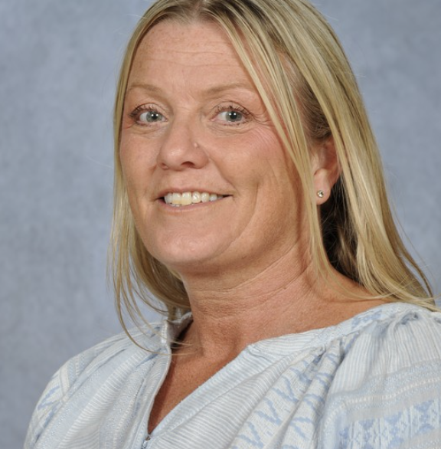
Meet the staff
Miss Hughes
Class Teacher
Monday and Tuesday
Miss Llewellyn
Class Teacher
Wednesday, Thursday and Friday
Mrs Jones
Class LSA
Monday and Friday
Mrs Woodward
Class LSA/HLTA
Tuesday, Wednesday and Thursday

Slide 3
Reception/Year 1 Weekly Timetable
Pupils access outdoor learning everyday.
Monday | Tuesday | Wednesday | Thursday | Friday
Maths or Literacy | Maths or Literacy | Maths or Literacy | Maths or Literacy | Maths or Literacy
Inquiry and Welsh | Inquiry | PE and ICT | Inquiry and Science | Inquiry
Y6 Weekly Timetable

Slide 4
Structure of the day
AM
Gates open at 08:45 am. Children must be in school by 9am at the latest.
Lessons begin at 9 am
Mornings begin with maths and numeracy, english and RWI.
Break time is at 10:10 – 10:30am. Pupils may bring in a healthy snack.
PM
Afternoon lessons focus on challenging, rich and open-ended inquiry questions. Pupils also have opportunities to apply the skills they learn in their maths and english lessons in new and broader contexts.
Science, Welsh, RE and assemblies also happen in the afternoon.
3:20pm – Home time.

Slide 5
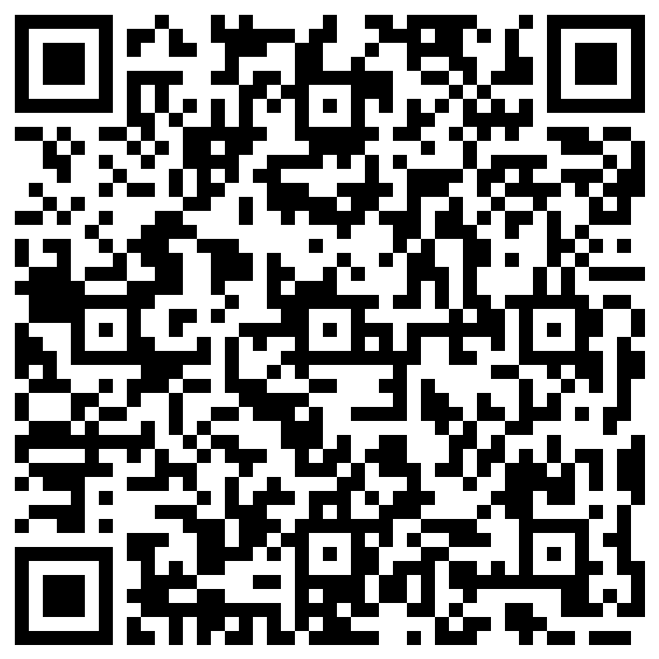
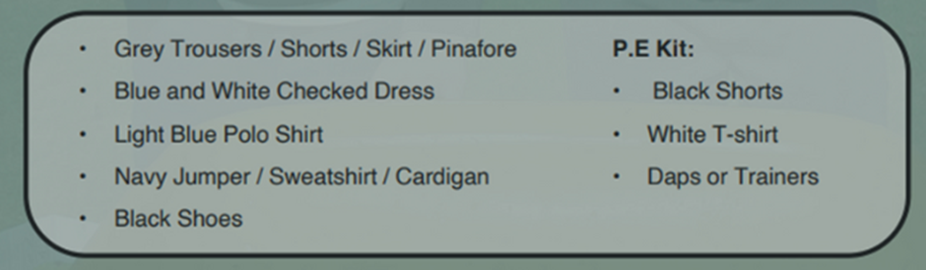
School Uniform
At Llangan primary school we strongly encourage pupils to wear school uniform. It encourages a sense of equality, pride and belonging in our school and local community. Please could parents ensure all children’s belongings are clearly labelled.
Our uniform consists of:
Parents can purchase uniform items embroidered with the school’s logo at the following outlets:
The Pencil Case (Cowbridge)
Uniform to go (Online)
My Uniform (Online)
Please label all belongings.

Slide 6


Water & Snack
To help keep pupils healthy and focused throughout the day, please ensure your child brings:
A water bottle filled with water to stay hydrated.
A healthy snack if they would like one for break time (e.g. fruit, vegetables, or a small portion of nuts or seeds).
Please label all belongings.

Slide 7
School Lunches
School meals are free for all pupils at Llangan Primary.
They may be pre-ordered via your ParentPay account.
The menu is set by Big Fresh. As a school, we are unable to change the choices provided each day. If your child does not like anything on the menu, please ensure you provide a packed lunch for your child.
Please label all belongings.

Slide 8
Dates for your Diaries
PCSO Visit - 9th September 2025
Local Area Walk - 10th September 2025
Harvest Festival – 26th September 2025
INSET Day – 20th October 2025
Half term – 27th – 31st October 2025
School Photos – 3rd November 2025
Christmas Concert – 11th December 2025
Please check the School news App for up-to-date events that will be happening in school.
We are in the process of organising a school trip and details will be shared as soon as we have confirmation.

Slide 9
Ready to Learn
Please make sure your child brings all the appropriate equipment to school each day.
Book bags MUST be brought to school each day. Your child will read every day and the book bag will also be used for storing letters coming home from school.
Please label all belongings.

Slide 10
Maths
Help your child to learn to count, read and write numbers.
This can include numbers up to 10, 20 and 100 (when your child is ready).
Learning skills in a concrete way, moving on to independently applying them.
Continue to use maths in everyday situations. This could include:
counting leaves, pebbles, toys
using coins when shopping
measuring ingredients when cooking
Mathletics.
We use Mathletics to support our learning in school. Different challenges are set according to the skills we are covering in class. Mathletics logins are needed and are available in the front of their homework book.

Slide 11
Literacy
All pupils are working at the level that is appropriate to where they are.
Reading at home is vital. This can be done through sharing stories, re-telling familiar stories. Reception children will be bringing reading books home shortly. It is imperative that parents listen to their children read. Parents can log a comment in their child’s reading log.
Pupils access our Read, Write, Inc scheme. This allows pupils to learn their phonics and is used throughout our teaching when your child is ready.
Spellings
Pupils will be sent spellings to practise which will relate to the red words according to their RWI group. These will be available on our school webpage.
Giglets
The school also uses an App called Giglets which supports pupils reading. Their log in for giglets is placed at the front of their homework learning log book.

Slide 12
Inquiry based learning
Each term, our learners focus on a specific area of the curriculum. This ensures that at Llangan, we spend plenty of time accessing exciting learning opportunities and we become experts in these areas.
The curriculum is split into six areas of learning and experience (AoLEs).
Language, Literacy and Communication
Maths and Numeracy
Humanities
Science and Technology
Expressive Arts
Health and Wellbeing

Slide 13

Outdoor Learning
We access Outdoor Learning every day. Outdoor experiences are a meaningful part of your child’s learning journey. Children may get muddy, wet, or sandy – and that’s part of the fun!
Please help us by providing suitable pair of wellies so that they can fully embrace these experiences in comfort and safety.

Slide 14
Weekly events for R/Y1
PPA is covered by Mrs Stevens and Mrs Woodward on a Monday and Wednesday afternoon.
Reception and Year 1 PE day is a Wednesday. Please ensure your child has the correct PE kit. Your child may wear their PE kit to school (please make sure they bring a school jumper too). School PE kit consists of navy jogging bottoms/shorts with a white t-shirt.
Homework will be issued every two weeks, on a Friday. Homework is to be handed in a week and a half later, on a Wednesday, so it can be marked. Homework will be explained to the children and will be explained on the class page on our school website. Each child will have a Home Learning Log Book, however they may record these activities on Seesaw. Please support us in our quest for excellence in presentation by insisting your child completes their learning to the highest standards.

Slide 15
Attendance
Pupils should be aiming for 100% attendance!
Research consistently shows a direct link between attainment and attendance.
Communication with parents if attendance levels become a concern.
Holidays are no longer authorised in term time in line Vale of Glamorgan expectations.
If your child is unable to attend school, the school office needs to be notified either through email or phone call.

Slide 16
Keeping in Touch
If you need to speak to a member of staff, please contact the school office via phone or email and we will get back to you as soon as possible.
Please do not pass on messages at the school gate; all absences and messages must be reported to the school office.
Staff are available at the end of each day (except Wednesdays) to chat through informal and brief issues.
- Weekly newsletter via the school website.
- Please download the School News App

Slide 17
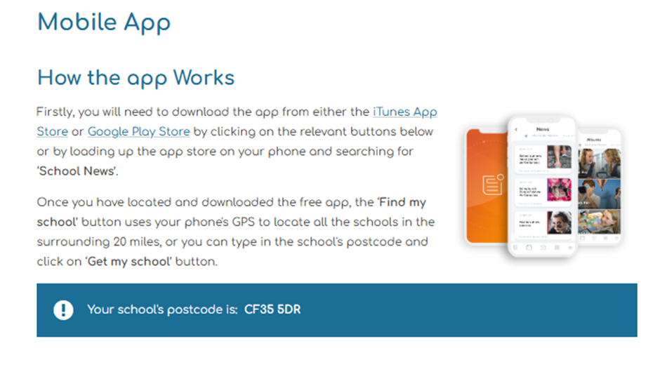
School App

Slide 18

Resource Wishlist
In Pili-Pala, we use a range of resources to enhance our learning and development. These include practising letter formation in shaving foam, sand play, and a range of writing resources. To keep these resources replenished, we kindly ask for a donation of £1 a week. This can be paid through Parent Pay.
We also have an Amazon Wishlist, where each class has a wishlist of resources we may need throughout the the term.
Our Amazon Wishlist can be found using the following QR Code or https://www.amazon.co.uk/hz/wishlist/ls/DM1ISOQSZWIX?ref_=wl_share
These items do not need necessarily have to be bought from Amazon and maybe found cheaper from other outlets. .

Slide 19
SeeSaw
SeeSaw is used to track your child’s progress and evidence skills and different activities. We also celebrate pupil’s work through this platform.
At times, SeeSaw may be used as a way to reassure you of your child’s wellbeing.
Please note, SeeSaw is not to be used as a way to communicate with your child’s teachers. This can be done via the office or speaking to teachers regarding quick messages in person at the end of the day.
Seesaw Login have already been sent home. If you have not received your child’s login, please let us know.

Slide 20
Questions…
Please feel free to look around our classroom where we will be available to answer any questions you might have about life in Reception and Year 1.

