Slide 1


Welcome to
Year 6
www.llanganschool.co.uk llangan_primary_school

Slide 2
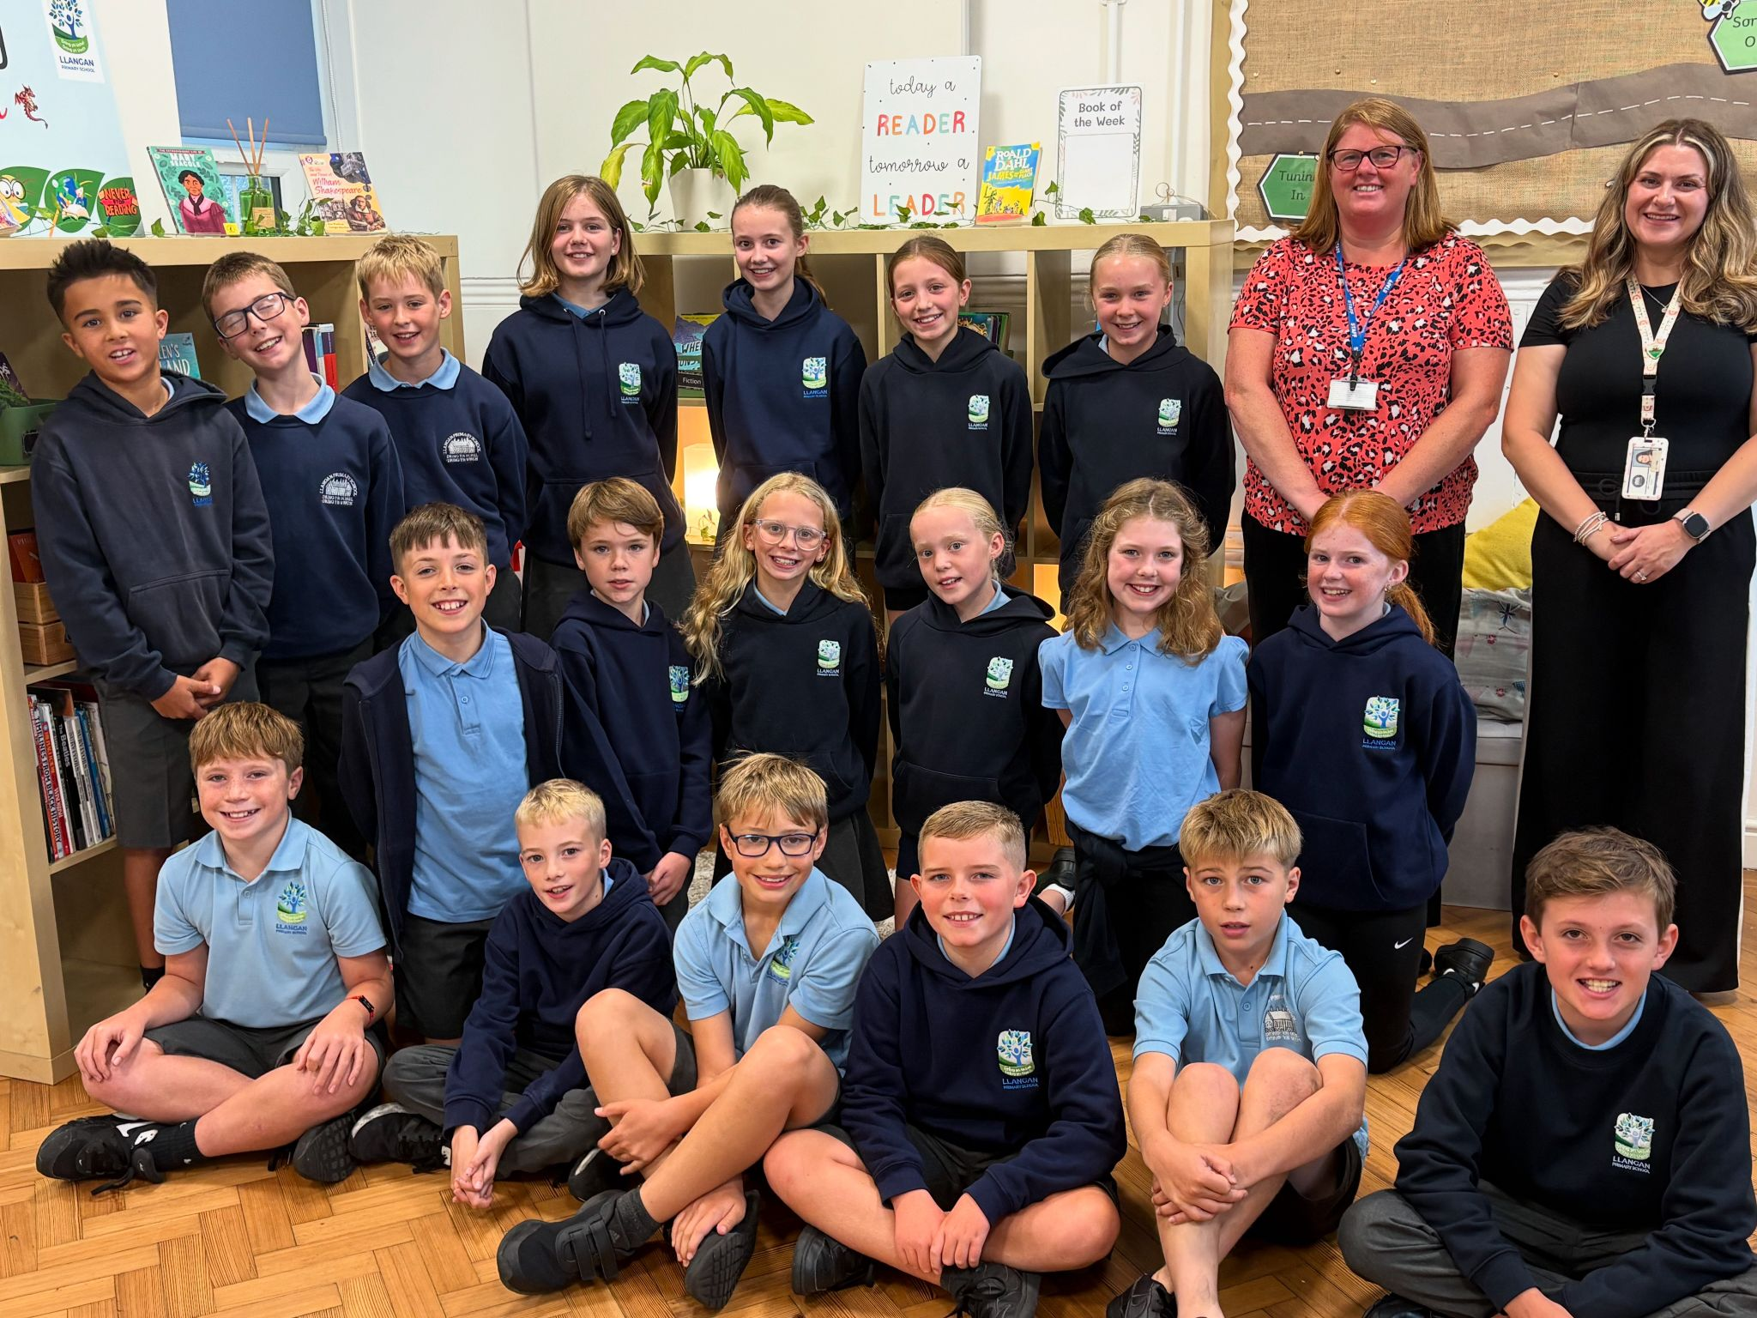
Meet the staff
Mrs Heavyside
Monday, Tuesday and Wednesday
Mrs Antoniou
Thursday and Friday

Slide 3
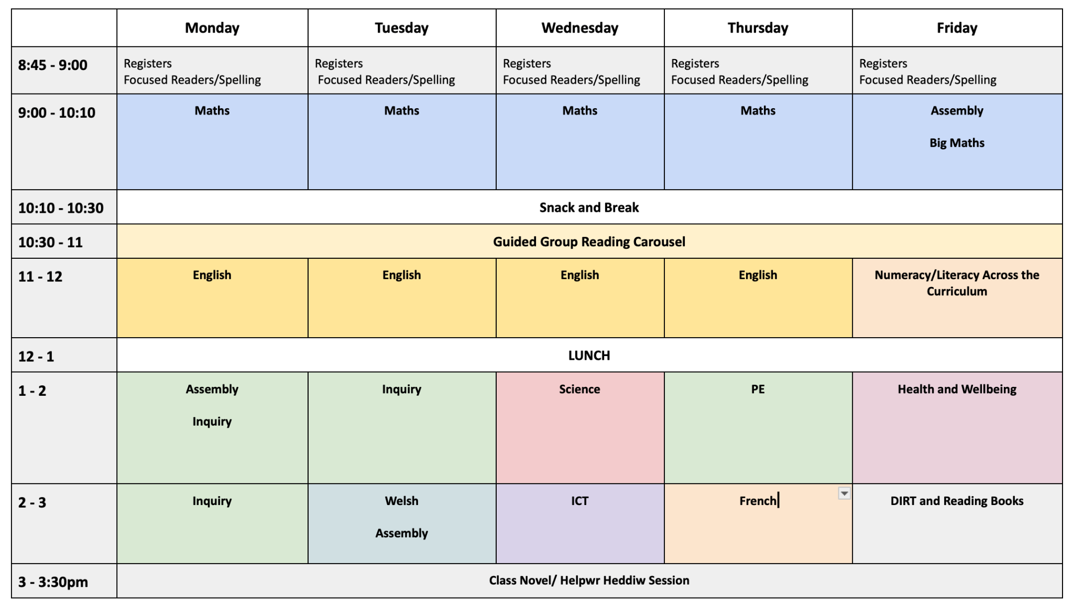
Y6 Weekly Timetable

Slide 4
Structure of the day
Breakfast Club
Gates open at 8:05am, 8:25am last entry. Pupils must be registered to use our breakfast club provision.
AM
Gates open at 08:45 and close at 08:55.
Lessons begin at 09:00
Mornings begin with maths and numeracy, moving on to English and guided group reading.
Break time is at 10:10 – 10:30 am, pupils may bring a healthy snack.
PM
Afternoon lessons focus on challenging, rich and open-ended inquiry questions. Pupils also have opportunities to apply the skills they learn in their maths and English lessons in new and broader contexts. Science, Welsh, RE and assemblies also happen in the afternoon.

Slide 5
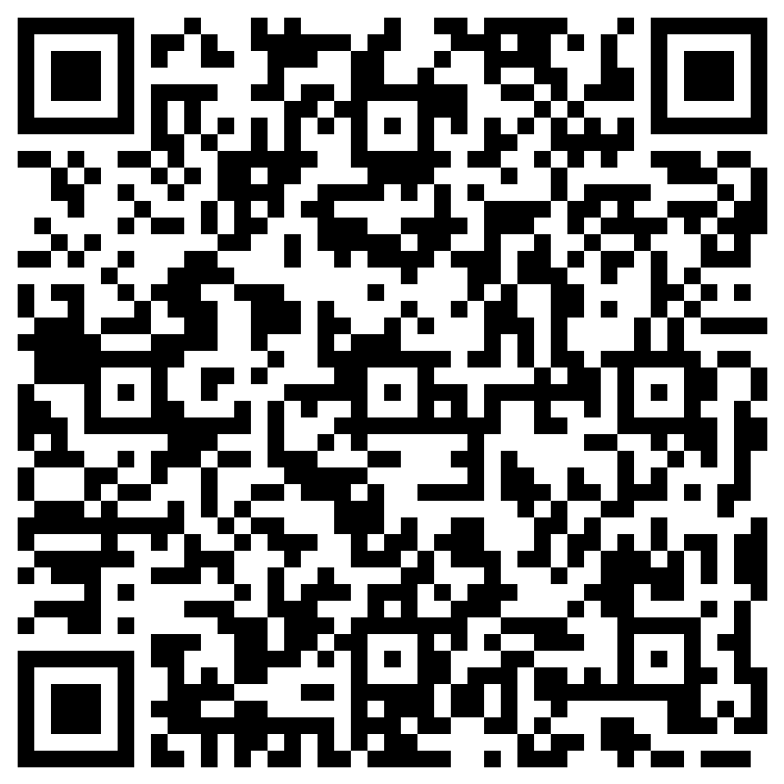
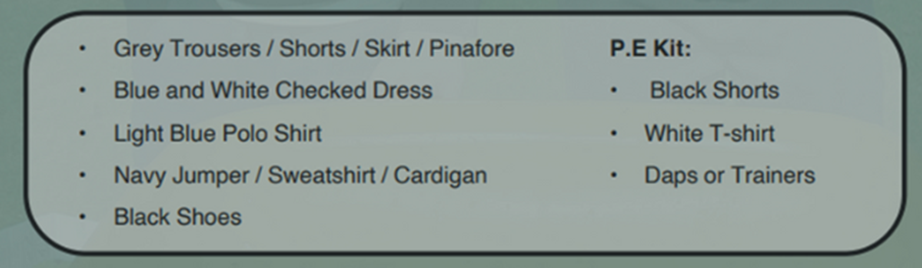
School Uniform
At Llangan primary school we strongly encourage pupils to wear school uniform. It encourages a sense of equality, pride and belonging in our school and local community. Please could parents ensure all children’s belongings are clearly labelled. Our uniform consists of:
Parents can purchase uniform items embroidered with the school’s logo at the following outlets:
• The Pencil Case (Cowbridge)
• Uniform to go (Online)
• My Uniform (Online)

Slide 6

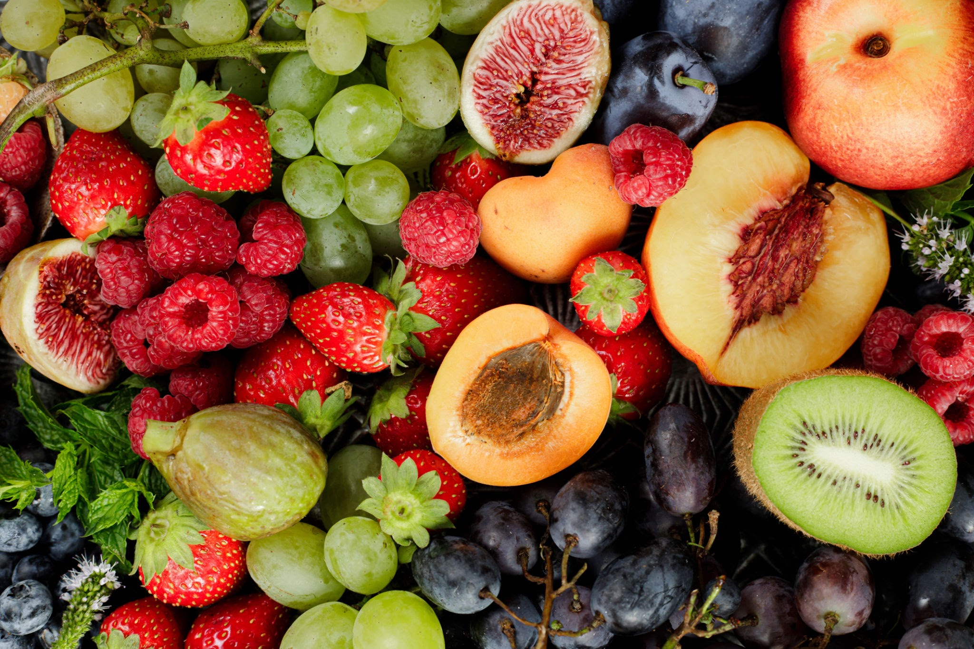
Water & Snack
To help keep pupils healthy and focused throughout the day, please ensure your child brings:
A water bottle filled with water to stay hydrated.
A healthy snack if they would like one for break time (e.g. fruit or vegetables. No nuts or squash please.

Slide 7
School Lunches
School meals are free for all pupils at Llangan Primary.
They may be pre-ordered via your ParentPay account.
The menu is set by Big Fresh. As a school, we are unable to change the choices provided each day. If your child does not like anything on the menu, please ensure you provide a packed lunch for your child.

Slide 8
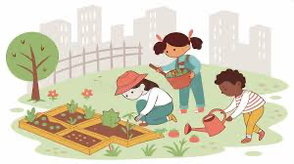
Outdoor Learning
Outdoor learning provision will be provided for all children with Mrs Stevens. This is a weekly session with a group, from each year group. These activities are taking place on a Thursday.
Don’t forget if the weather is wet or cold please provide suitable clothing to wear, such as a waterproofs, a warm coat and wellies for the session.

Slide 9

Dates for your Diaries
Fri 26th Sept: Harvest Festival & coffee morning (9:30am)
Y4, 5, 6 trip to WNO at Millennium Centre
Mon 13th Oct: Flu immunisations
Mon 20th Oct: INSET Day
Weds 22nd Oct: Trip to Imperial War Museum, London 7am - 9pm!
Mon 3rd Nov: School photographs
Fri 28th Nov: Jump out day (approx. 2pm)
Please check school calendar on our website!

Slide 10

Ready to Learn
Please make sure your child is dressed appropriately for the school day and brings all the appropriate equipment to school each day.
Book bags MUST be brought to school each day. Your child will read every day and the book bag will also be used for storing letters and homework books coming home from school.

Slide 11
Maths
Challenge increases in Year 6 to prepare for secondary school, but pupils are given tasks that meet them at their current point of learning.
All times tables must be known fluently
Numbers to 100,000,000 and decimal/fractional numbers
Developing competency and fluency in all four operations
Applied maths in real contexts: geometry, measures, statistics etc.
Focus on problem-solving and reasoning
Pupils will learning new skills in a concrete way, supported as needed before moving on to independently applying them.
Continue to support your child by using maths in everyday situations – e.g. budgeting, discounts, weights and measures, timetables.
Mathletics is assigned for homework but is also a great revision tool for times tables.

Slide 12
Literacy
Reading at home is still vital! Even in Year 6!
Y6 pupils will need increased independence and maturity as pupils write in a more extended way. Demand for more detail, and understanding the purpose of the writing.
Use of tools such as a dictionary and a thesaurus to help independence.
Independently applying basic skills such as checking for correctly punctuated sentences.

Slide 13
Spelling
Children will be put into spelling groups. Their spelling groups are to be found in the front cover of their Home Learning Logs.
New spelling words will be issued every Friday; they will be published on the school website class page.
Please support your child to learn their spelling words, including being able to write them in a sentence.
Children will be tested on their spelling words every Friday.
Spellings can also be found on Google Classroom and Edshed.

Slide 14
Inquiry based learning
Each term, our learners focus on a specific area of the curriculum. This ensures that at Llangan, we spend plenty of time accessing exciting learning opportunities and we become experts in these areas.
The curriculum is split into six areas of learning and experience (AoLEs).
Language, Literacy and Communication
Maths and Numeracy
Humanities
Science and Technology
Expressive Arts
Health and Wellbeing
This term, we will be working on inquiries in the Humanities area of the curriculum. In Year 6, we will be focusing on ‘Power and Conflict’ - in particular, ‘How did WWII change life in Wales?’

Slide 15
Weekly events for Y6
PPA is covered by Mrs Stevens and Mrs Woodward on Thursday afternoons.
PE day is on a Thursday. Your child may wear correct PE kit to school.
Spelling words are issued and tests carried out on Fridays.
Homework will be issued every two weeks, on a Friday. Homework is to be handed in a week and a half later, on a Wednesday, so it can be marked.
Homework will be explained to the children and will be explained on the class page on our school website.
Each child will have a Home Learning Log Book. Please support us in our quest for excellence in presentation by insisting your child completes their learning to the highest standards.
Outdoor Learning on a Thursday, please bring a coat and wellies!

Slide 16
Attendance
Pupils should be aiming for 100% attendance!
Research consistently shows a direct link between attainment and attendance.
Communication with parents if attendance levels become a concern.
Term-time holidays are recorded as unauthorised absences in line Vale of Glamorgan expectations.
If your child is absent from school, it must be reported via phone or an email to the office.

Slide 17

Punctuality
School opens at 8:45.
School starts at 8:55.
Registration closes at 9:00am.
Please aim for your child to be in on time everyday in order to avoid your child missing out on being introduced to their learning day. Being punctual also helps other children from being disturbed.

Slide 18
Keeping in Touch
If you need to speak to a member of staff, please contact the school office via phone or email and we will get back to you as soon as possible.
Please do not pass on messages at the school gate; all absences and messages must be reported to the school office.
Staff are available at the end of each day (except Wednesdays) to chat through informal and brief issues. If you require to speak to a class teacher for a longer period, please make an appointment via the school office.
Weekly newsletter via the school website.
Please download the School News App

Slide 19
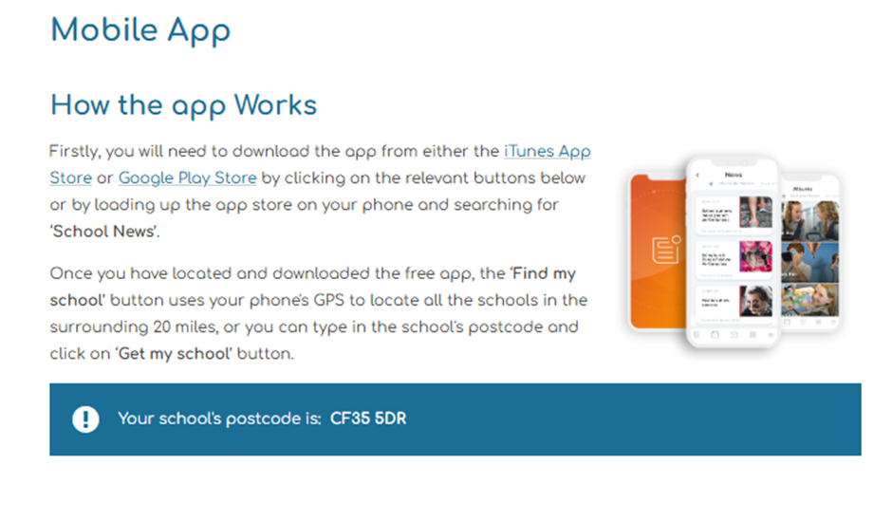
School News App

Slide 20
Llangrannog
We will be visiting Llangrannog 11-13th March

Slide 21
Handbook
Copies of our school Handbook will be sent home with children shortly.
All important information is located here.

Slide 22
Questions…
Please feel free to look around our classroom where we will be available to answer any questions you might have about life in Year 6.

