Slide 1
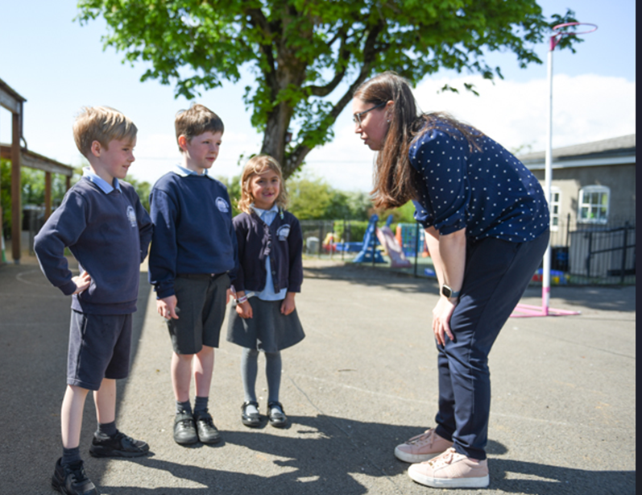
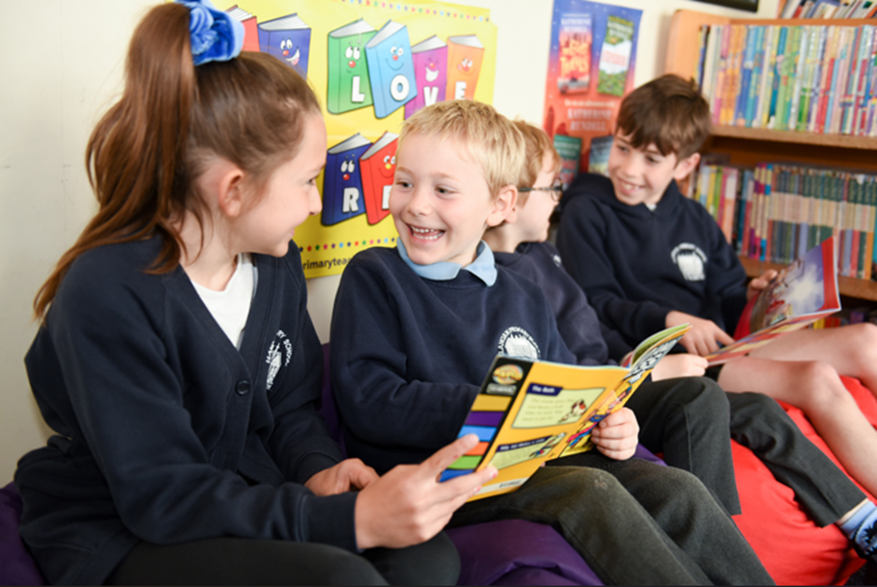
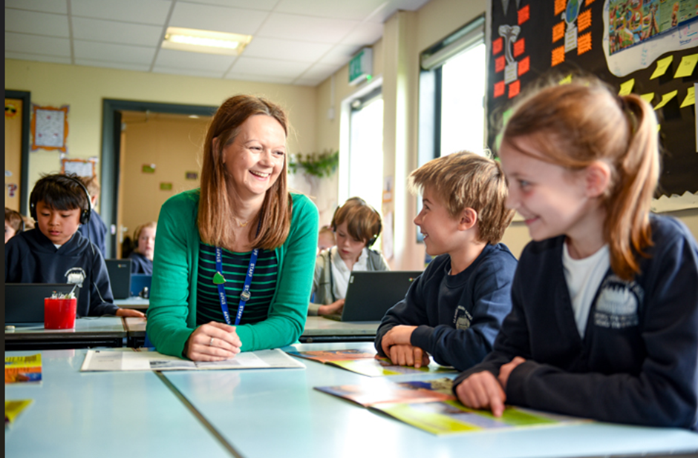
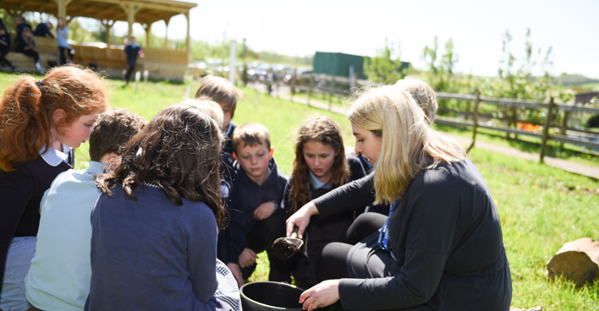
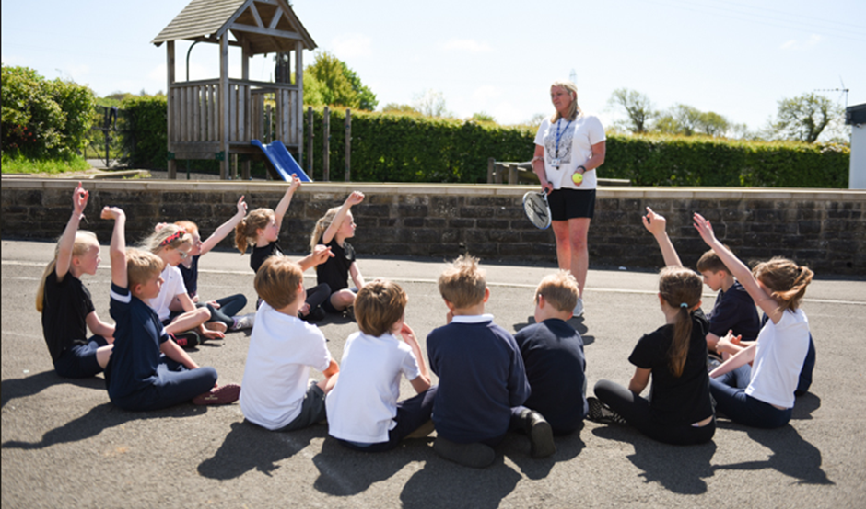
Phonics and Spelling

Slide 2

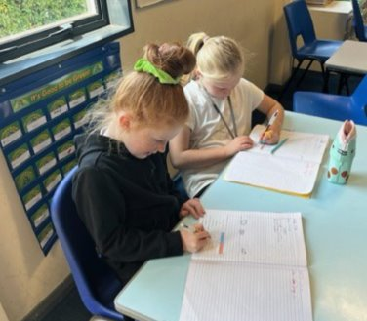
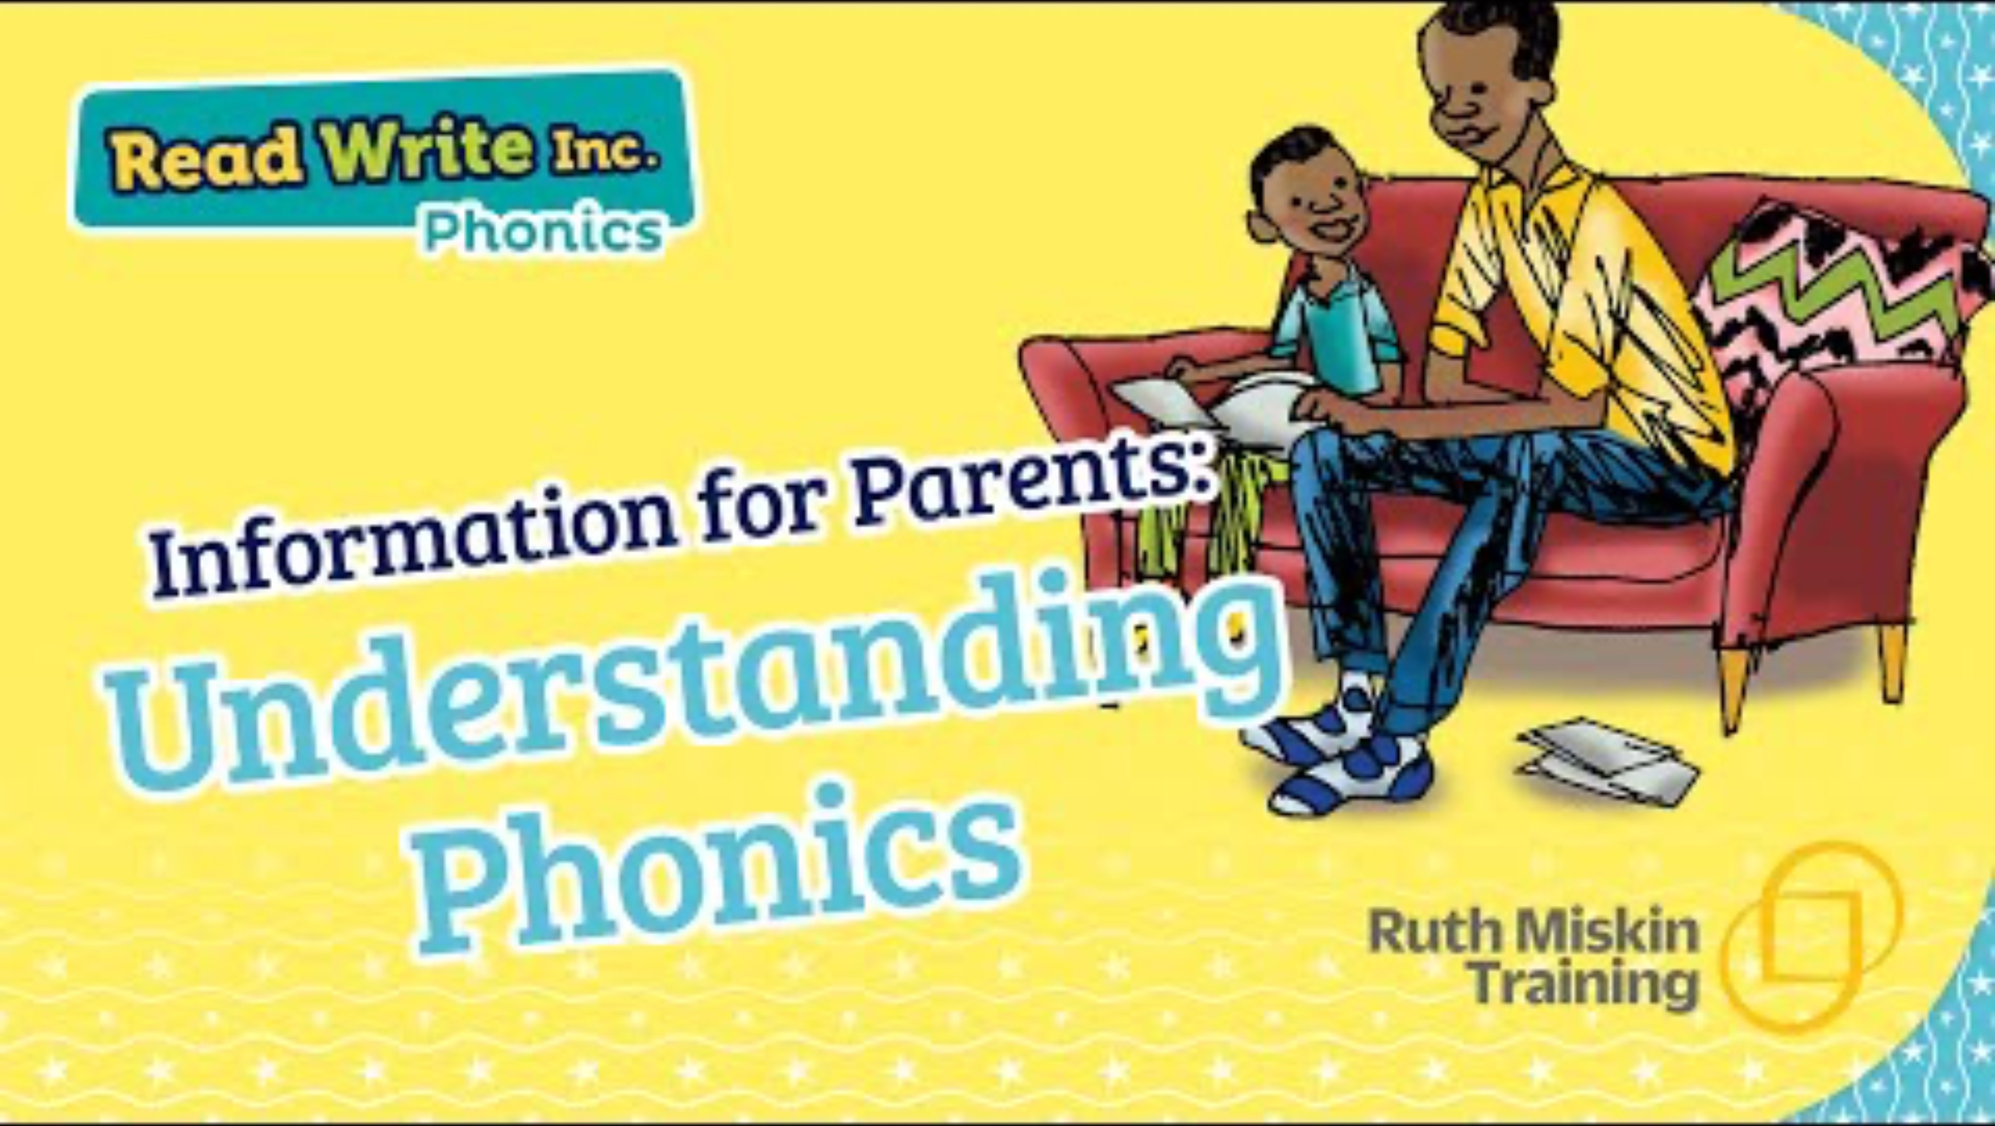
Phonics
Read Write Inc. Phonics is a literacy programme developed by Ruth Miskin and published by Oxford University Press. It is taught in over 5000 schools in the United Kingdom, making it the country’s most popular way for children to learn to read using phonics.

Slide 3
What is Phonics?
Phonics - the sounds that our alphabet represent.
We have 26 letters, 44 sounds and 150+ ways of writing those sounds!
It is the most difficult language to crack!
We need to make sure our children learn these sounds quickly and that they are embedded. The best way to do that is have fun learning, but also repeat, practise and repeat again and again and again!

Slide 4
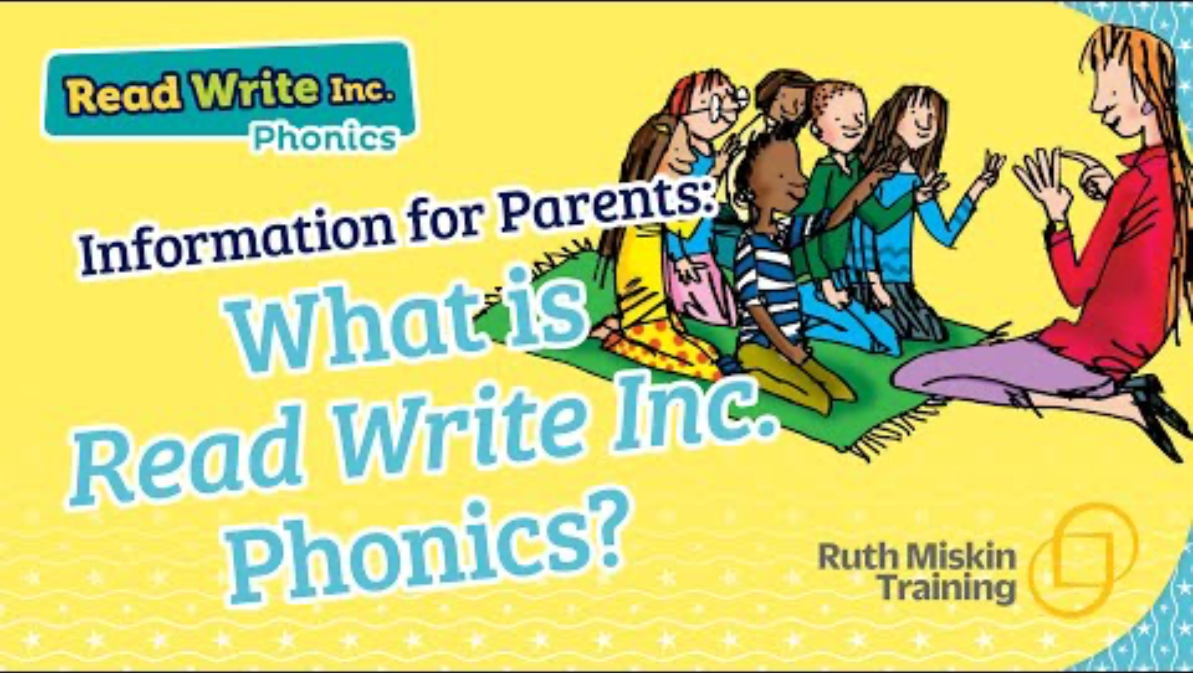
Phonics
What is Read Write Inc

Slide 5
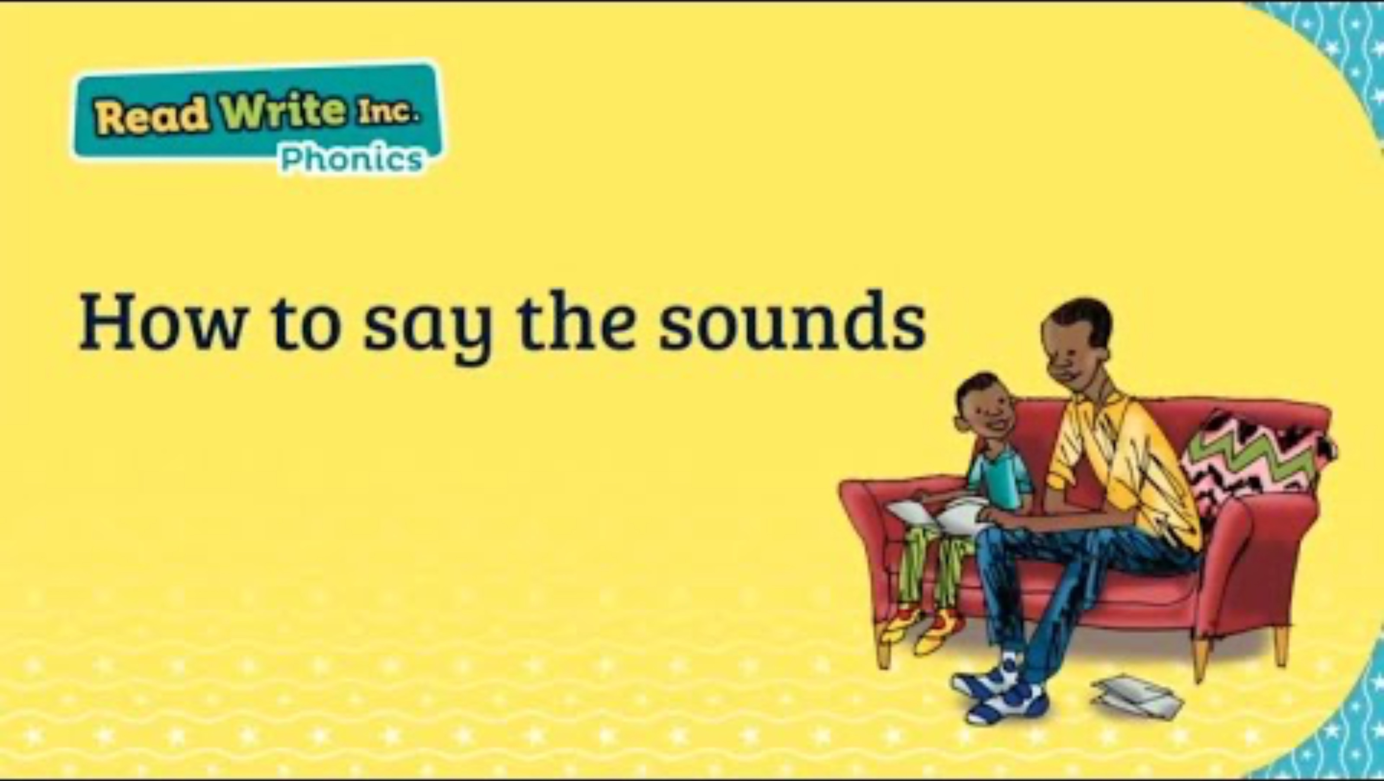
Pure Sounds
It is vital that we teach our children to pronounce the sounds correctly.
We call these Pure Sounds.
How to Say the Sound

Slide 6
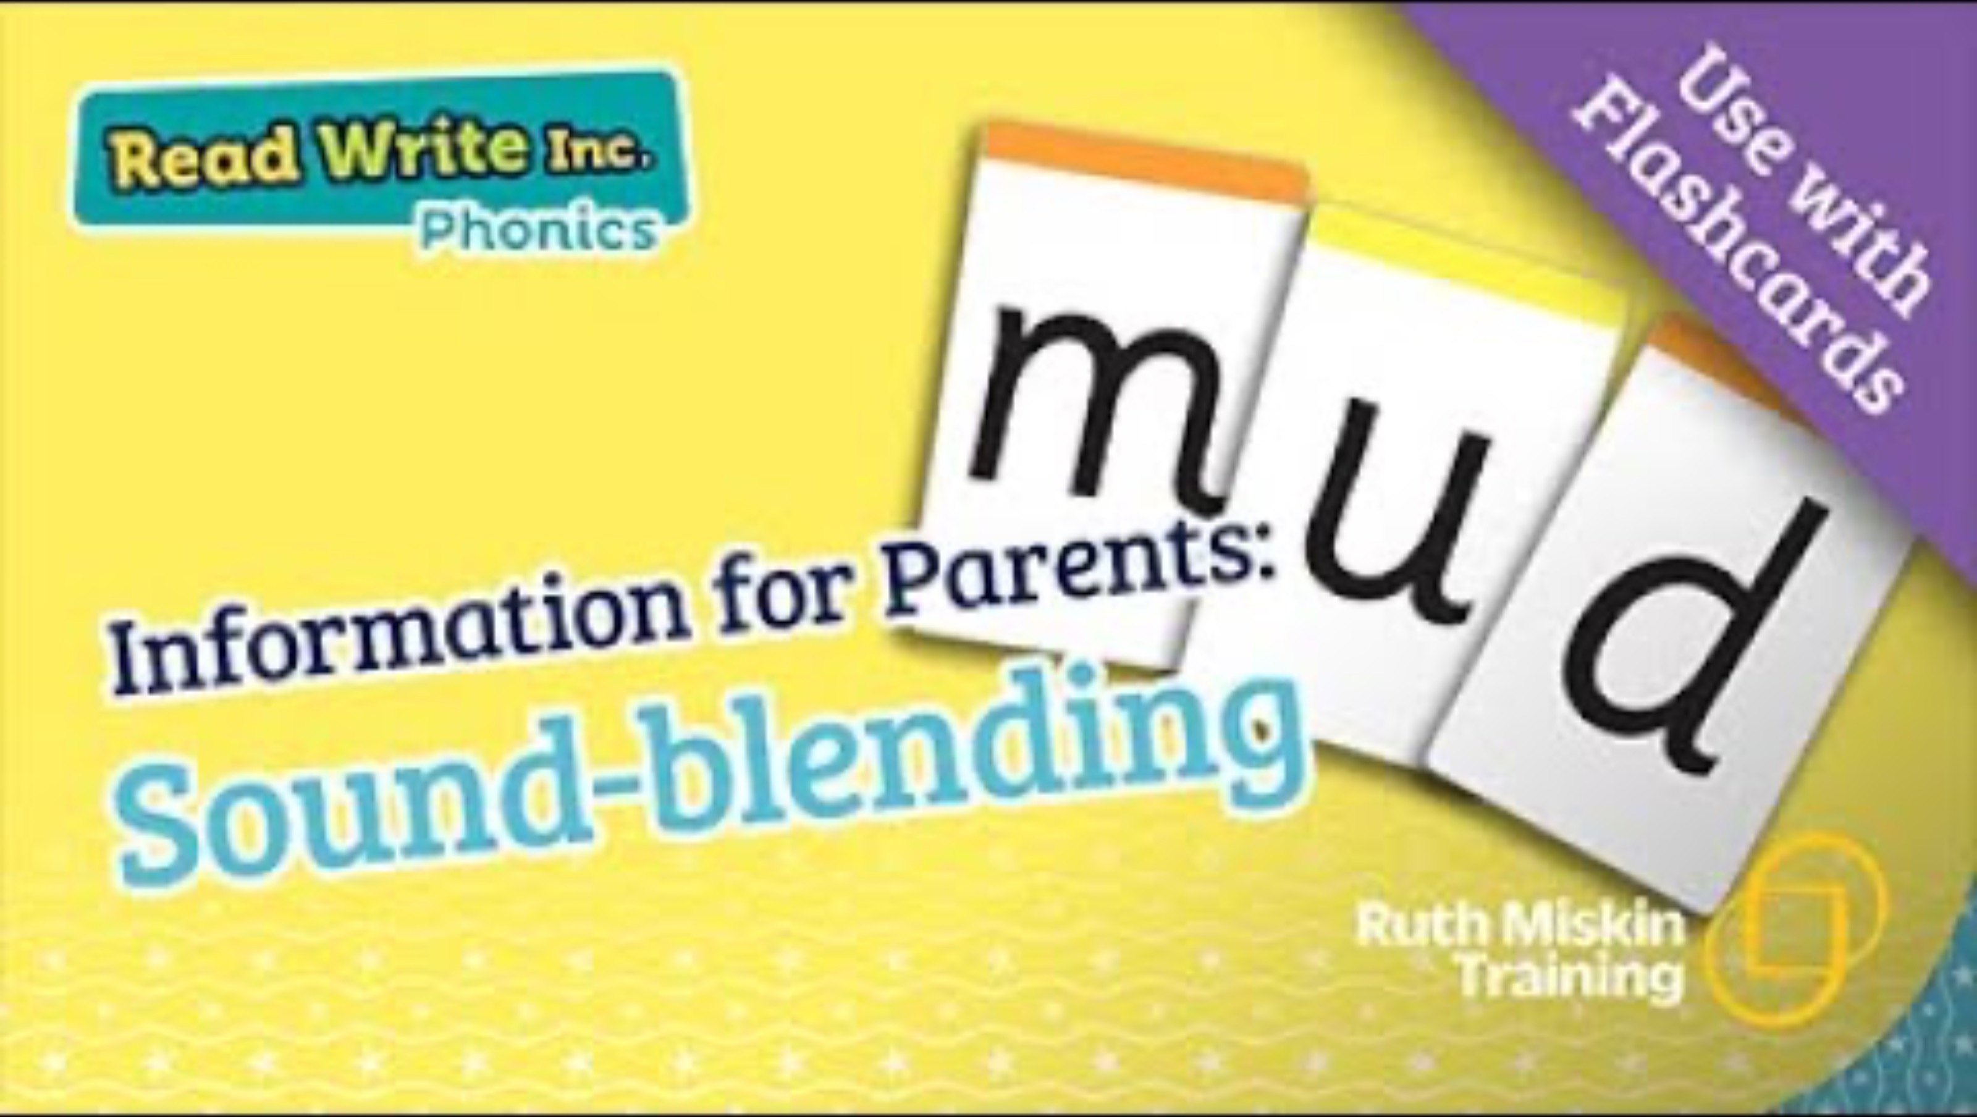
Phonics
Sound-Blending
Once the children have learnt some sounds they can start to blend them to begin to read words.

Slide 7
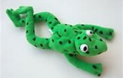
Fred Talk
Fred the Frog helps us to learn our sounds!
He only speaks in sounds!
He helps the children listen to the sounds and begin to blend the words without reading them.

Slide 8
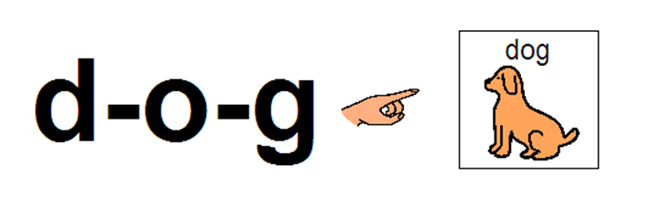
Word time
Fred is not the only way we teach children to blend sounds.
We use the letter cards and magnetic letters.
This section of the lesson is called Word Time.

Slide 9


….and now write it!

Slide 10
Rhymes to Write!
To help the children write the sounds we use a rhyme to help.
These link to the letter pictures.
When the children write, they sit at desks. They are taught the correct sitting position and pencil grip.

Slide 11
Writing Words
Once the children are secure writing some letters, as with reading, we begin to blend the letters to write some words.
Fred is back!

Slide 12
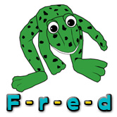
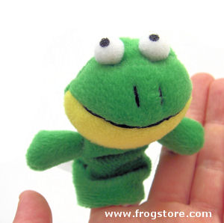

Fred fingers

Slide 13
Recap….
RWI teaches:
Speedy Sounds
Blending
Handwriting

Slide 14

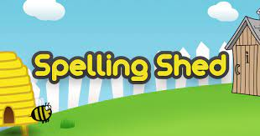
Spelling
In Llangan pupils from Reception to Year 6 are all able to access Spelling Shed.
Pupils are assigned specific spelling assignments each week.
Pupils from Year 2 (when they are ready) to Year 6 all have a weekly spelling test every Monday. These spellings are assigned on Spelling Shed and are also available on their class homework page on the school website.
Spelling Shed provides:
A game-like format that helps builds your child’s confidence in spelling
The ability for your child to create their own weekly word lists
A full spelling curriculum that is grade level specific and provides weekly online and offline activities
The ability to track your child’s progress and see what words they are frequently misspelling.
Spelling along with vocabulary and phonics are critical foundational skills that help your child with reading fluency and reading comprehension.

Slide 15
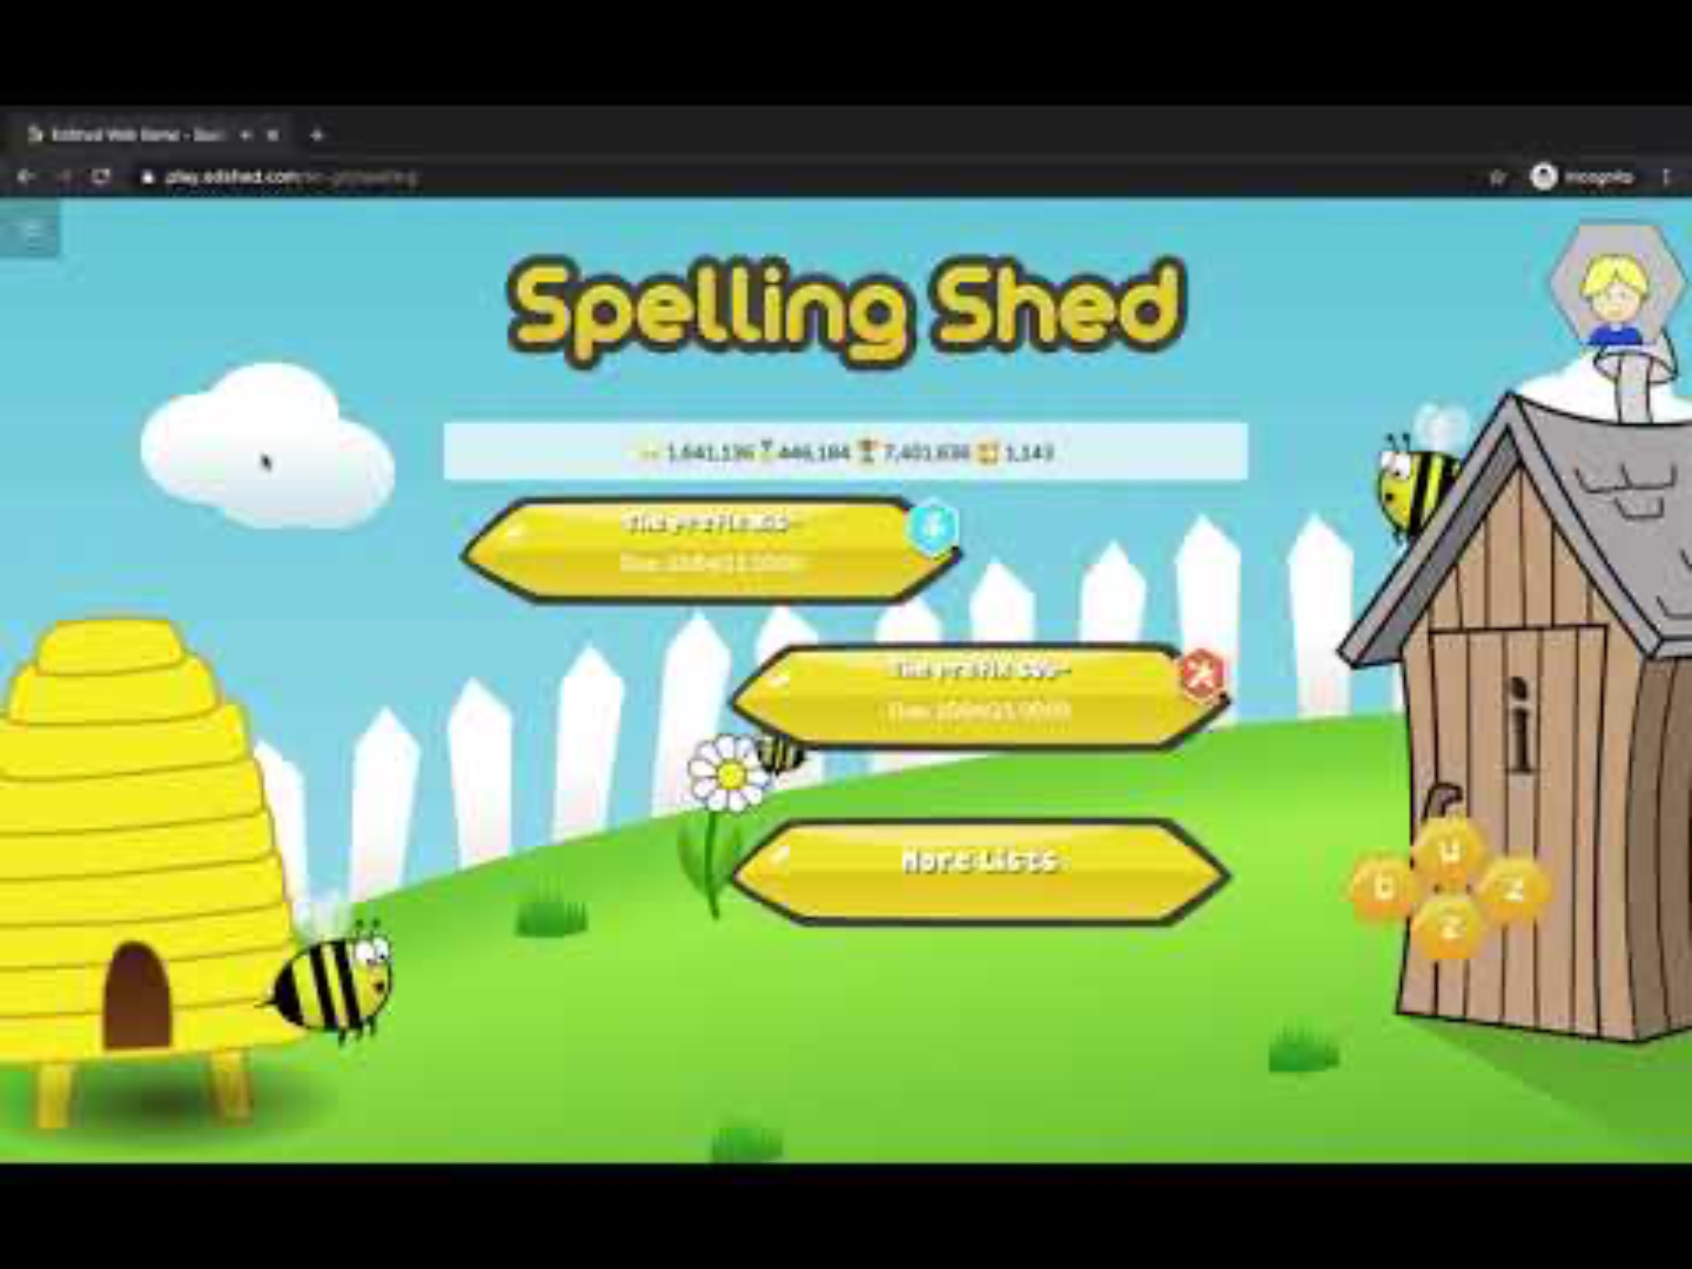
Spelling
How do we access Spelling Shed?

Slide 16
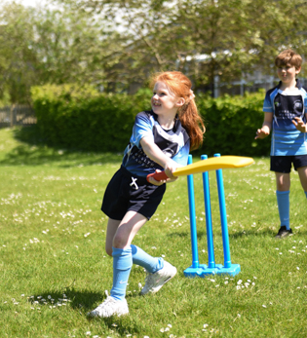
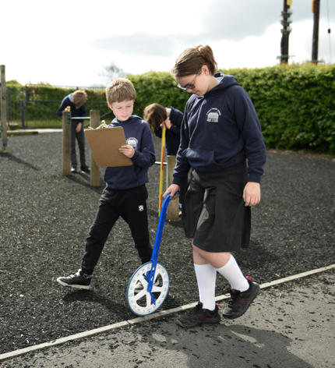
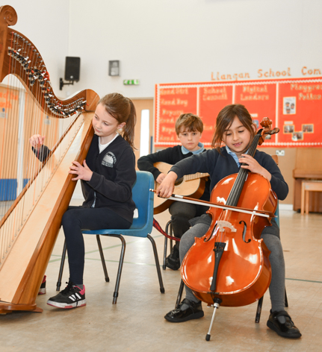
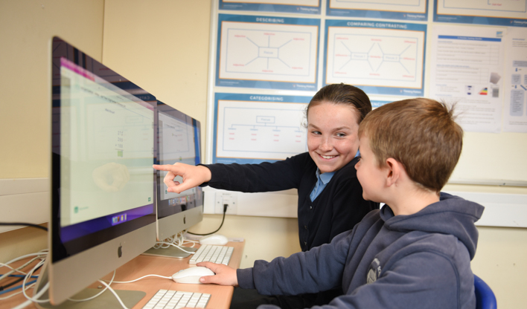
Any Questions?

