Slide 1
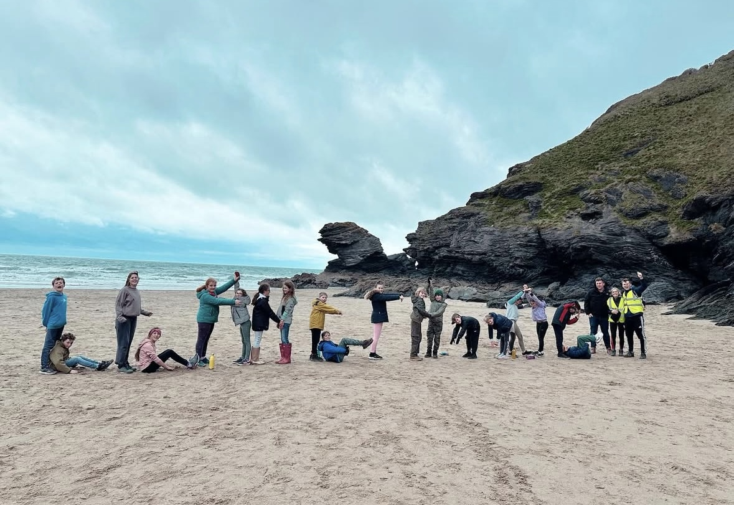
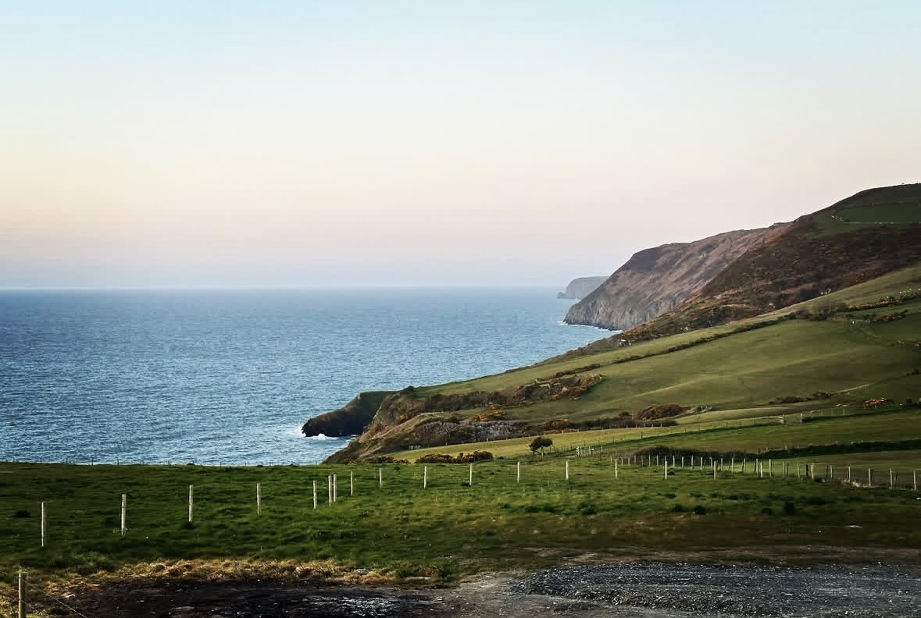

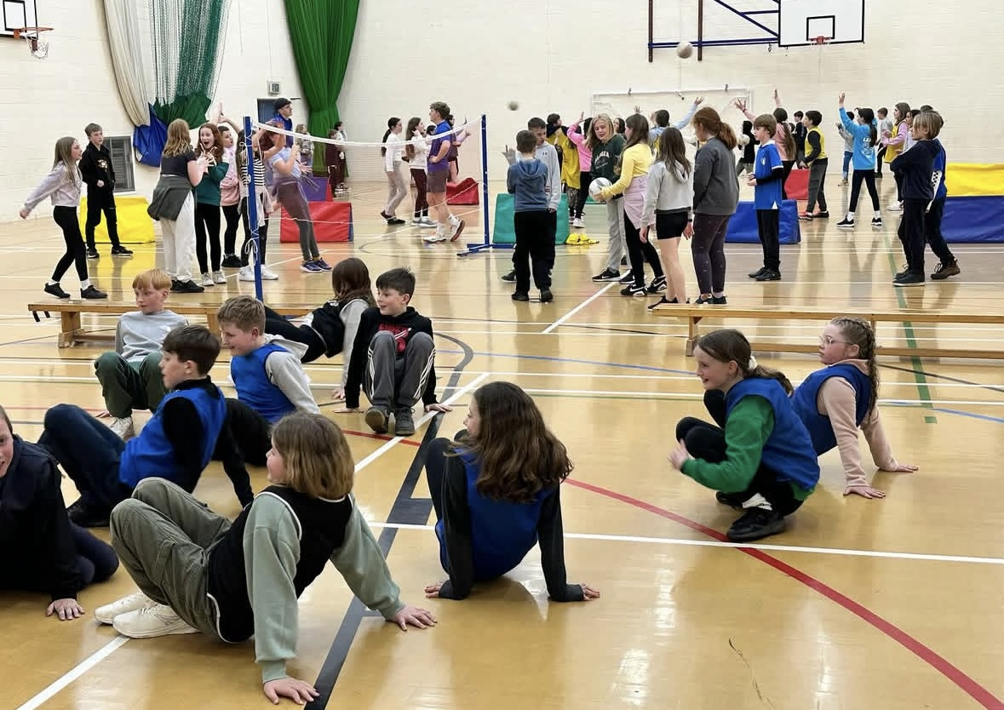
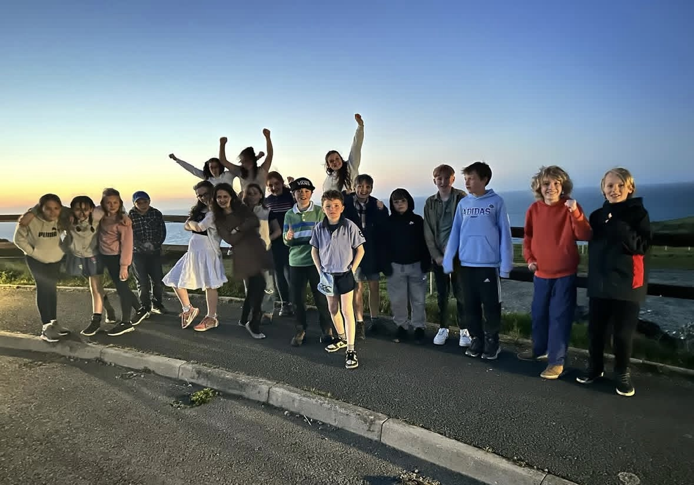
Llangan School
Year 6 Residential
Llangrannog
Parents Meeting 2025

Slide 2
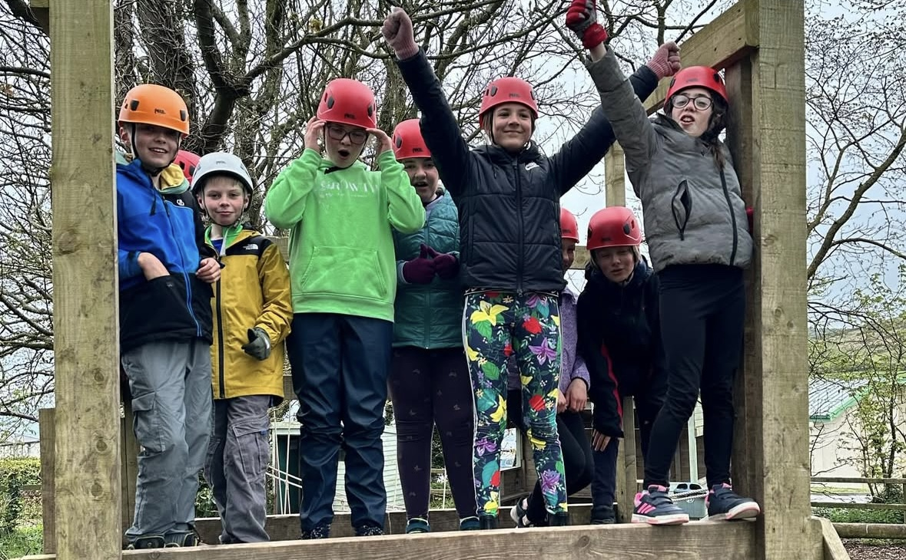
Residential aims
& benefits to you child
Aims of the Residential:
Encourage independence and resilience
Develop teamwork and communication skills
Build confidence through new challenges
Foster a love for outdoor learning and adventure
Create lasting memories with friends
Benefits for the Children:
Experience a range of exciting outdoor activities
Strengthen friendships and social skills
Learn problem-solving and leadership in real-life settings
Step out of their comfort zone in a safe, supportive environment
Have fun while developing key life skills
Notes:
When conducting research, it is easy to go to one source: Wikipedia. However, you need to include a variety of sources in your research. Consider the following sources:
Who can I interview to get more information on the topic?
Is the topic current and will it be relevant to my audience?
What articles, blogs, and magazines may have something related to my topic?
Is there a YouTube video on the topic? If so, what is it about?
What images can I find related to the topic?

Slide 3
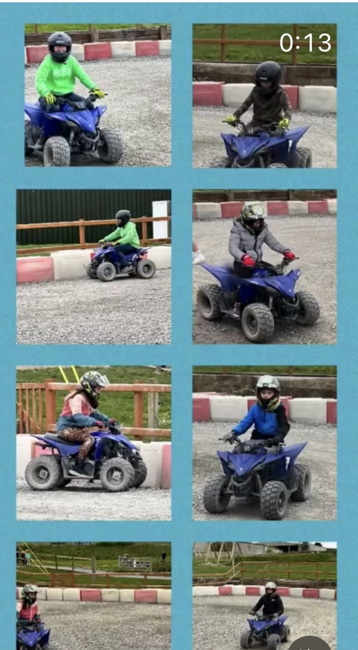
Llangrannog is an excellent opportunity for the children in Year 6 to meet with other children in their year group from other Cowbridge Comprehensive feeder schools.
The residential visit gives the children the opportunity to build friendship groups between the schools, and ease some of the apprehensions they may have about starting high school.
Notes:
.
The pre-reading stage
The first stage of development is the pre-reading stage. The responsibility of the teacher is to encourage reading interest with enjoyable experiences and activities, with an emphasis on oral expression. The principal goal at this stage is to ensure that the learner is socially, mentally, emotionally and physically ready to learn to read. Spatial development is important at this stage. The pupil is taught to recognize spaces between words and the descending order of the lines in a text. He or she learns to read from left to right. Oral expression is the focus of instruction, and the development of sight vocabulary which is taught using sentences, signs, labels, etc. Simple ideas are expressed and organized in order to create sentences. The formation of words, starting with consonants, and the recognition of rhymes by word endings, are all taught.
Beginning reading
At this stage of development, the learner must acquire an ability to recognize the letters of the alphabet, but not to memorize them. This is accomplished through a phonic approach, learning the sounds of the letters not just the names of them. A card with a picture of an ant on it and the letter ‘a’ helps to give meaning to the sound ‘a’. A child must have a natural ease with the alphabet in order to learn letter sounds and word spellings comfortably, and exercises that are fun as well as instructive can facilitate learning it. In Llangan we use Ben and betty phonics in nursery and follow the ‘’RWI’ through Foundation Phase into lower KS2. Pupils are placed into the phonics group appropriate for their stage.
Developing reading fluency
The third stage of reading development is reading fluency. At this stage of development, the pupil is prepared to identify words that he or she cannot pronounce and find the pronunciation independently, read simple stories and feel comfortable learning new concepts. Pupils begin to use context clues, using information in the story to guess the meaning of certain unknown words or ideas. In Llangan we use the 8 reading behaviour approach to develop fluency:
Activate prior Knowledge
Visualise
Question
Self-monitor
Analyse and connect
Analyse and infer
Analyse and evaluate
Analyse and summarise
Materials need to be very diverse. Thee pupil is better able to make use of various texts, such as travel brochures, pictures, stamps from countries around the world and washing directions on clothes labels. It is very important, therefore, to make sure that the materials challenge the pupils and are relevant to the lessons, and that they continue to reflect the images and the interests of the children.

Slide 4

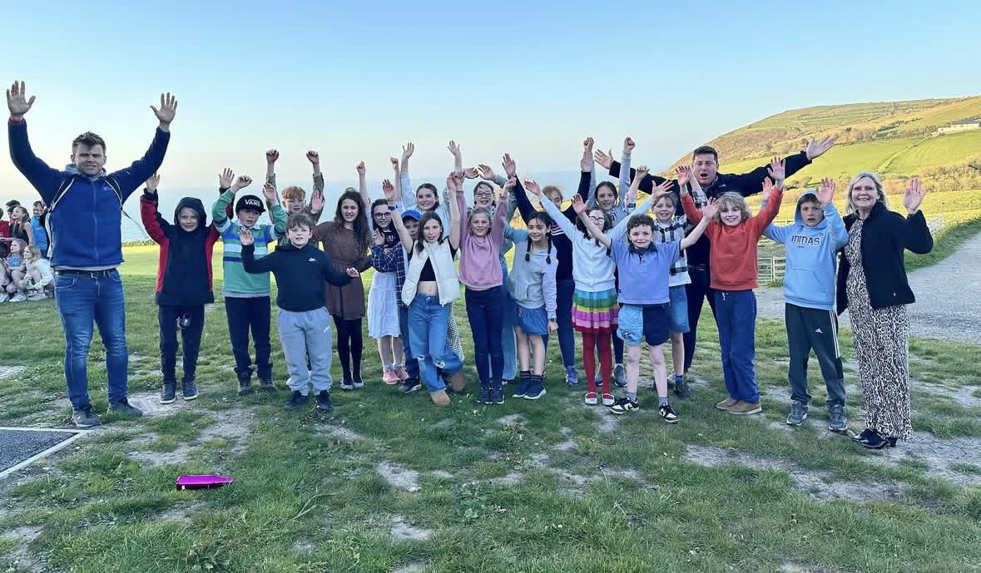
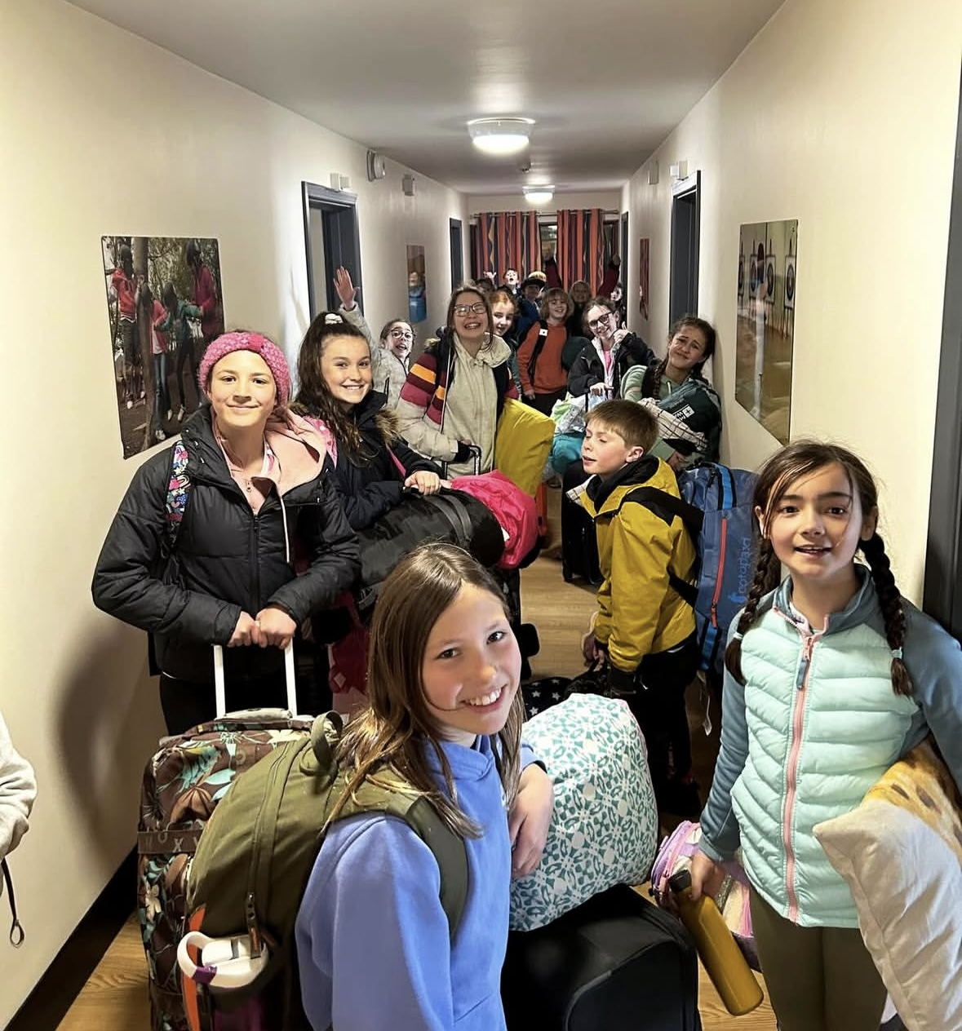
Y6
Residential
Travel Arrangements
The coach will depart from Llangan Primary School Monday 24th March 2025 at 8:30 am PROMPTLY.
Please be in school at 8:15am at the latest.
The coach will return to Llangan
Primary School at roughly 4:00 pm on Wednesday 26th April 2025. We will keep you updated on Instagram

Slide 5
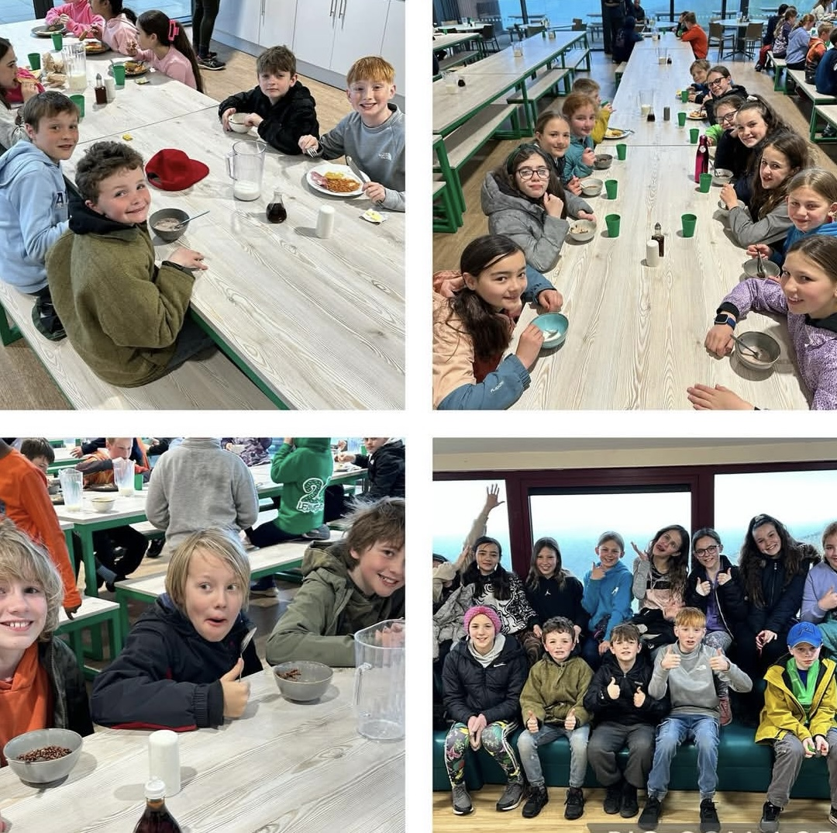
Food and Sleeping Arrangements
Meals & Dietary Requirements
Four daily meals: breakfast, dinner, tea, and supper, with healthy options for all.
Food Hygiene Rating: 5 (Food Standards Agency).
Special dietary needs (e.g., allergies, gluten-free, diabetic) are catered for—please inform us at least a week in advance and ensure this is noted on the Health Certificate.
Vegetarian meals are always available.
Cold drinks are free; hot drinks can be purchased outside mealtimes.
Children have already chosen their meals.
Accommodation & Safety
Separate secure rooms for Llangan boys and girls, with access restricted to them and staff.
Staff rooms are nearby, and children can access support overnight.
Llangrannog is a secure, monitored site, ensuring children’s safety at all times.

Slide 6
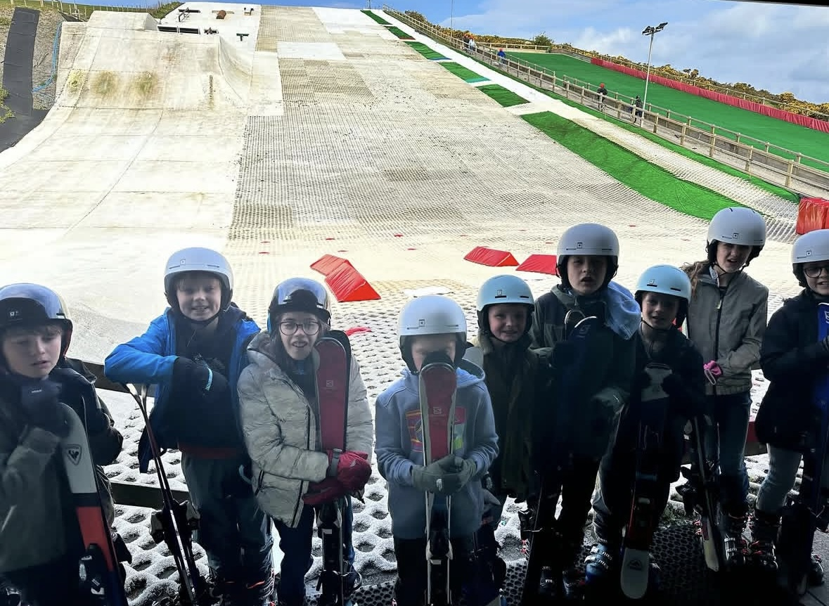
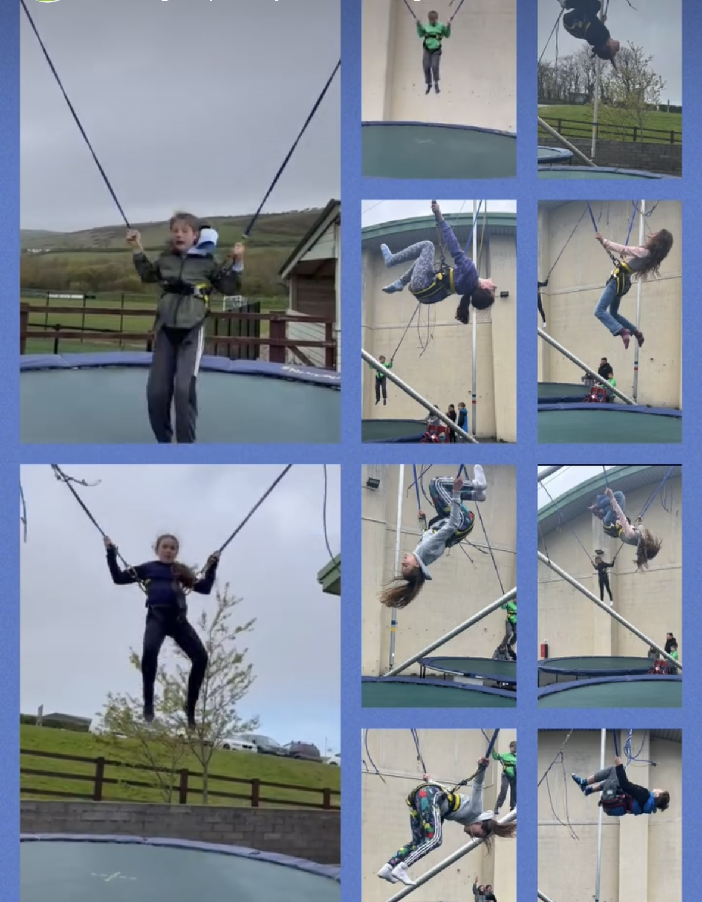
Activities
A full programme is provided in line with the course leaders requests, with a range of activities –
skiing
tobogganing
go-carting
archery
high ropes course
beach walk
climbing wall
challenging team games
low ropes course
nature walk
quad biking
zip run
swimming
environmental garden
trampoline
horse riding
problem solving
shelter building
orienteering
All of the above activities are staffed by qualified centre staff.
There is also a multi-purpose sports hall, outdoor playing fields, and an all weather playing area

Slide 7
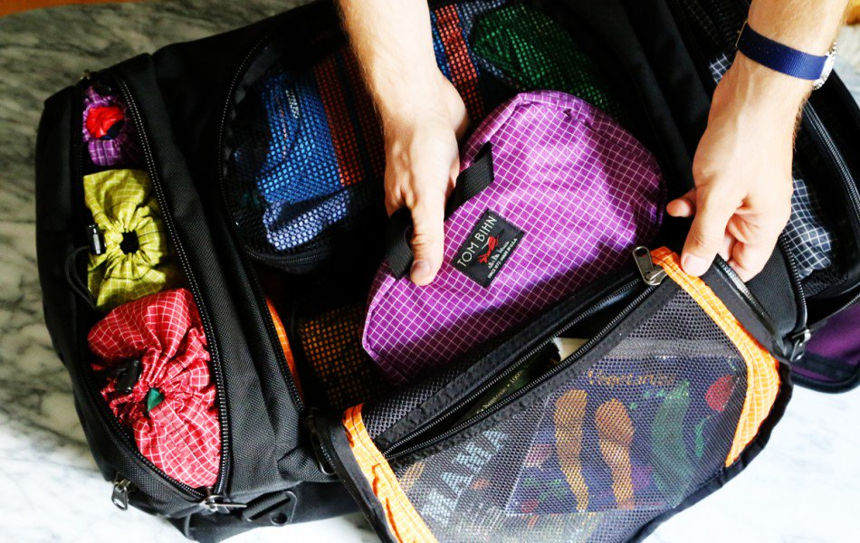
Packing
Sleeping bag
2x towels
Approx. 5 sets of clothes (not best!)
Warm jumper/hoodie
Waterproof coat and warm coat
Swimming costume/trunks
2 x plastic bags
Trainers for walking
Old pair of trainers or wellies for muddy activities and horse riding
Gloves, hat and scarf
Toiletries – toothbrush, toothpaste, shower gel, shampoo, hairbrush and suncream
Rucksack for coach journeys
Refillable water bottle
Book
Teddy (optional)
Wallet/purse £10
Pack with your child
Must be able to carry bag.
Bin Liner for muddy/wet things
NAME on everything.

Slide 8
What Not To Bring
Please don’t allow your child to bring:
any electrical equipment
no phones
no digital cameras
nop tablets/computers
no hair dryers
chewing gum
energy drinks
THEY CAN BRING A DISPOSABLE CAMERA- WE WILL TAKE LOTS OF PHOTOS

Slide 9
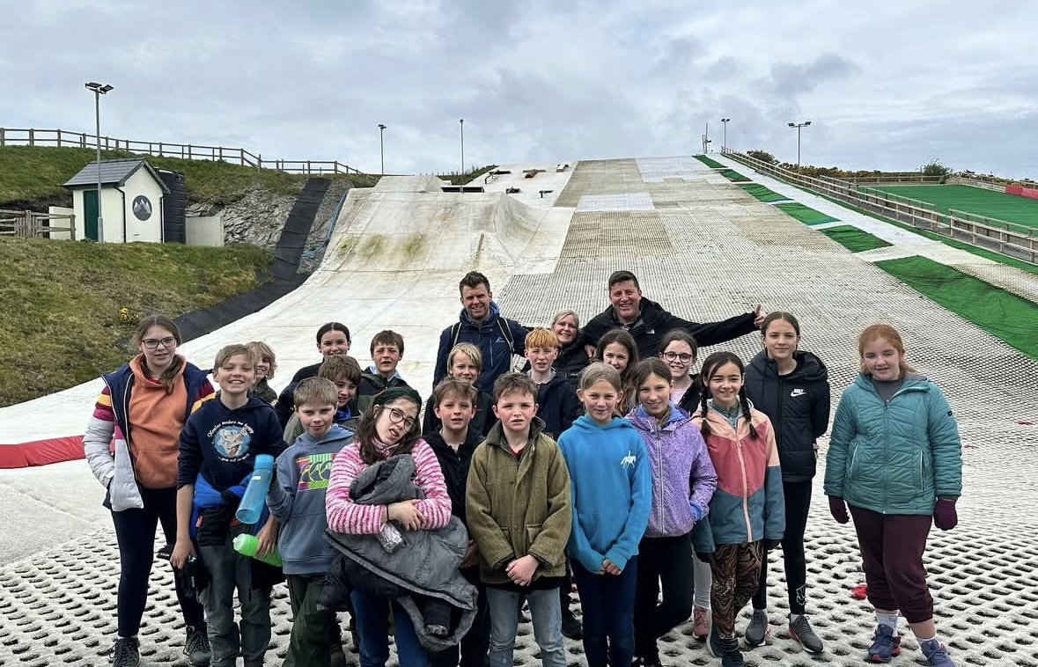
Insurance & Health and Safety
Staff at Llangan have arranged the course in conjunction with the Centre’s management and specialist activity staff.
In addition to the Centre staff, teachers accompany parties from schools. The children are closely supervised on all activities, and all equipment is regularly inspected to ensure that it is safe and suitable for use.
Arrangements at the Centre have been developed over 80 years to provide a safe and caring environment for children at the Centre, and on activities. Staff operate activities to the highest safety standards.
The centre has a Risk Assessment and strict staff guidelines for every aspect of the Centre’s work as well as for any problems that might arise. Staff ensure that children know what to do in an emergency, in case of accidents or illnesses and all centre staff are first aid trained.
There is someone available at all times, day and night. There is a night porter on duty throughout the night. There are also CCTV cameras strategically placed around the Centre. The accommodation blocks and main gate are locked during the night.

Slide 10
Contact
Llangrannog:
01239 652140
llangrannog@urdd.org
Email:
LlanganPS@valeofglamorgan.gov.uk
Instagram and Twitter
If there are any problems at all, Mrs Heavyside will call you.

Slide 11
Any Questions?
Medical Forms!
Any medication at all needs to be logged to be on a form in order for us to administer any medications.
Notes:
You can use this slide as your opening or closing slide. Should you choose to use it as a closing, make sure you review the main points of your presentation. One creative way to do that is by adding animations to the various graphics on a slide. This slide has 4 different graphics, and, when you view the slideshow, you will see that you can click to reveal the next graphic. Similarly, as you review the main topics in your presentation, you may want each point to show up when you are addressing that topic.
Add animation to images and graphics:
Select your image or graphic.
Click on the Animations tab.
Choose from the options. The animation for this slide is “Split”. The drop-down menu in the Animation section gives even more animations you can use.
If you have multiple graphics or images, you will see a number appear next to it that notes the order of the animations.
Note: You will want to choose the animations carefully. You do not want to make your audience dizzy from your presentation.

