Slide 1
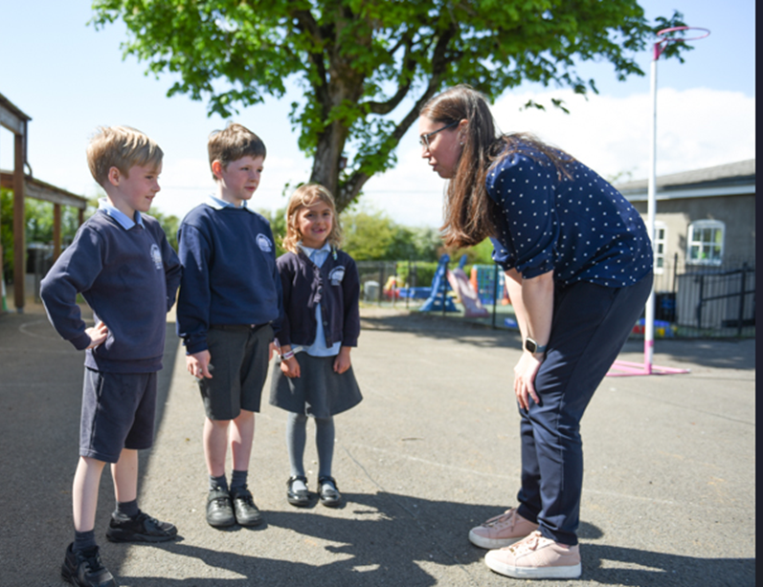
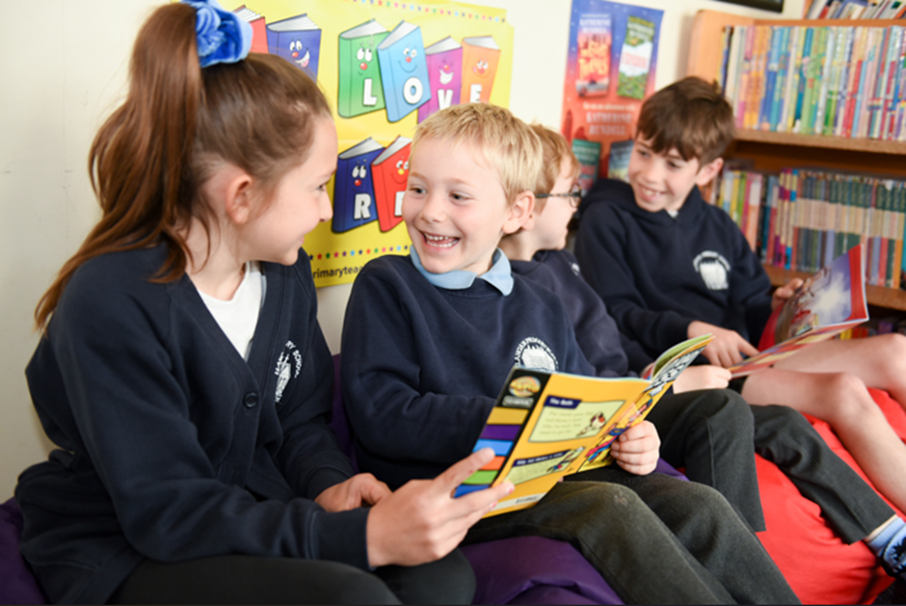
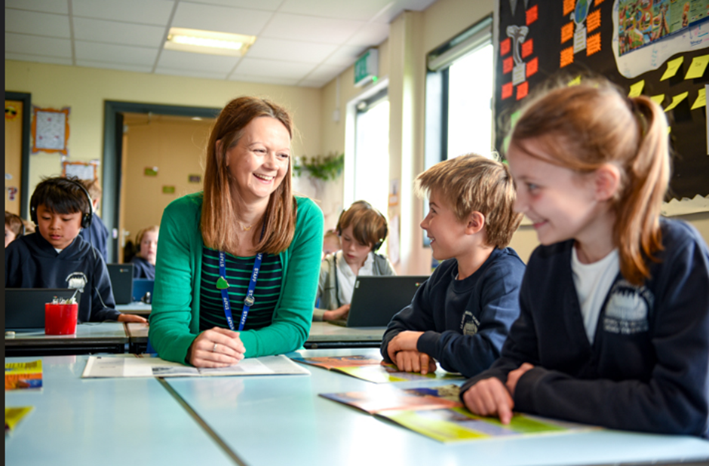
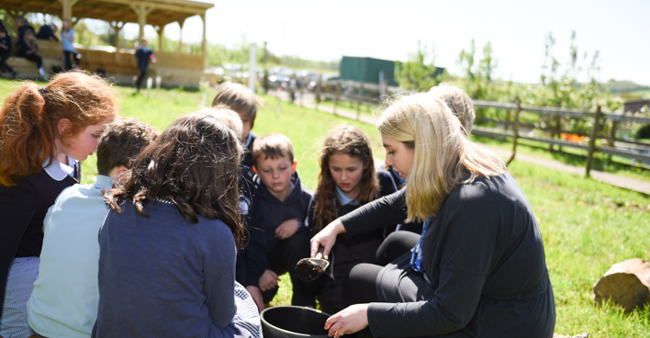
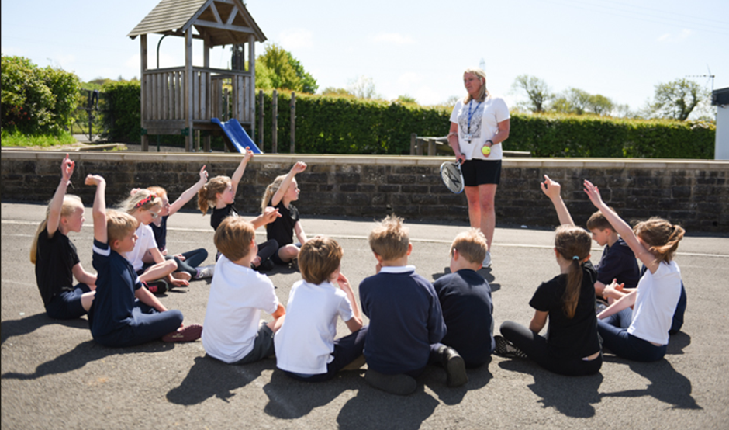

Helping at Home
Llangan Primary School
Parent Workshop

Slide 2
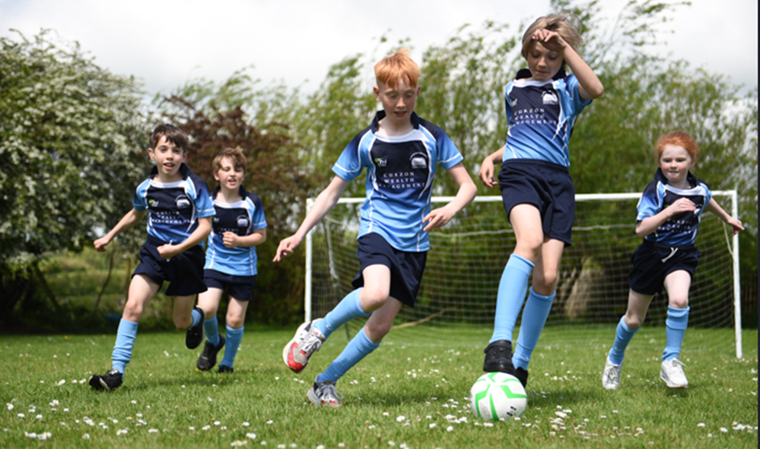
Helping at Home
Homework
Phonics and Reading | Reading Books
Spelling | Edshed – Spelling Shed
Maths | Mathletics
Learning Log | Learning log book- sent home once a fortnight.
Notes:
When conducting research, it is easy to go to one source: Wikipedia. However, you need to include a variety of sources in your research. Consider the following sources:
Who can I interview to get more information on the topic?
Is the topic current and will it be relevant to my audience?
What articles, blogs, and magazines may have something related to my topic?
Is there a YouTube video on the topic? If so, what is it about?
What images can I find related to the topic?

Slide 3
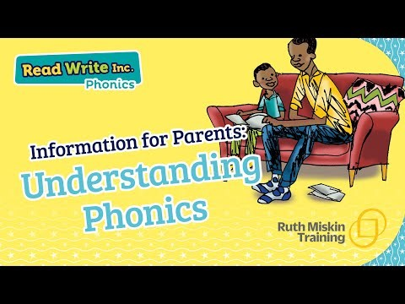
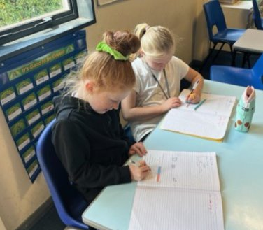

Phonics
https://www.youtube.com/watch?v=bXOJUPNVnLc
Helping at Home
We will be looking at Read, Write Inc during our phonic workshop in Spring Term.

Slide 4
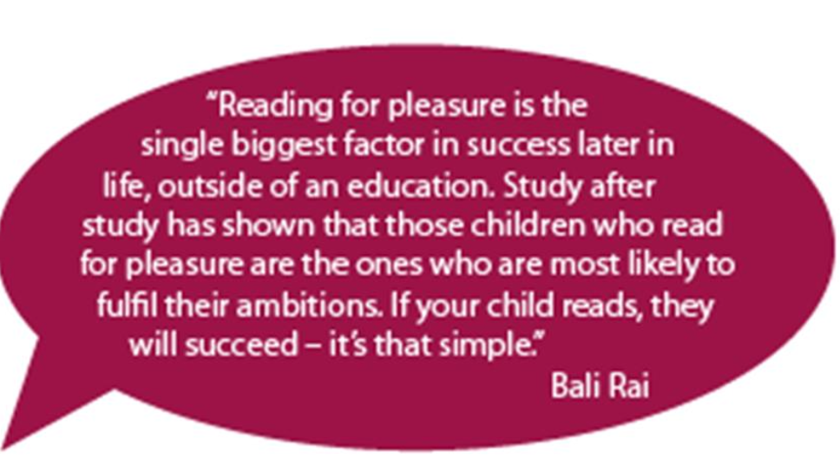
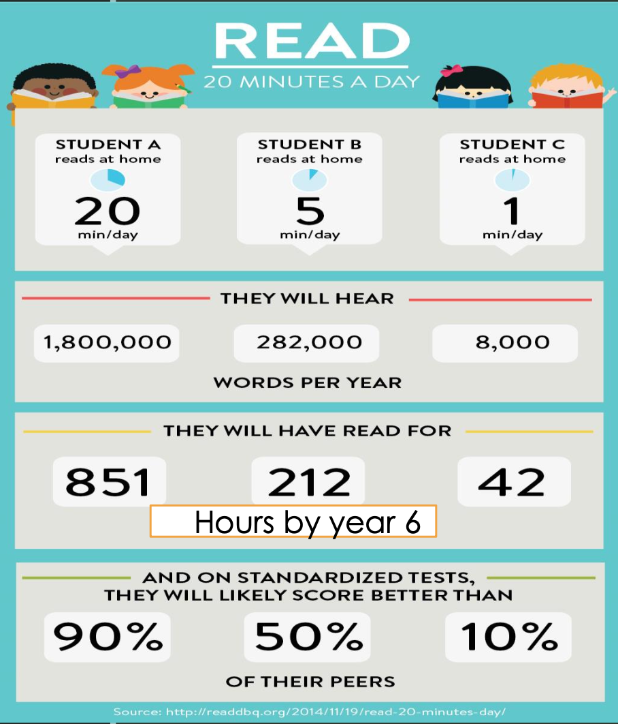
Reading
A child’s initial contact with words and symbols happens before going to school. The first exposure a child has to literacy is at home and in the community. Attitudes and values are directly and indirectly taught, and influence what the child perceives as relevant and important to his or her personal success. As a child grows older and begins to go through different stages of reading development, a number of other factors could also influence success in learning to read. These factors determine the reading readiness: parents and the family environment, the child’s attitudes and values, and teachers
The pre-reading stage
Beginning reading
Developing reading fluency
Activate prior Knowledge
Visualise
Question
Self-monitor
Analyse and connect
Analyse and infer
Analyse and evaluate
Analyse and summarise
Notes:
.
The pre-reading stage
The first stage of development is the pre-reading stage. The responsibility of the teacher is to encourage reading interest with enjoyable experiences and activities, with an emphasis on oral expression. The principal goal at this stage is to ensure that the learner is socially, mentally, emotionally and physically ready to learn to read. Spatial development is important at this stage. The pupil is taught to recognize spaces between words and the descending order of the lines in a text. He or she learns to read from left to right. Oral expression is the focus of instruction, and the development of sight vocabulary which is taught using sentences, signs, labels, etc. Simple ideas are expressed and organized in order to create sentences. The formation of words, starting with consonants, and the recognition of rhymes by word endings, are all taught.
Beginning reading
At this stage of development, the learner must acquire an ability to recognize the letters of the alphabet, but not to memorize them. This is accomplished through a phonic approach, learning the sounds of the letters not just the names of them. A card with a picture of an ant on it and the letter ‘a’ helps to give meaning to the sound ‘a’. A child must have a natural ease with the alphabet in order to learn letter sounds and word spellings comfortably, and exercises that are fun as well as instructive can facilitate learning it. In Llangan we use Ben and betty phonics in nursery and follow the ‘’RWI’ through Foundation Phase into lower KS2. Pupils are placed into the phonics group appropriate for their stage.
Developing reading fluency
The third stage of reading development is reading fluency. At this stage of development, the pupil is prepared to identify words that he or she cannot pronounce and find the pronunciation independently, read simple stories and feel comfortable learning new concepts. Pupils begin to use context clues, using information in the story to guess the meaning of certain unknown words or ideas. In Llangan we use the 8 reading behaviour approach to develop fluency:
Activate prior Knowledge
Visualise
Question
Self-monitor
Analyse and connect
Analyse and infer
Analyse and evaluate
Analyse and summarise
Materials need to be very diverse. Thee pupil is better able to make use of various texts, such as travel brochures, pictures, stamps from countries around the world and washing directions on clothes labels. It is very important, therefore, to make sure that the materials challenge the pupils and are relevant to the lessons, and that they continue to reflect the images and the interests of the children.

Slide 5
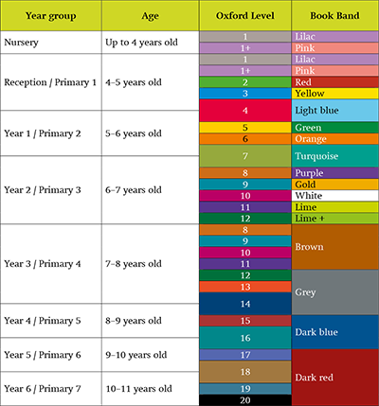

Reading
In Llangan, our home reading books are now all book banded so pupils are bringing home the correct book based on their reading / phonic assessment. Once your child has achieved a reading age above 12 years old, they will start free reading.
Helping at Home

Slide 6

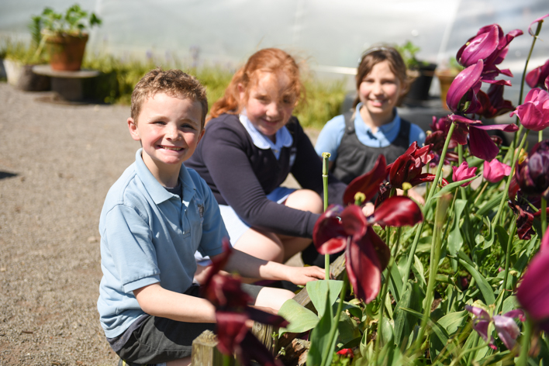
Reading
How to read with your child?
https://www.youtube.com/watch?v=-OG2Q6pPQYw
Helping at Home

Slide 7
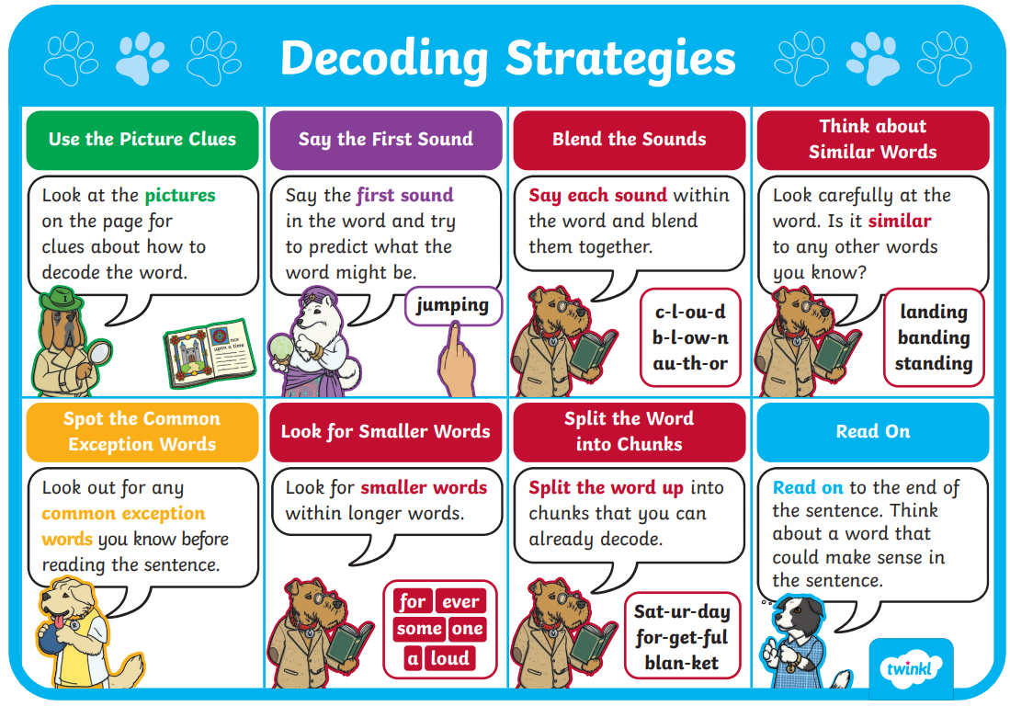
Reading
How to encourage my child?
Child reads the words
If your child faces an unfamiliar sound
Encourage them to sound out each letter by splitting the word into letter sounds (not names) c-a-t
Then Encourage your child to blend sounds together – c-at / ca-t/ cat
Build up sight vocabulary
Helping at Home

Slide 8
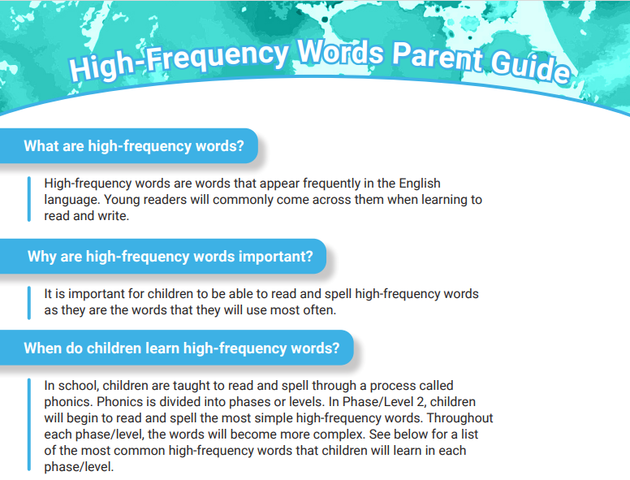
Reading
Helping at Home

Slide 9
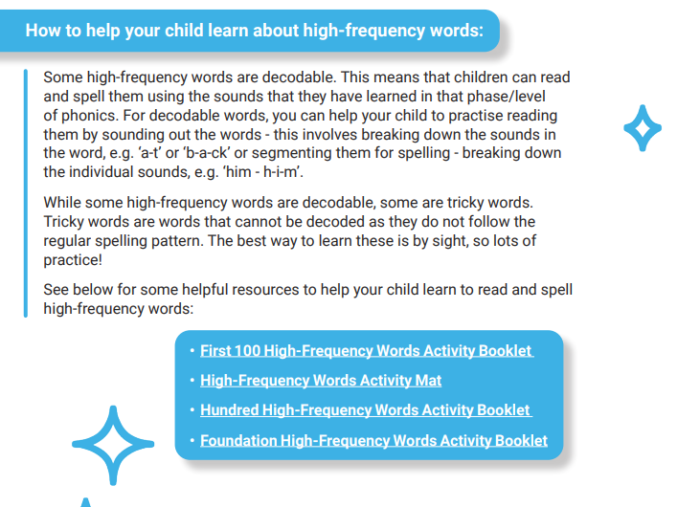

Slide 10
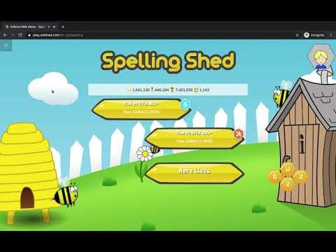


Spelling
Helping at Home
https://www.youtube.com/watch?v=uVHb4srs0RU

Slide 11
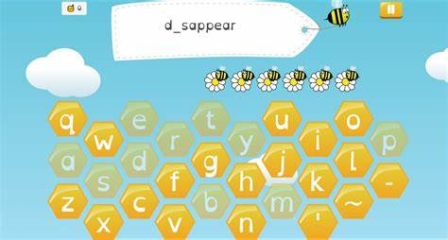
Spelling
In Llangan pupils from Reception to Year 6 are all able to access Spelling Shed.
Pupils are assigned specific spelling assignments each week.
Pupils from Year 2 (when they are ready) to Year 6 all have a weekly spelling test every Monday. These spellings are assigned on Spelling Shed and are also available on their class homework page on the school website.
Helping at Home

Slide 12

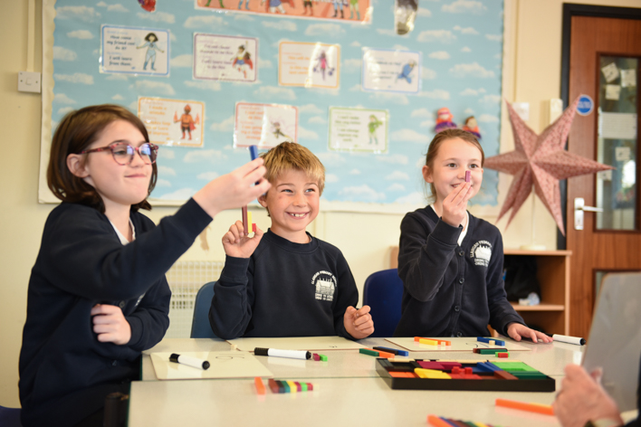
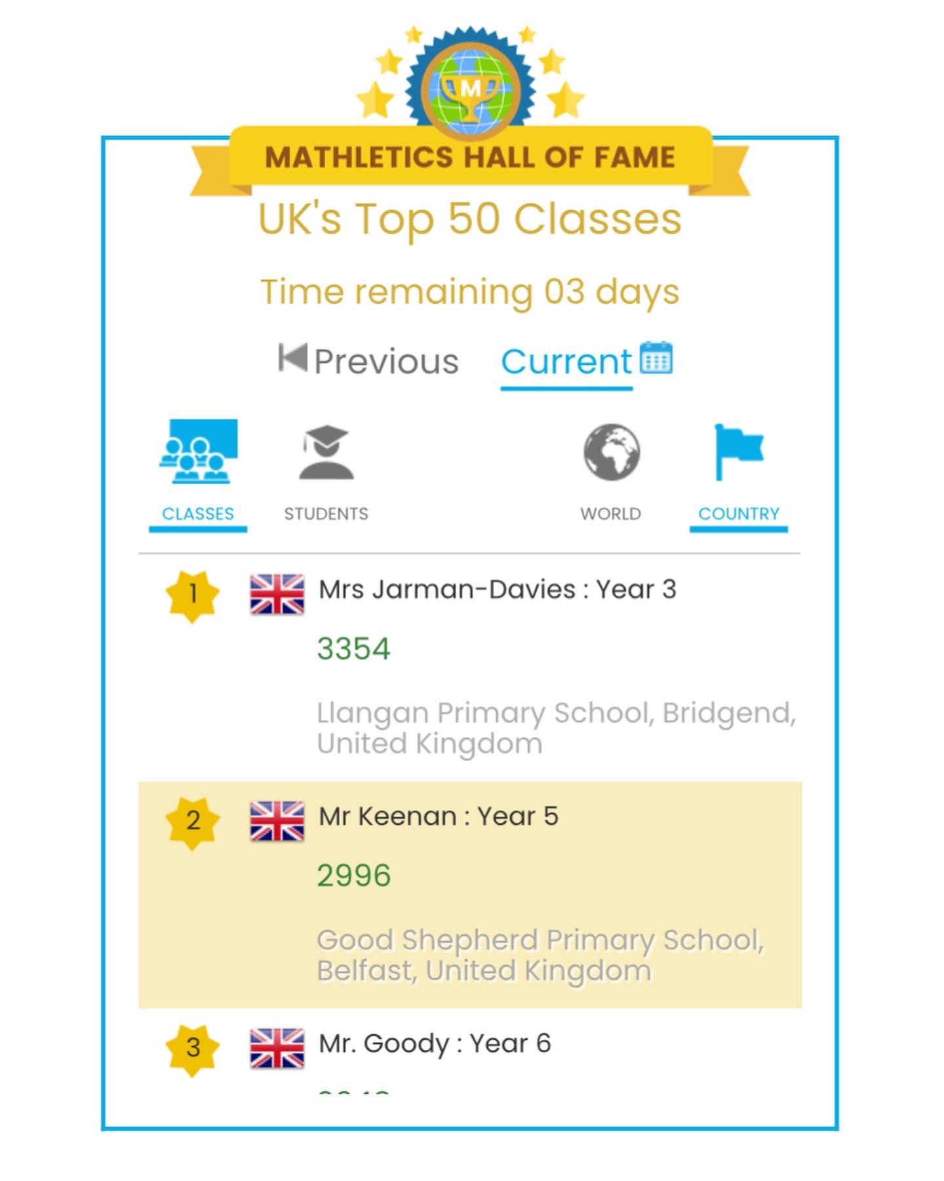
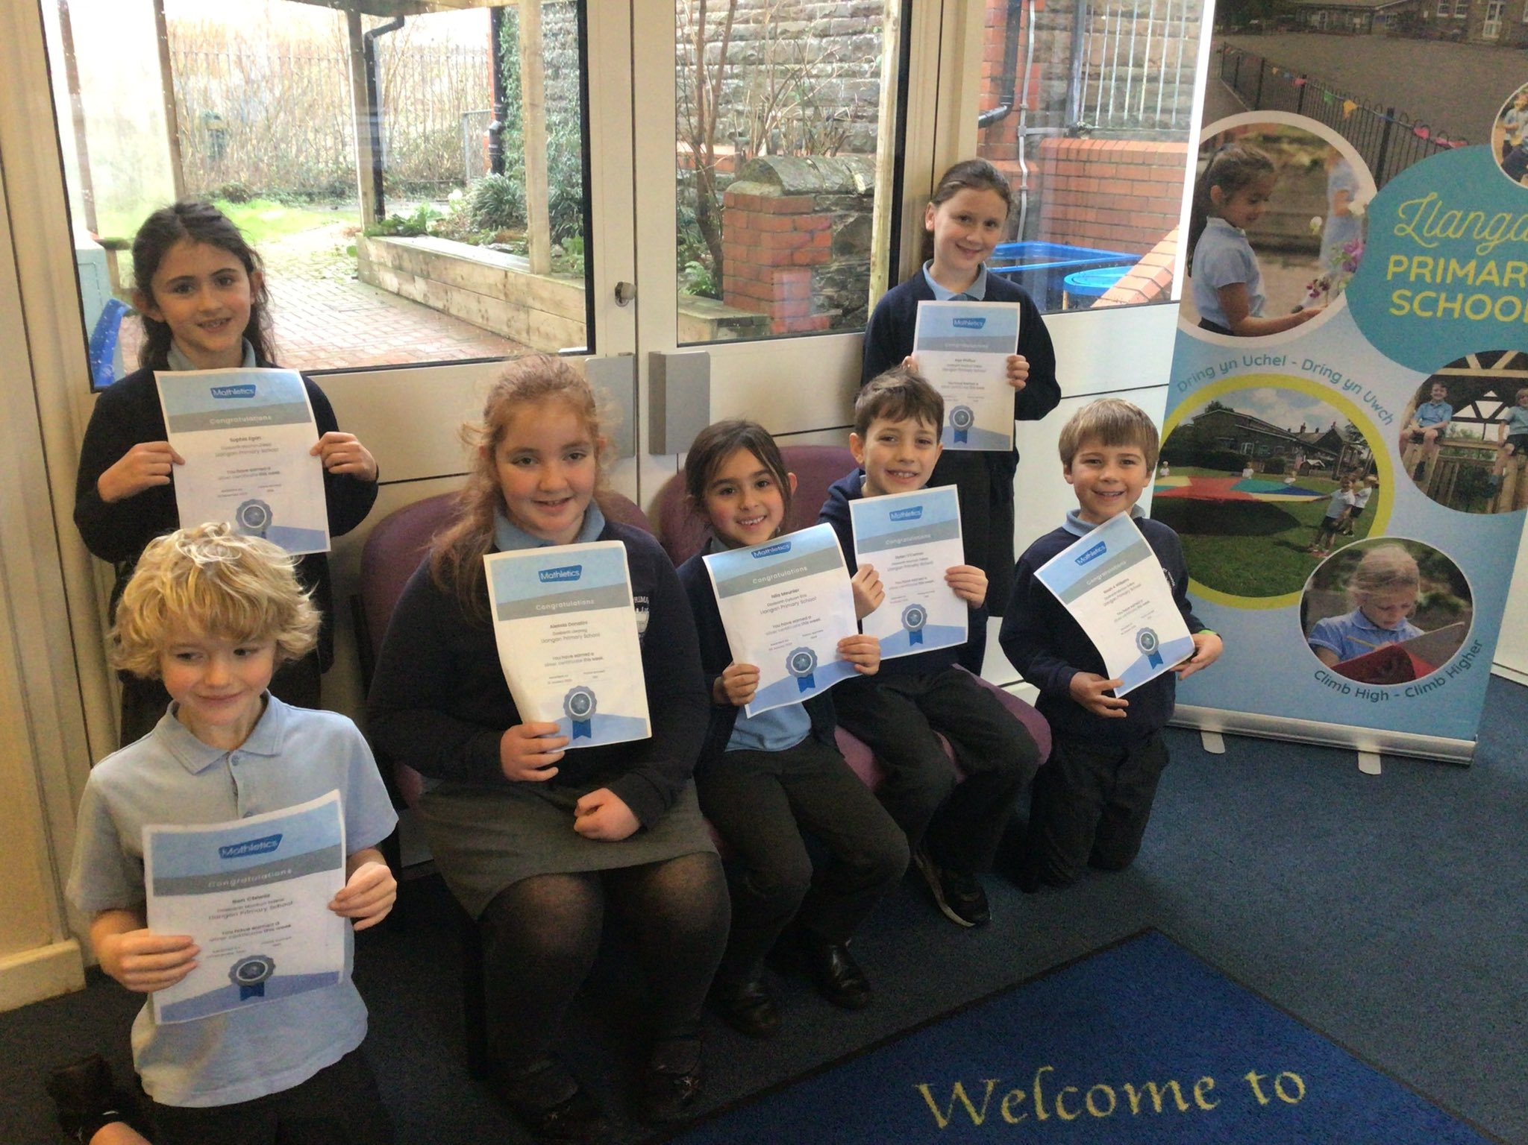

Maths
In Llangan, we teach pupils a range of mathematical skills. Pupils have a maths session every morning.
Practical maths - Practical activities to do and understand before using it to solve problems.
Children use objects and pictures to physically represent mathematical concepts alongside numbers and symbols –for example, using Lego bricks to add and subtract numbers. This helps them visualise abstract ideas, and as they become more proficient, they will gradually stop relying on physical props.
Apply it to other contexts to develop a deeper understanding of numeracy e.g. in knowledge & understanding of the world (science, geography, history)
To support our maths skills in school we encourage pupils to use Mathletics at home.

Slide 13

Maths
https://www.youtube.com/watch?v=tDSts0k24zg

Slide 14
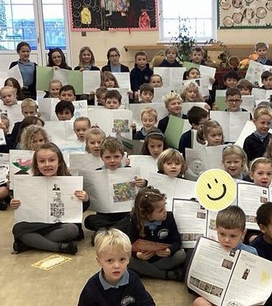
Learning Logs
These are based on a question connected to the time of the academic year.
They are set on a fortnightly basis and encourage pupils to be as independent as possible.
For younger pupils, we encourage pupils to be creative whether this is making a craft or drawing a picture about the learning log question. Only when pupils are ready, we encourage them to have a go at attempting writing – this may be start with just writing single sounds.

Slide 15
Any Extras?
Engage with the news- BBC Newsround.
Access mathletics any time.
Fill your child’s life with rich experiences.
Maths in the world around them- time, timetables, money, weight and measure etc.
Talk to them and spend time with them.
Helping at Home

Slide 16
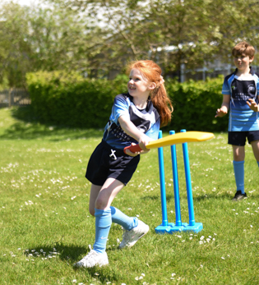
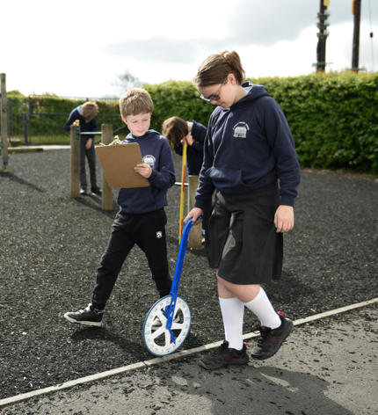
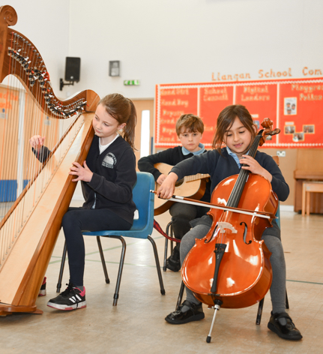
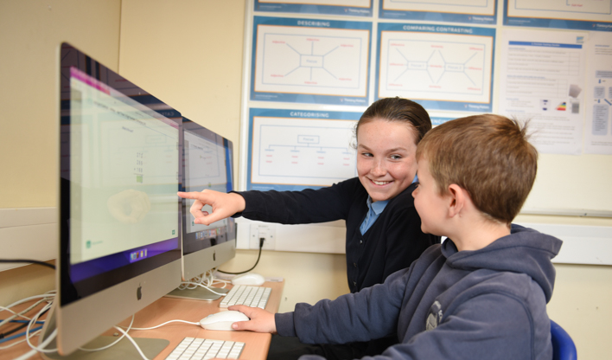
Any Questions?
Notes:
You can use this slide as your opening or closing slide. Should you choose to use it as a closing, make sure you review the main points of your presentation. One creative way to do that is by adding animations to the various graphics on a slide. This slide has 4 different graphics, and, when you view the slideshow, you will see that you can click to reveal the next graphic. Similarly, as you review the main topics in your presentation, you may want each point to show up when you are addressing that topic.
Add animation to images and graphics:
Select your image or graphic.
Click on the Animations tab.
Choose from the options. The animation for this slide is “Split”. The drop-down menu in the Animation section gives even more animations you can use.
If you have multiple graphics or images, you will see a number appear next to it that notes the order of the animations.
Note: You will want to choose the animations carefully. You do not want to make your audience dizzy from your presentation.

