Slide 1
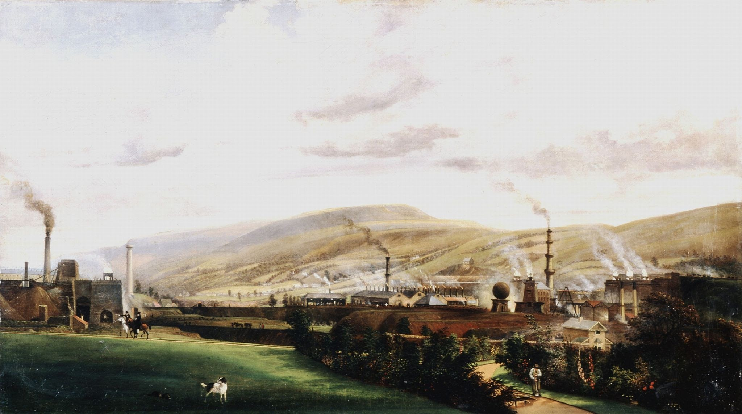
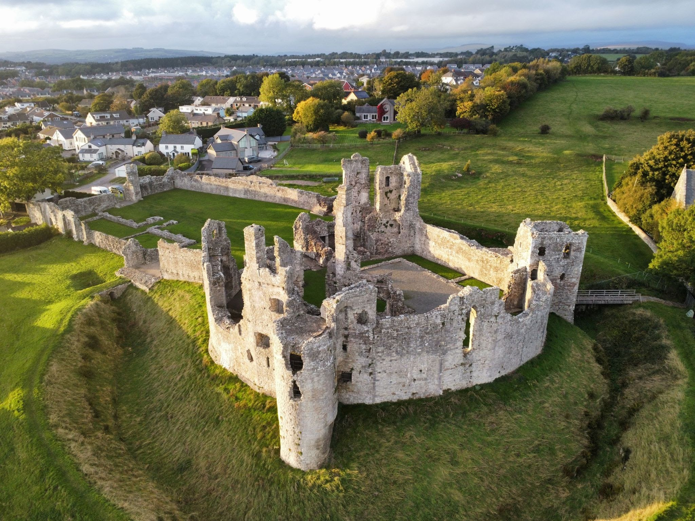
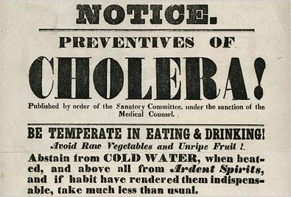
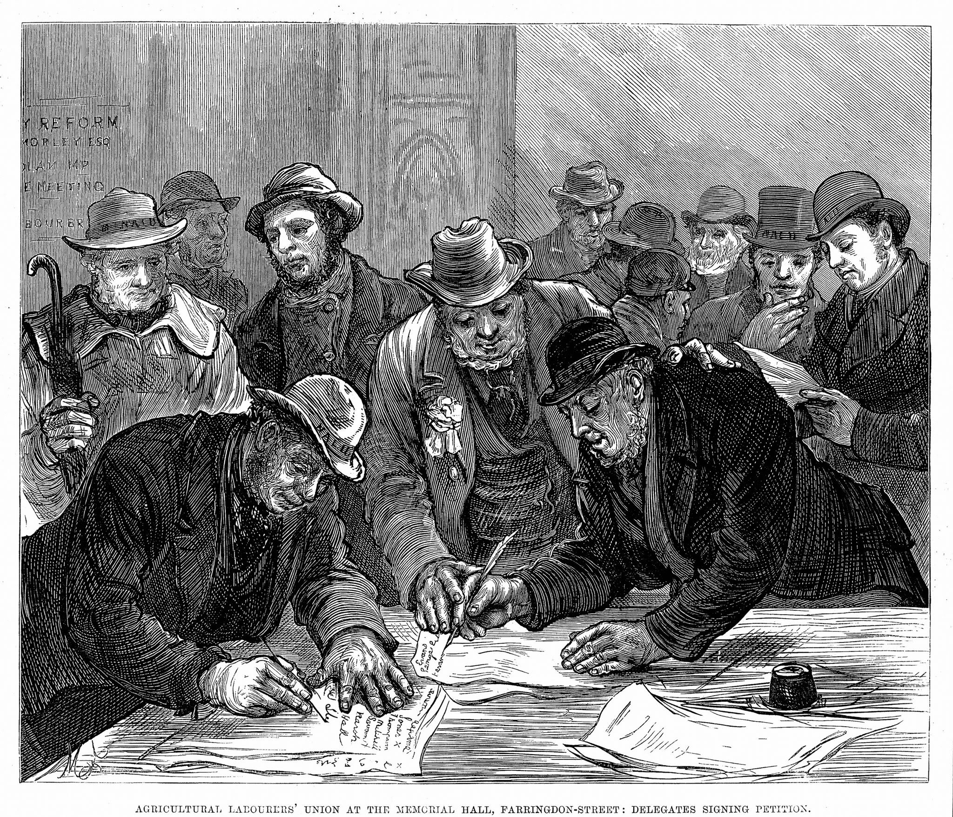

Essential Questions
How did the industrial revolution change communities in Wales?
Year 5 and Year 6 Autumn Term Inquiry – Hum/Sci & Tech
A study in environments and the world around us
Tuning In -
Finding Out -
Sorting Out -
Going Further -
Reflect & Act -
Image here
Image here
Image here
Image here
Image here
Why am I learning this?
Why am I learning this?
Why am I learning this?
Why am I learning this?
Why am I learning this?
Essential Question: What was Wales like before and at the start of the Industrial Revolution?
Why am I learning this? To understand our local history (Cynefin) and compare how quiet rural Welsh villages transformed into bustling, noisy industrial hubs.
Essential Question: How did workers fight for their rights, and what were the broader impacts of industry?
Why am I learning this? To understand power structures, social justice, workers' protests, global trade connections, and environmental impacts
Essential Question: What were the working and living conditions like for families and migrants?
Why am I learning this? To explore how economic need drove migration into South Wales and examine the realities of child labour and Victorian family life.
Essential Question: How do we analyse historical data to understand population growth and public health?
Why am I learning this? To build data-handling, graphing, and critical-thinking skills by analysing real 19th-century primary sources
Essential Question: How has our industrial past shaped modern Welsh identity (Cynefin), and how can we share our learning?
Why am I learning this? To reflect on how historical choices shape present-day Wales and communicate our findings through digital and interactive media.
Sensory Experience: Transitioning from clean, quiet outdoor nature into a dark, noisy classroom filled with industrial factory soundscapes, coal dust props, and crowded seating.
Historical Discovery: Exploring how Merthyr Tydfil grew from a small farming village before 1750 into an iron-making town.
Literacy & Art: Writing emotive contrast diary entries ("The day the smog came") and creating monochrome charcoal drawings of colliery landscapes and terraced streets
My experience as a learner
My experience as a learner
My experience as a learner
My experience as a learner
My experience as a learner
Field Trip & Virtual Workshop: Visiting Cyfarthfa Castle to investigate the contrast between wealthy Ironmasters and working families, alongside a BBC Bitesize primary source investigation.
Stories & Perspectives: Reading stories of local figures like Martha and Cian (a 17-year-old Irish migrant) to learn about migration to Wales.
Jobs Card Game: Investigating 19th-century jobs—including tip girls, furnace boys, puddlers, and air-door boys—and assessing their wages and hazards.
Maths & Numeracy: Plotting population line graphs using census data from 1801–1901 and comparing disease death rates between poor and wealthy areas.
Health & Sanitation Study: Examining 1849 cholera posters, outdoor privies, contaminated street pumps, and "one-up, one-down" housing.
Creative Writing: Drafting a formal letter of complaint to an Ironmaster.
Protests & Rights: Studying the Merthyr Riots (1831), Dic Penderyn, and the rise of trade unions and working-class rights.
Inventions & Global Impact: Learning about innovations like Adrian Stephens' steam whistle (1833) at Dowlais Ironworks and how Welsh iron and coal were traded globally.
Environmental Impact: Evaluating the long-term ecological footprint of heavy industry on Welsh landscapes, rivers, and health
Whole School Museum Showcase: Working collaboratively to build a curated 3D Minecraft town depicting a Welsh valley town pre- and post-industry.
Digital Media & Audio: Creating interactive QR codes linked to student-recorded audio monologues, in-character dialogues, and digital mini-documentaries.
Reflection: Debating whether the long-term benefits of the Industrial Revolution outweighed its immediate hardships and presenting ideas on building a greener future for Wales.

