Slide 1


Welcome to Nursery -
Dosbarth Gwenynen
www.llanganschool.co.uk llangan_primary_school

Slide 2
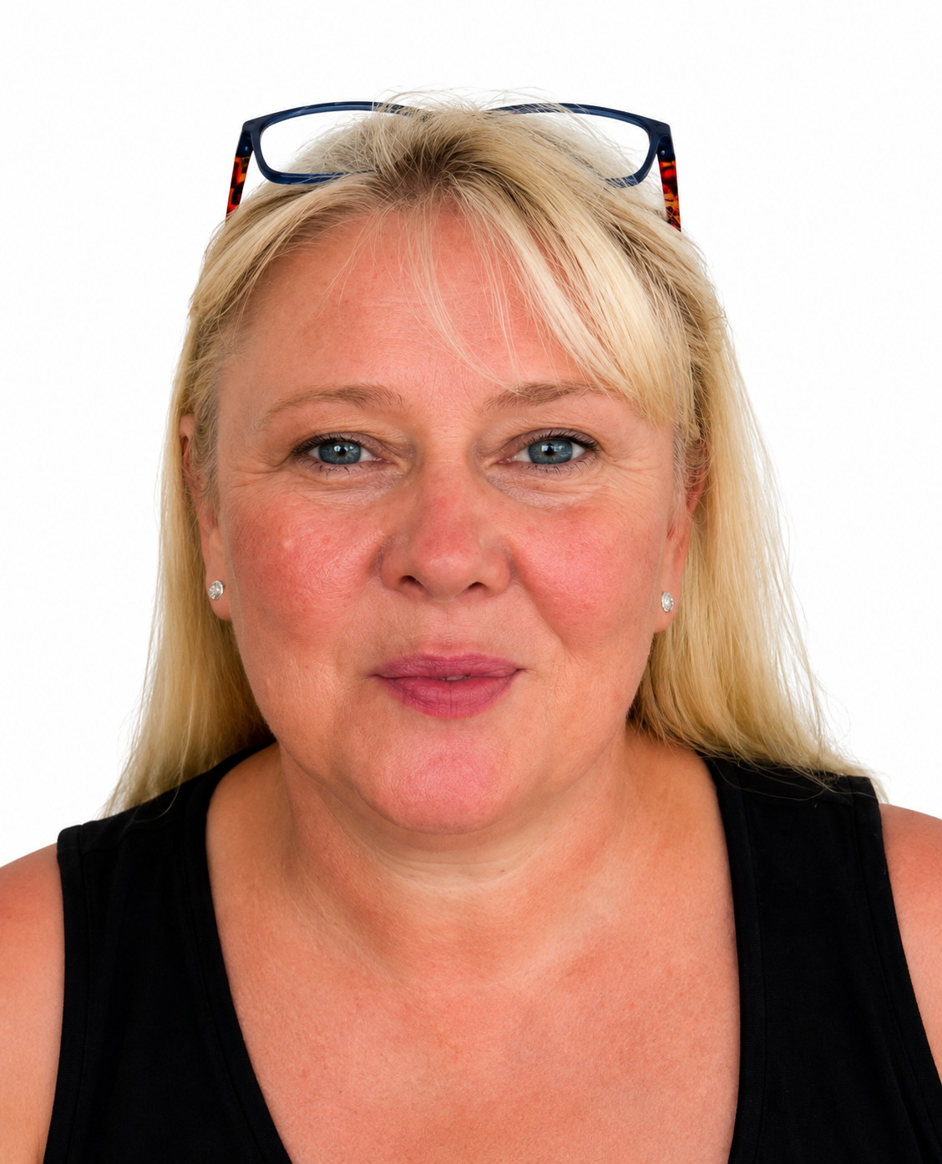
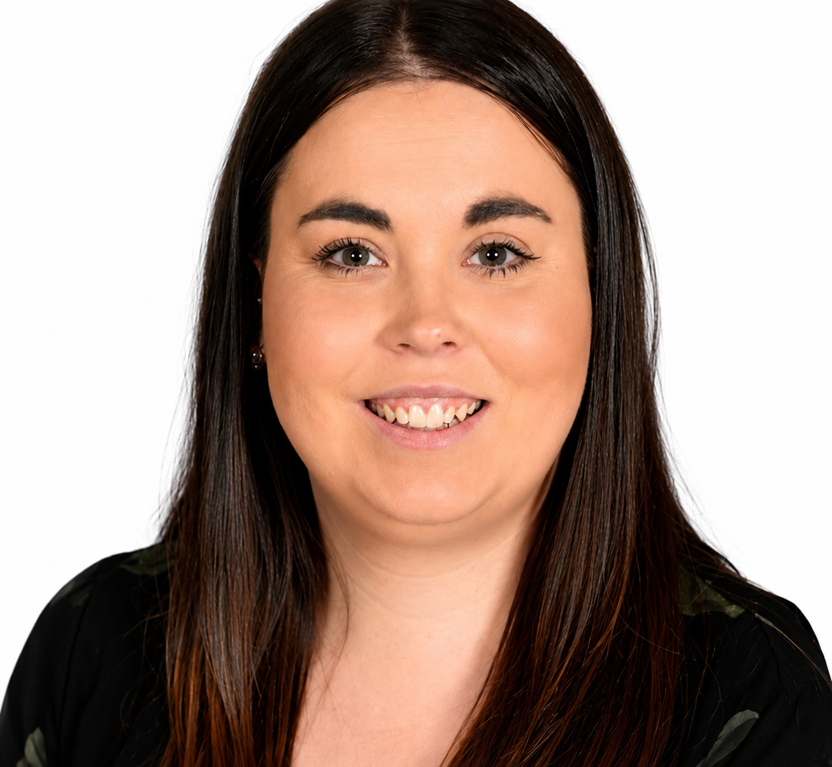
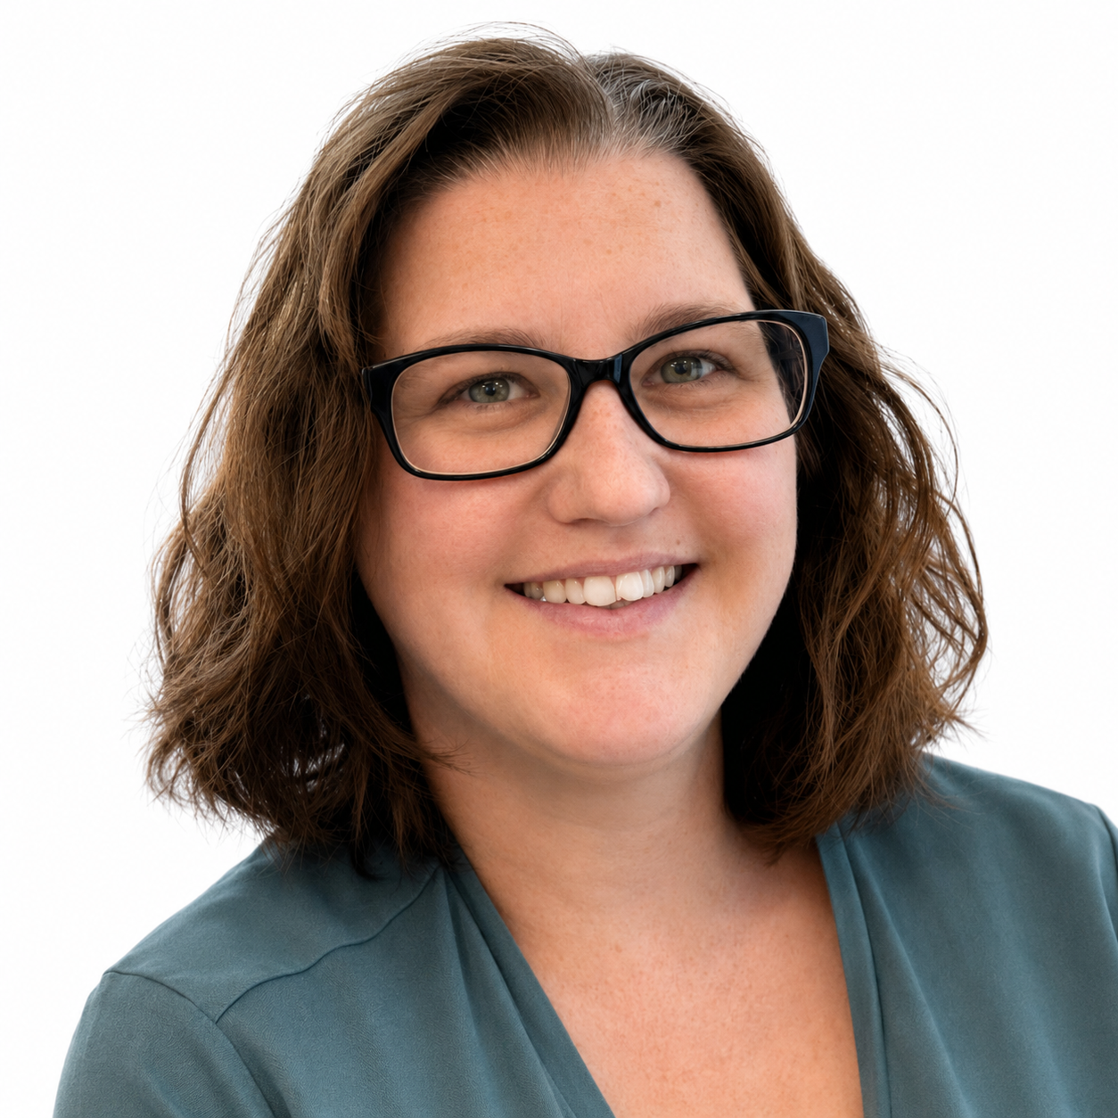
Meet the staff
Mrs C Stevens
Nursery Lead
Miss L Davies
Class LSA &
Wraparound Lead
Mrs R Hill
Class LSA

Slide 3
What will my child need for Nursery?
Your child will need..
Wellies for our outdoor learning sessions and Welly Wednesday (Please bring these into school as soon as you can, all clearly labelled which will be kept in school until the end of the school year or until we feel like they have outgrown them)
Children are asked to come into school on FRIDAYS wearing their PE kit.
A bag MUST be brought to school each day. Please ensure your child has at least 1 lot of spare of clothes and a spare bag to put wet clothes in. Their bag will also be used for storing letters and art and craft coming home from school.
A water bottle everyday clearly labelled.
A fruit or vegetable snack only everyday clearly labelled. (NO NUTS)

Slide 4
Structure of the day
Breakfast Club
8:00am – 8:25am: £3.00 per session
8:25am – 8:45am: Free Breakfast Club session
Pupils must be registered to use our breakfast club provision. Please contact the office if you require registration forms.
Nursery - AM
Gates open at 08:45am and close at 08:55/9.00am. You can come to the top or bottom gate.
Lessons begin at 09:00am and we start our mornings with completing our cool challenges and focus led activities.
Snack time is at 10:40am – 11.00am
Daily RWI session with children who are ready.
Hometime is at 11:30am if your child is not attending Llangan wraparound/childcare provision. Pupils attending Llangan Childcare provision will remain in the cwtch with a member of staff while the children not attending are being dismissed.

Slide 5
Nursery Weekly Timetable
Pupils access outdoor learning everyday.
Please ensure they have appropriate footwear/clothing available to go outside.
Monday | Tuesday | Wednesday | Thursday | Friday
Cool Challenges Indoors and Outdoors | Cool Challenges Indoors and Outdoors | Welly Wednesday | Cool Challenges Indoors and Outdoors | PE
Welsh | Inquiry Focus Led Activity | Cool Challenges Indoors and Outdoors | Inquiry Focus Led Activity | Health and Wellbeing
Y6 Weekly Timetable

Slide 6
Weekly events for Nursery
Our PE day is on a FRIDAY. As always, please send your child in wearing the appropriate PE kit.
Welly Wednesday is on a WEDNESDAY. Please provide your child with a pair of wellies at the start of the year which we can keep in school for these sessions. Also, please provide your child with an appropriate coat on this day according to the weather.
Each child will have a Home Learning Log Book, however they may record these activities on Seesaw. Please support us in our quest for excellence in presentation by insisting your child completes their learning to the highest standards.
Homework will be issued every two weeks on a FRIDAY. Homework is to be handed in a week and a half later, on a Wednesday, so it can be marked. Homework will be explained to the children and will be explained on the class page on our school website.
Nursery PE day is a Friday.
Please ensure your child has the correct PE kit. Your child may wear their PE kit to school (please make sure they bring a school jumper too). School PE kit consists of navy jogging bottoms/shorts with a white t-shirt.
Homework will be issued every two weeks, on a Friday. Homework is to be handed in a week and a half later, on a Wednesday, so it can be marked. Homework will be explained to the children and will be explained on the class page on our school website. Each child will have a Home Learning Log Book, however they may record these activities on Seesaw. We will also share homework on seesaw.

Slide 7


Water & Snack
To help keep pupils healthy and focused throughout the day, please ensure your child brings:
A water bottle filled with water to stay hydrated. No squash or fruit juice. This will be filled up throughout the day by a member of staff if needed.
A healthy snack if they would like one for snack time (fruit and vegetables only) NO NUTS!
Please label all belongings.

Slide 8
School Lunches
School meals can be purchased through Parent Pay if your child is staying for wraparound.
If your child is attending wraparound and prefers, you can provide them with a packed lunch.
Lunches can be pre ordered via your ParentPay account. If they aren't then a member of staff will choose the hot meal of the day for them.
The menu is set by Big Fresh. As a school, we are unable to change the choices provided each day. If your child does not like anything on the menu, please ensure you provide a packed lunch for your child or you can chose an alternative choice that they will like through Parent Pay.
Wraparound staff will always keep you informed if your child is not enjoying the school meals so an alternative can be considered.
Please label all packed lunches and water bottles

Slide 9
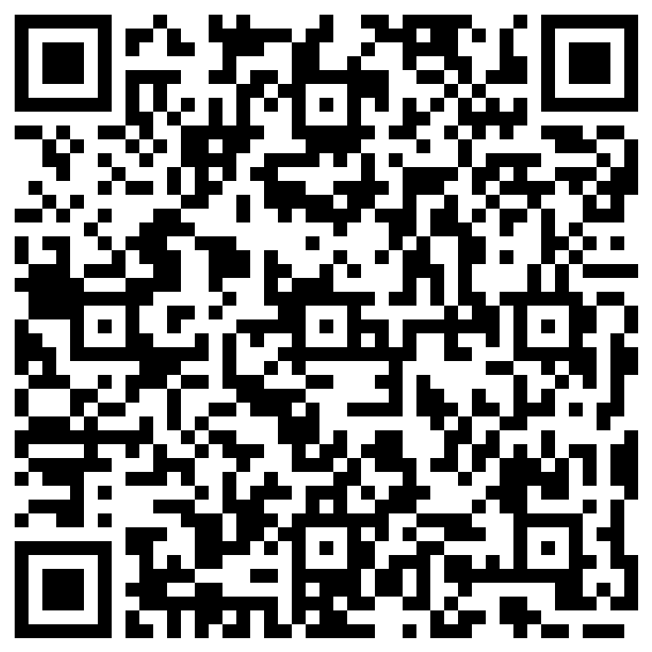
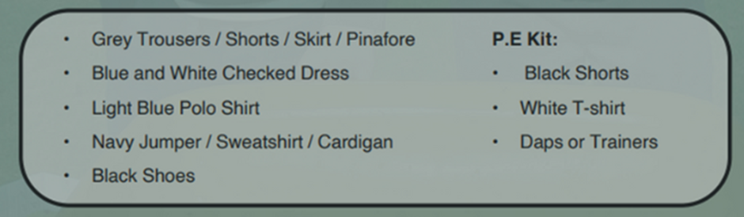
School Uniform
At Llangan primary school we strongly encourage pupils to wear school uniform. It encourages a sense of equality, pride and belonging in our school and local community. Please could parents ensure all children’s belongings are clearly labelled.
Our uniform consists of:
Parents can purchase uniform items embroidered with the school’s logo at the following outlets:
The Pencil Case (Cowbridge)
Uniform to go (Online)
My Uniform (Online)
Please label all belongings.

Slide 10

Attendance
Pupils should be aiming for 100% attendance!
Research consistently shows a direct link between attainment and attendance.
There will be communication with parents if attendance levels become a concern.
Term time holidays are recorded as unauthorised absences in line with Vale of Glamorgan expectations.
If your child is unable to attend school, the school office needs to be notified either through email or phone call.

Slide 11
Maths
Recognizing numbers, reading and writing them
Counting aloud
Pointing to objects one at a time while counting
Understanding quantity: Knowing that "3" means three things
Comparing quantities - More/less, same/different
Beginning to understand adding and subtracting using objects
Simple mental addition and subtraction within 5 using visuals or fingers
Recognizing and creating simple patterns
Sorting objects by color, shape, size, or type
Recognizing and naming basic 2D shapes
Beginning to talk about 3D shapes (cube, ball/sphere)
Exploring position and direction: in, on, under, next to, behind, in front
Using language of size: big/small, tall/short
Understanding length, weight, and volume through play (e.g., pouring water, using scales)
Comparing objects: heavier/lighter, longer/shorter
Sequencing events - what happens first, next, last
Understanding daily routines: morning, lunchtime and bedtime
Beginning to recognise days of the week
Continue to use maths in everyday situations. This could include: using coins when shopping or measuring ingredients when cooking

Slide 12
Literacy
In the early years, literacy is about so much more than learning to read and write, it’s about developing a love of language. Children build the foundations for literacy through talking, listening, singing, mark-making and playing with sounds and words. Everyday experiences such as sharing stories, noticing print in the environment, and enjoying rhymes all help children develop the skills they need to become confident communicators.
At this stage, we focus on fostering curiosity, imagination and enjoyment, while gradually introducing the building blocks of reading and writing in meaningful and playful ways.
When pupils are ready we will be learning a sound per week following our school phonics scheme RWI. Please revise these sounds at home with your child so they are more familiar with them. If you require anymore information on our RWI scheme please speak to a member of staff.

Slide 13
Inquiry Based Learning
Each term, our learners focus on a specific area of the curriculum. This ensures that at Llangan, we spend plenty of time accessing exciting learning opportunities and we become experts in these areas.
The curriculum is split into six areas of learning and experience (AoLEs) which are...
Language, Literacy and Communication
Maths and Numeracy
Humanities
Science and Technology
Expressive Arts
Health and Wellbeing

Slide 14
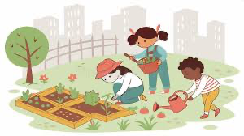
Outdoor Learning
We access Outdoor Learning every day. Outdoor experiences are a meaningful part of your child’s learning journey in Llangan. Children may get muddy, wet or sandy and that’s part of the fun and learning!
We will also be doing Welly Wednesday every Wednesday morning. Please help us by providing a suitable pair of wellies so that they can fully embrace these experiences in comfort and safety. Please don’t forget to label these! Please could you also provide your child with a waterproof coat on this day as the autumn & winter approaches.

Slide 15
Seesaw
Seesaw is a simple way for us to share your child’s learning and special moments from nursery with you. We use it to post photos, videos, celebrate achievements and keep you informed about what we’ve been learning in class.
At times, SeeSaw may be used as a way to reassure you of your child’s wellbeing.
Please note, SeeSaw is not to be used as a way to communicate with your child’s teachers. This can be done via the office or speaking to teachers regarding quick messages in person at the end of the day.
Seesaw Login have already been sent home. If you have not received your child’s login, please let us know.
If your child attends wraparound, you will also have a login sent home.

Slide 16
Wraparound/Llangan Childcare
If you would like your child to join wraparound please contact the school office.
School lunches may be pre-ordered via your ParentPay account or if not a member of staff will order the hot meal of the day for them.
The menu is set by Big Fresh. As a school, we are unable to change the choices provided each day. If your child does not like anything on the menu, please ensure you provide a packed lunch for your child or choose an alternative meal on parent pay.
Snack - Please send in an additional snack for the afternoon. Fruit or vegetables only - NO NUTS.
Please provide at least 1 set of spare pair of clothes for your child in case of toileting accidents , messy play, outdoor play and cooking activities.
If your child has a toileting accident, they will be sent home with a slip of paper to tell you.
Communication - Seesaw is used to share images from the afternoon. Please continue to use the school email address to contact wraparound staff and we will get back to you asap or you can talk to us down on the gate at home time.
Home time for wraparound is 3.20pm. The person collecting will be asked to sign the child out by a member of staff down at the gate.
If you have any questions regarding wraparound, please feel free to ask a member of staff.
ADHOC days are always available if needed, please email the office if you require any dates.

Slide 17
Keeping in Touch
If you need to speak to a member of staff, please contact the school office via phone or email and we will get back to you as soon as possible. Staff are working in their classrooms at the start of each day however staff are available at the end of each day (except Wednesdays) to chat through informal and brief issues.
Please contact the school office if you require an appointment.
Weekly newsletters & blogs are available via the school website.
Download the School News App to keep up to date with school life.
Please do not pass on messages at the school gate as this is a busy time for all members of staff. All absences and messages must be reported to the school office.

Slide 18
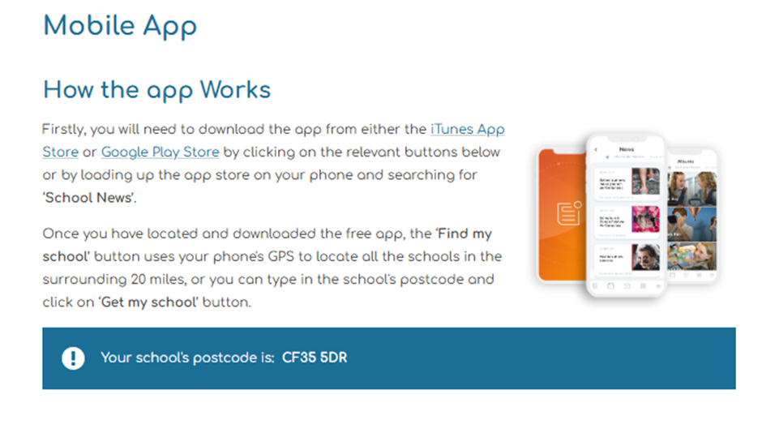
School App

Slide 19
Resource Wishlist
In Dosbarth Gwenynen, we use a range of resources to enhance our learners learning and development. These include practising letter formation in shaving foam, sand play, playdough and a range of writing resources. To keep these resources replenished, we kindly ask for a donation of £1 a week. This can be paid through Parent Pay.
We also have an Amazon Wishlist, where each class has a wishlist of resources we may need throughout the the term and would be very grateful for.
These items do not need necessarily have to be bought from Amazon and maybe found cheaper from other outlets.
Our Amazon Wish List is updated regularly. Please keep an eye out on Seesaw for an updated list.
.

Slide 20
Dates for your diary
24th September - Macmillan Coffee Morning (9.00am - 10.00am)
5th October - Individual pupil photos
9th October - Harvest Festival (2.00pm - 3.30pm) - Nursery children who don’t attend wraparound are welcome to come back to join in with our class song performance and then return back to parents to enjoy the rest of the harvest festival celebrations.
15th & 20th October - Parent/Teacher consultations
A school trip will be organised linked to our new inquiry, a date will be shared with you once we know.
Inset days
28th May
7th June
19th July
20th July

Slide 21

Questions…
Please feel free to look around our classroom where we will be available to answer any questions you might have about life in Nursery.

