Slide 1

Dosbarth Gwenynen
Our Cynefin

Slide 2
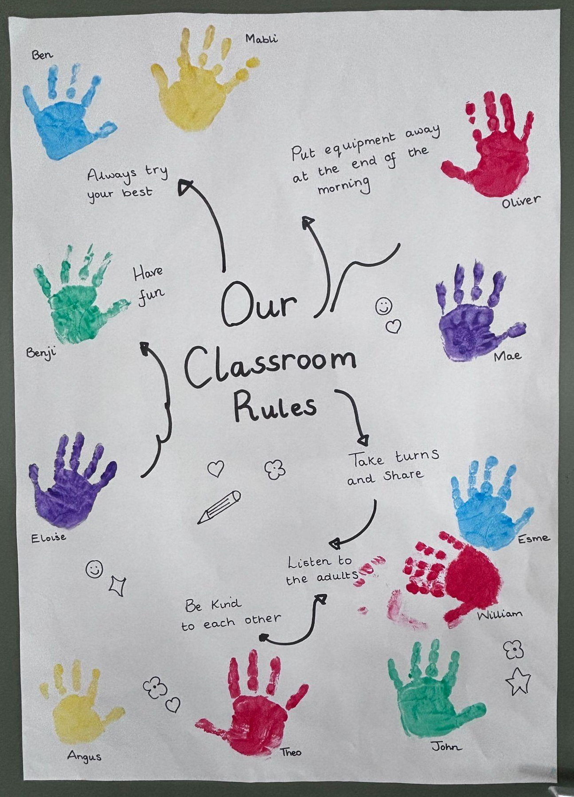
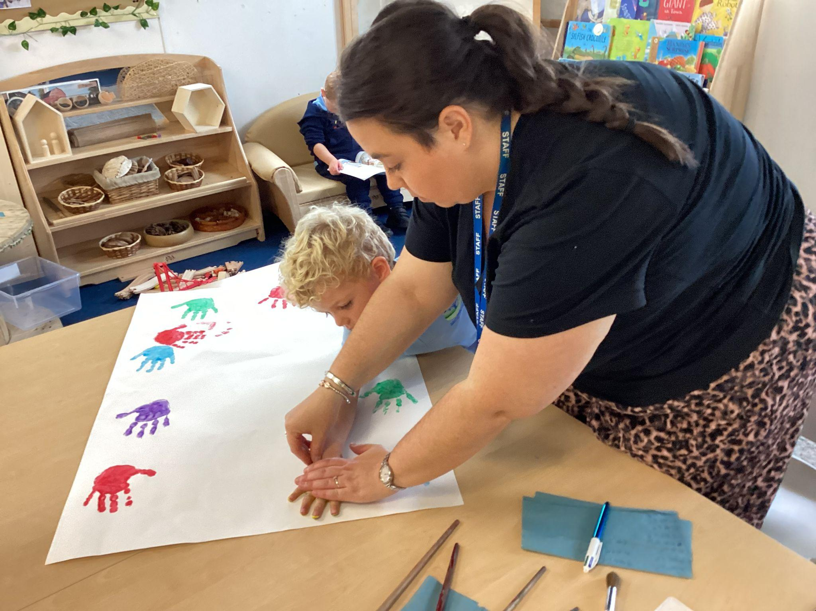
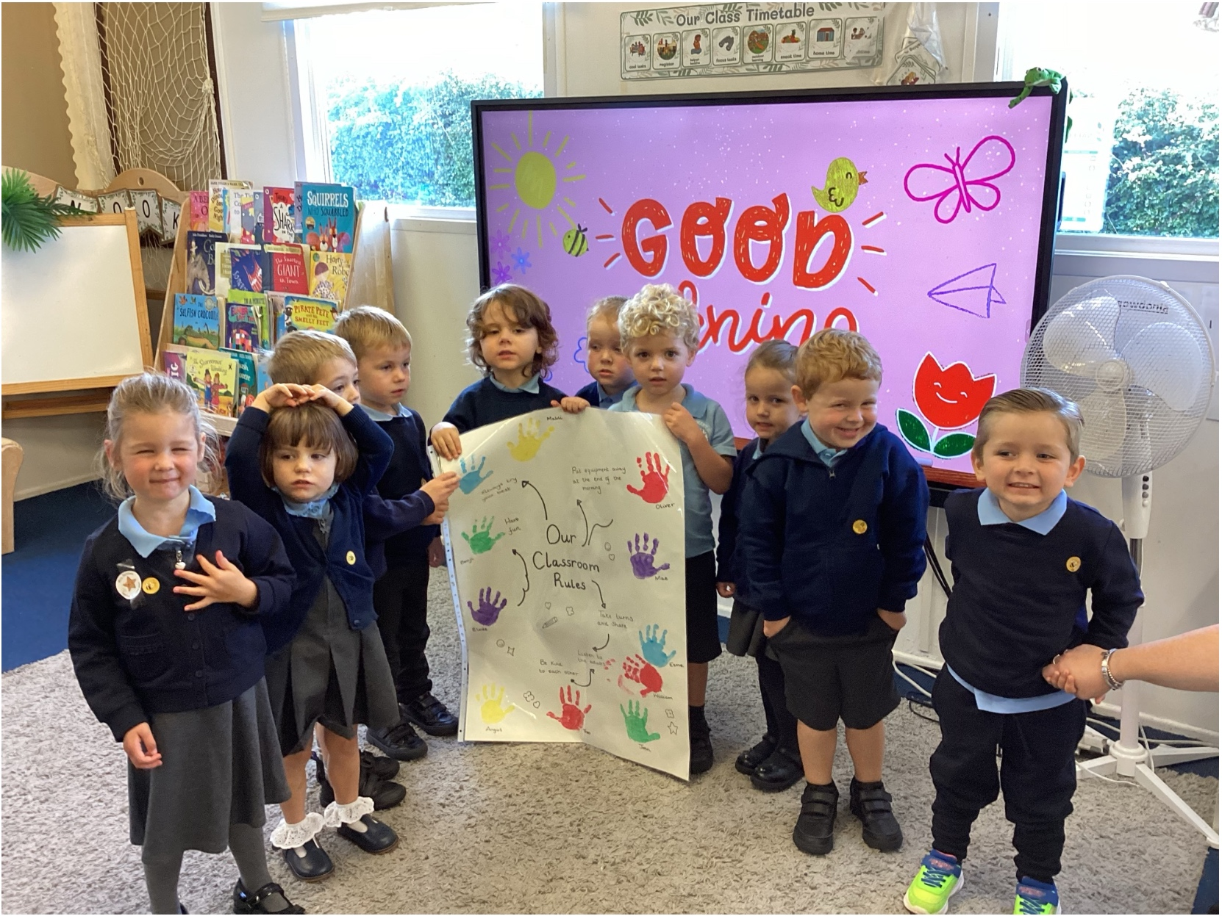
Our Classroom Charter
In Dosbarth Gwenynen, we started off by discussing how we can feel safe in our Cynefin. Together, we discussed our classroom rules and expectations and agreed to always try our best, have fun, be kind to each other, listen to the adults, take turns and share and put our equipment away at the end of the morning. We all showed our commitment by signing our charter with our handprints, creating a special reminder of how we can care for our Cynefin and each other.

Slide 3
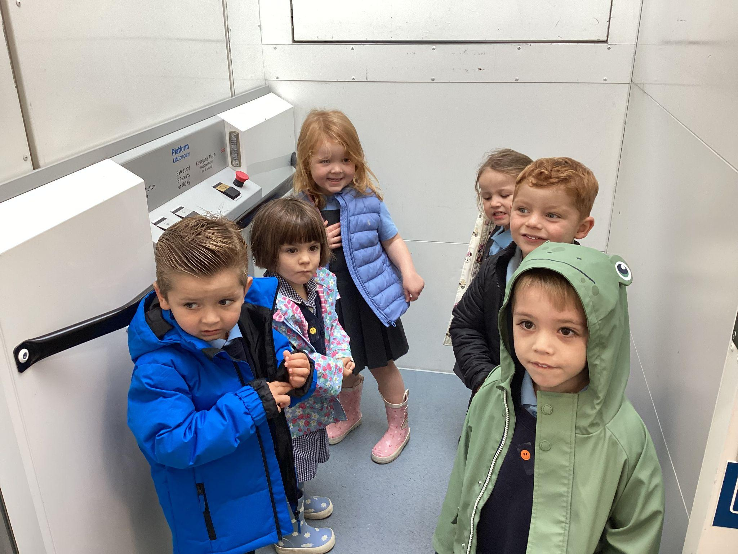
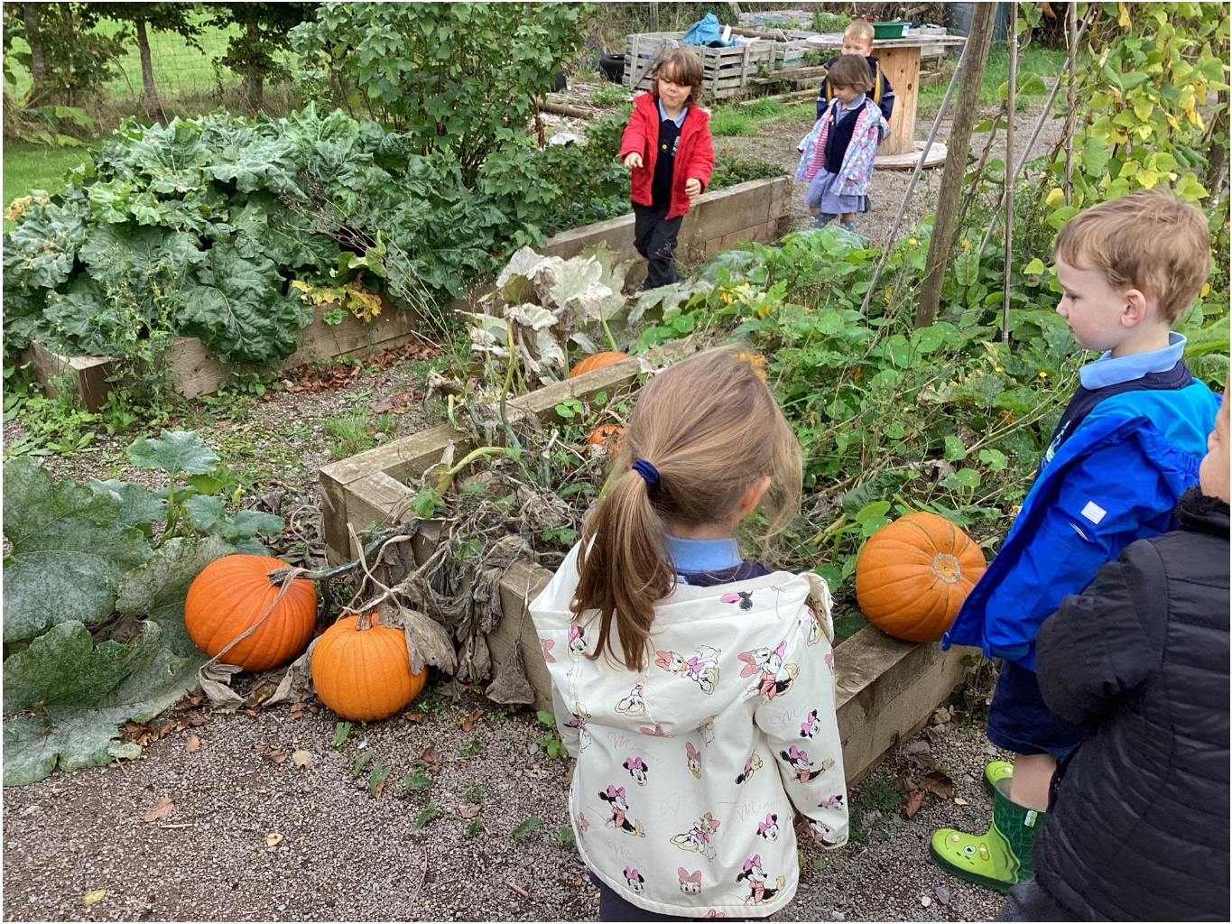
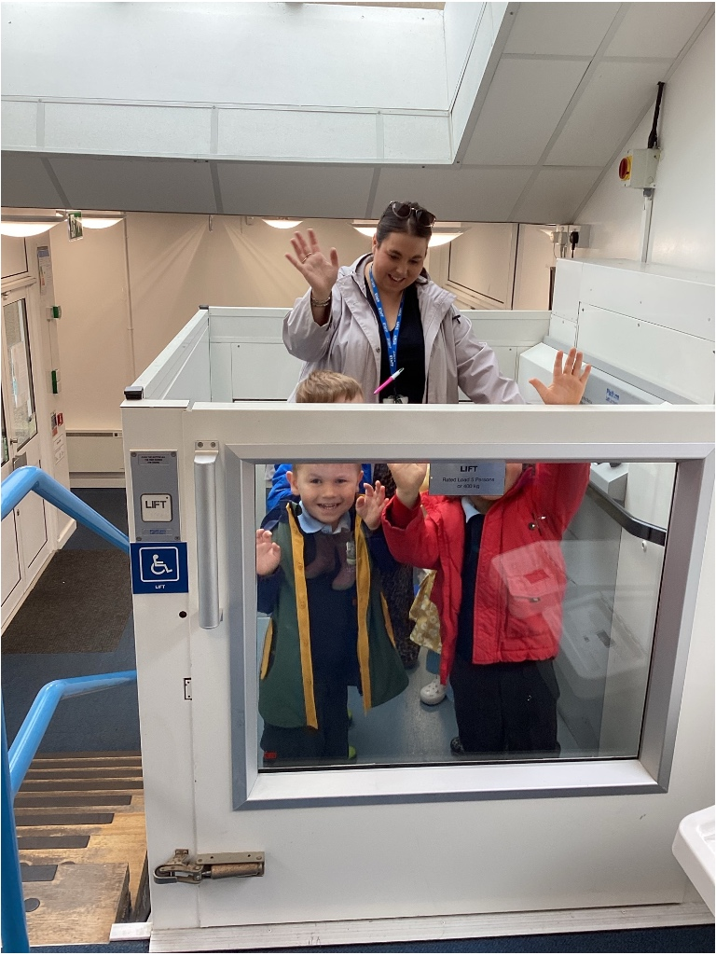
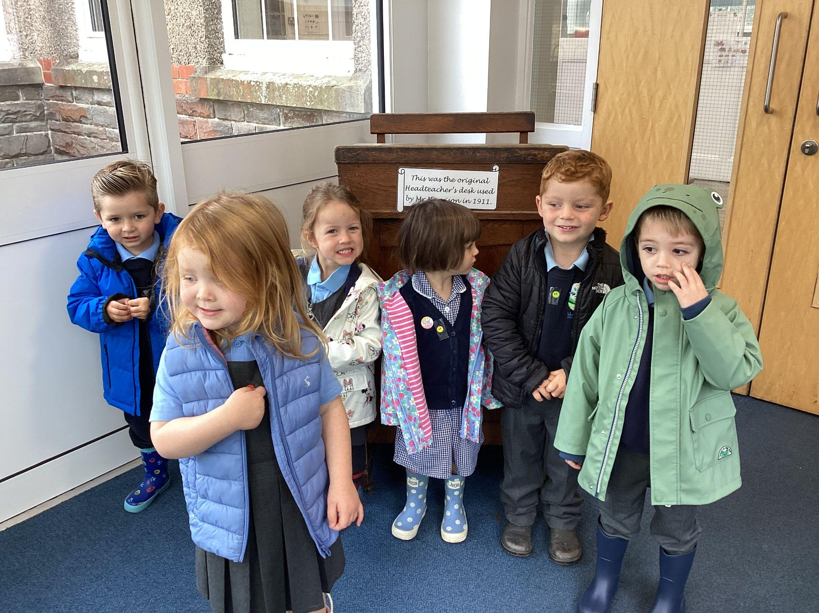
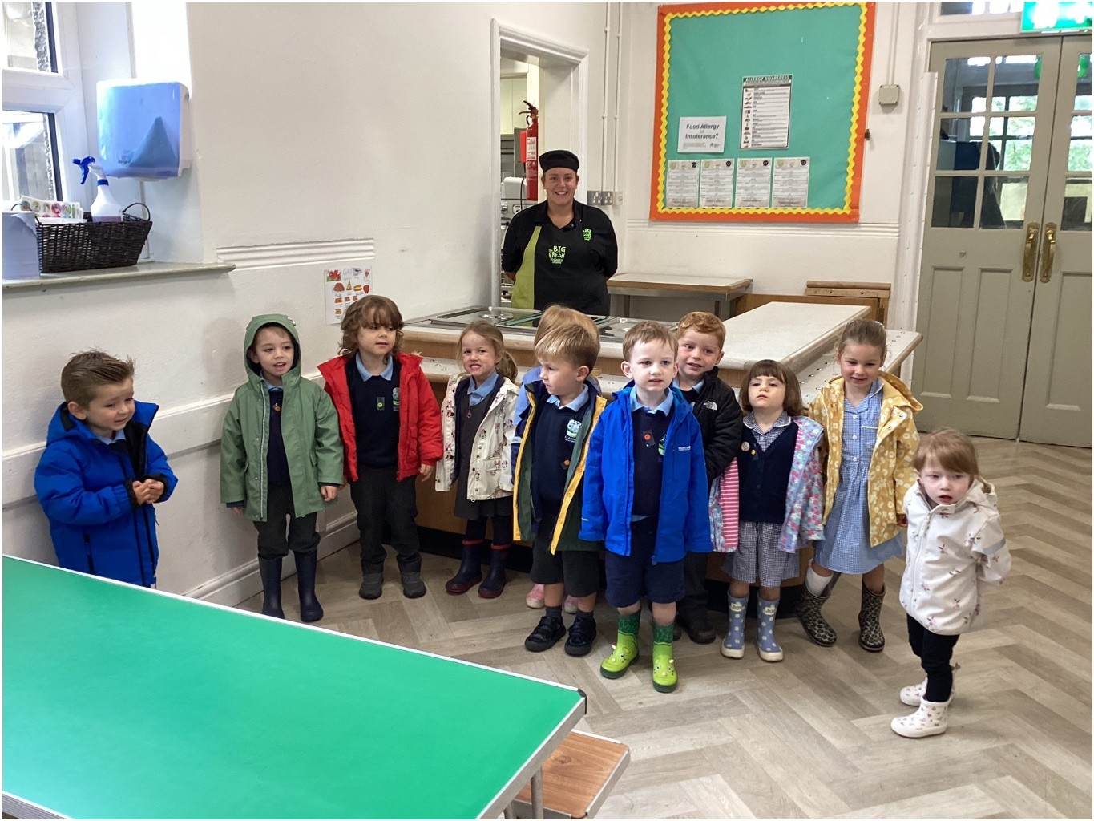
Exploring Our School Cynefin
We went on a special walk around our school to explore the different areas that make up our Cynefin. We discovered familiar places and we were so excited to see Cez, our cook and learn more about the important role she plays in our school community. We loved exploring, asking questions and beginning to understand how we all belong to our school.

Slide 4
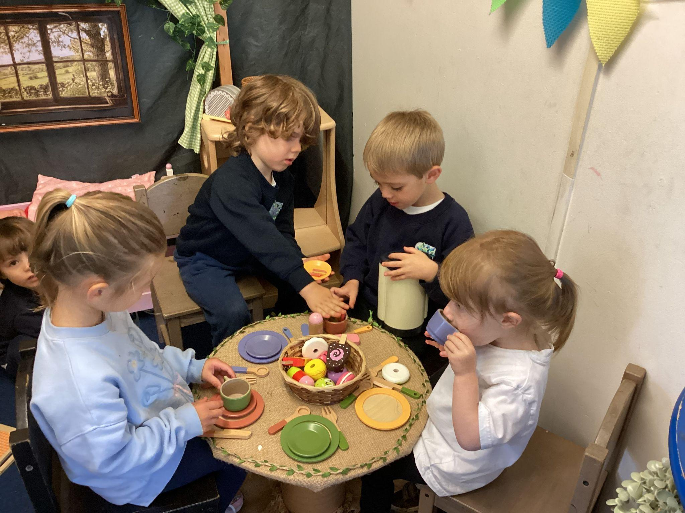
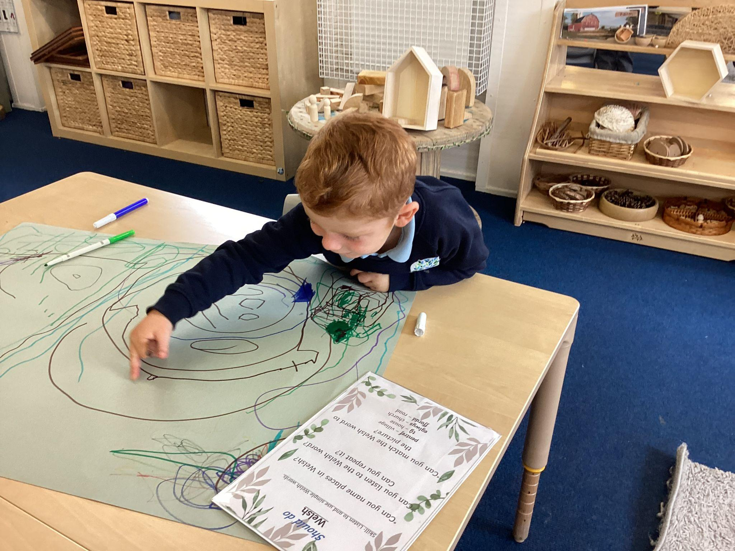
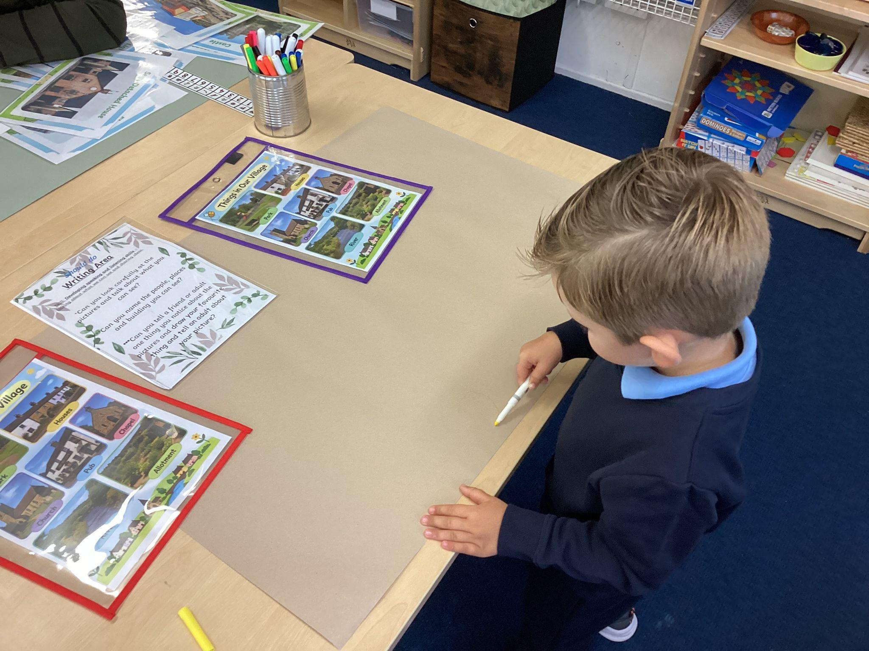
Cool Challenges
In our home corner having a tea party.
Identifying things in our village in Welsh. Tommy said “This is my house ”.
Drawing different things we would find in local villages. John drew a park.

Slide 5
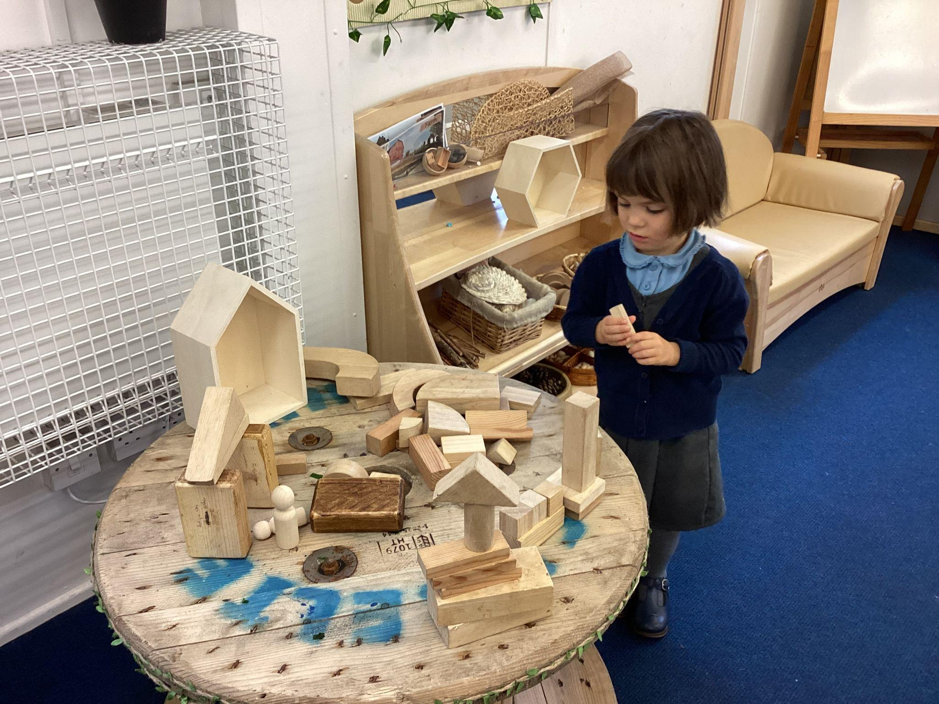
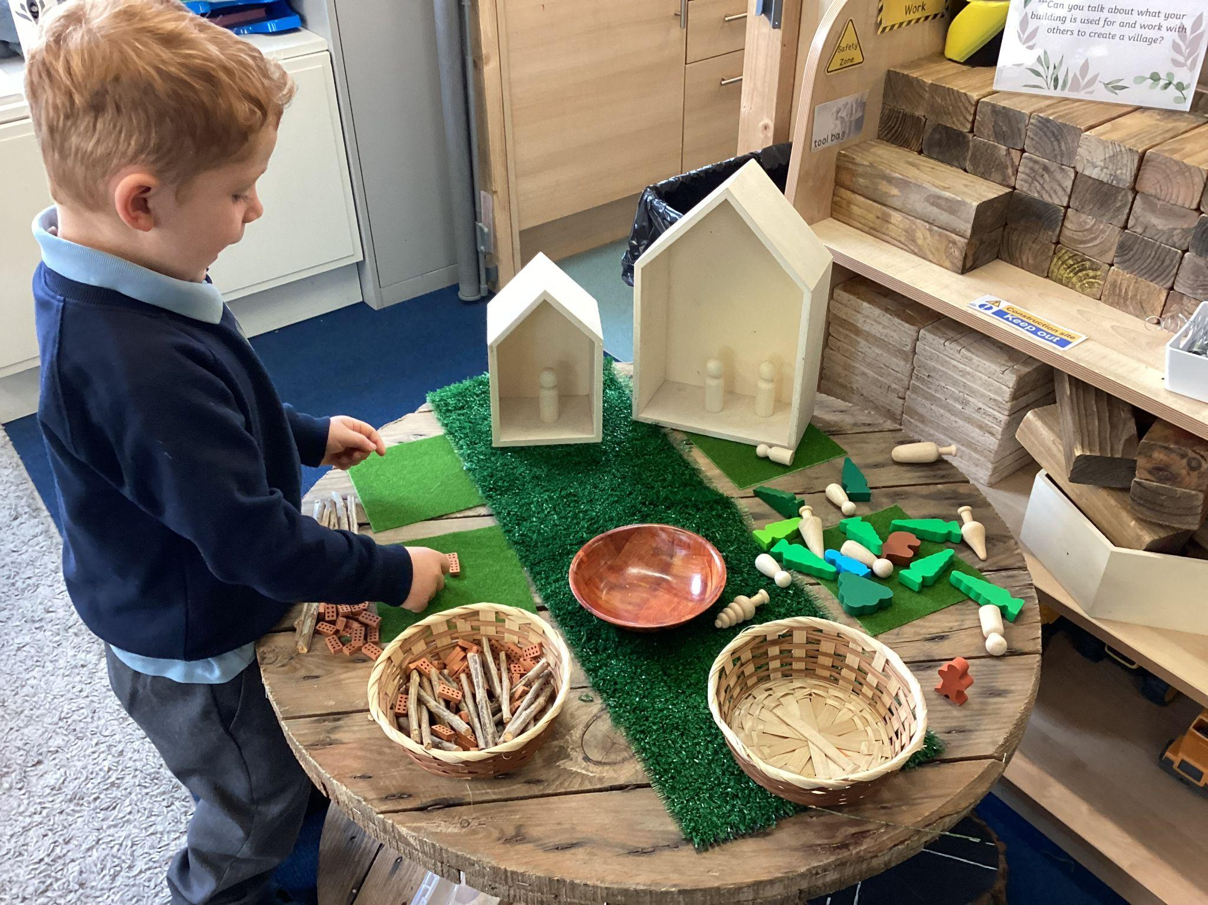
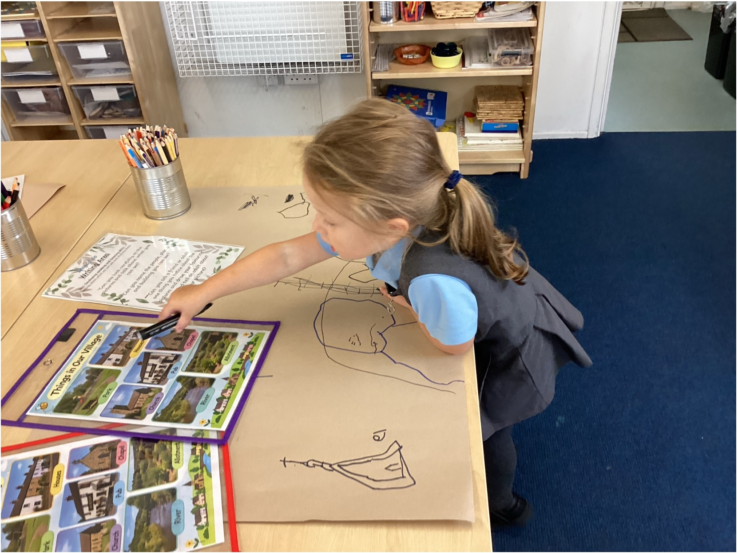
Cool Challenges
Making lots of different houses using the small blocks.
Y6 Weekly Timetable
Identifying different features of villages and drawing different houses.
Creating a village using blocks, bricks, sticks and other small world resources.

Slide 6
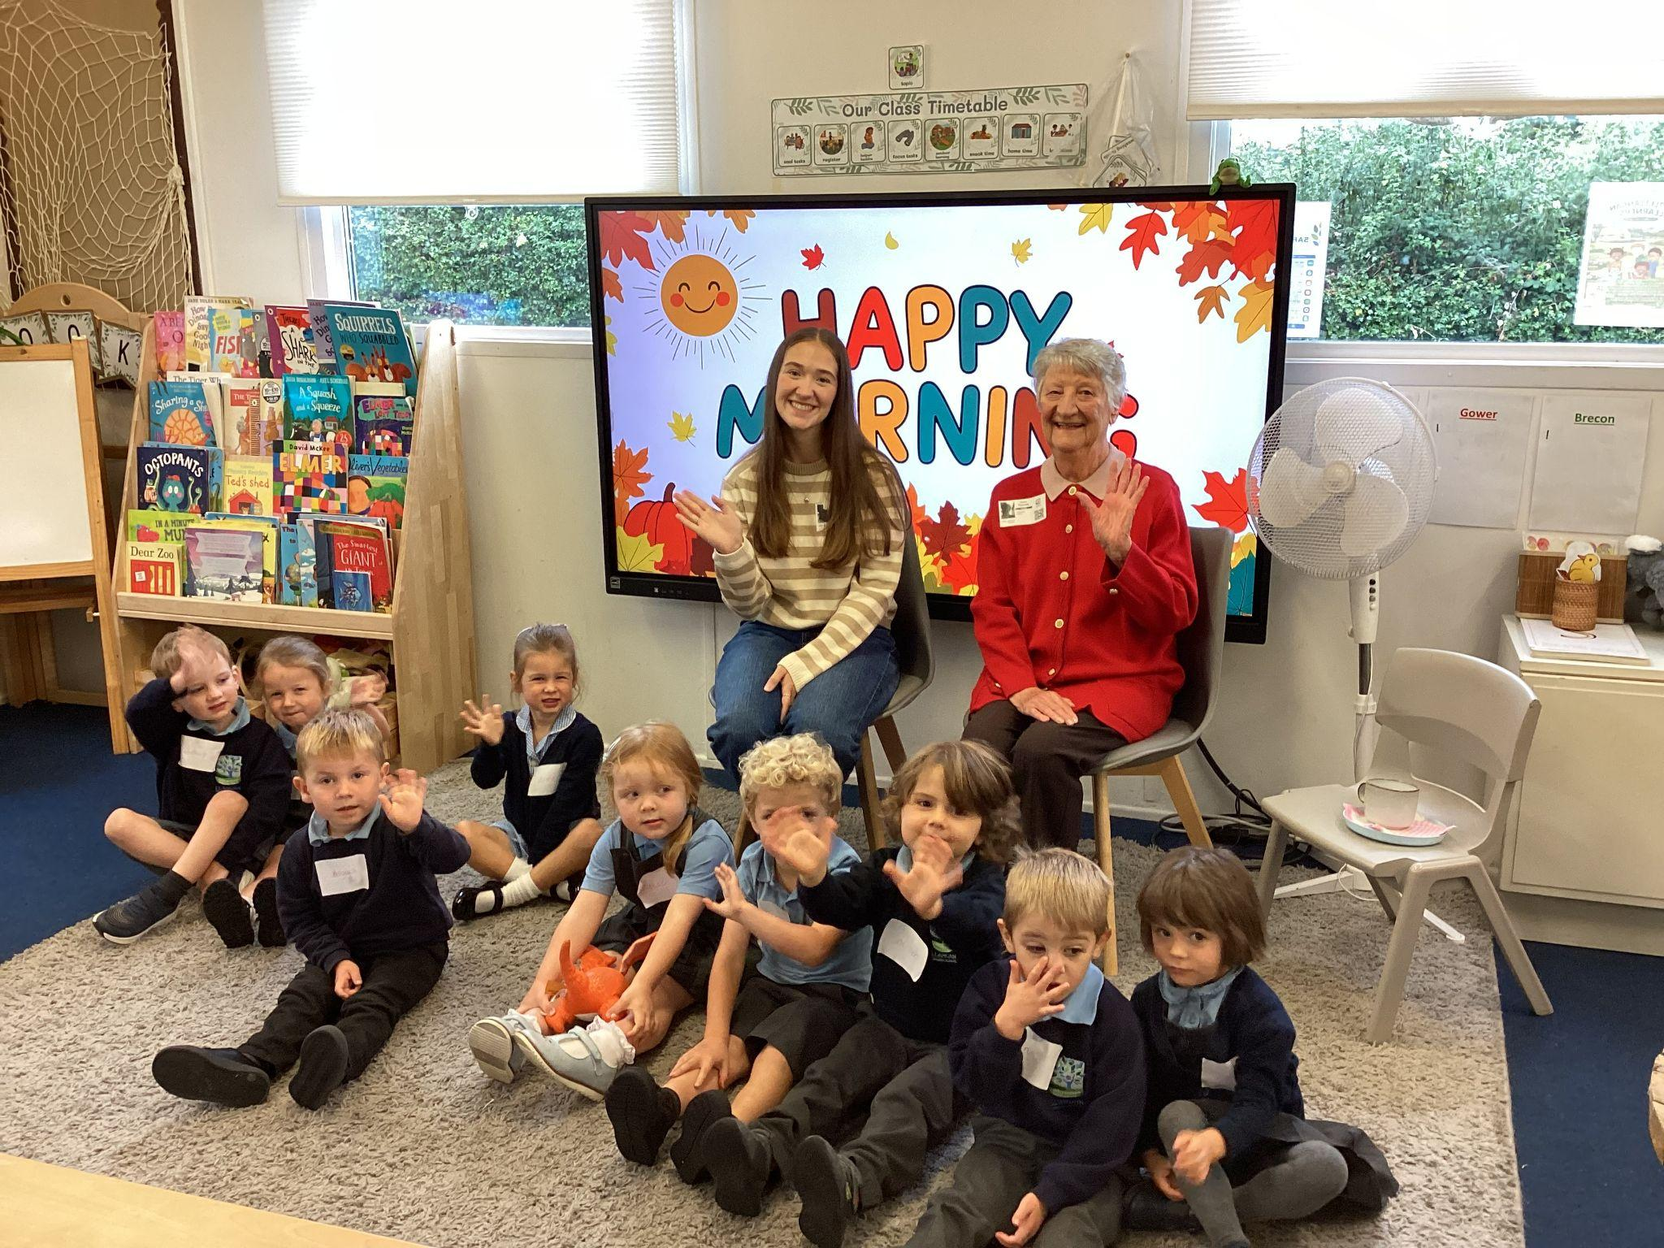
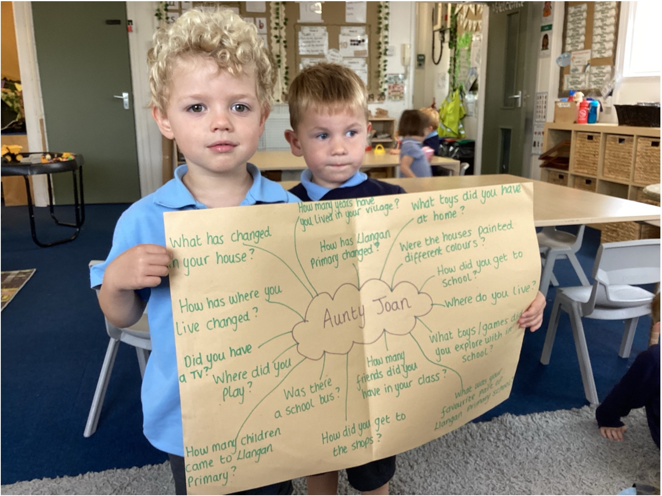
Some Special Visitors
We welcomed two special visitors, Aunty Joan and Meredith into Dosbarth Gwenynen to talk to us about growing up and what Llangan School was like when they attended and how the village of Treoes has changed. Before their visit, we thought carefully about questions we would like to ask them. We enjoyed listening to their memories, learning about how things have changed over time and discovering more about the history of our school and our Cynefin.

Slide 7
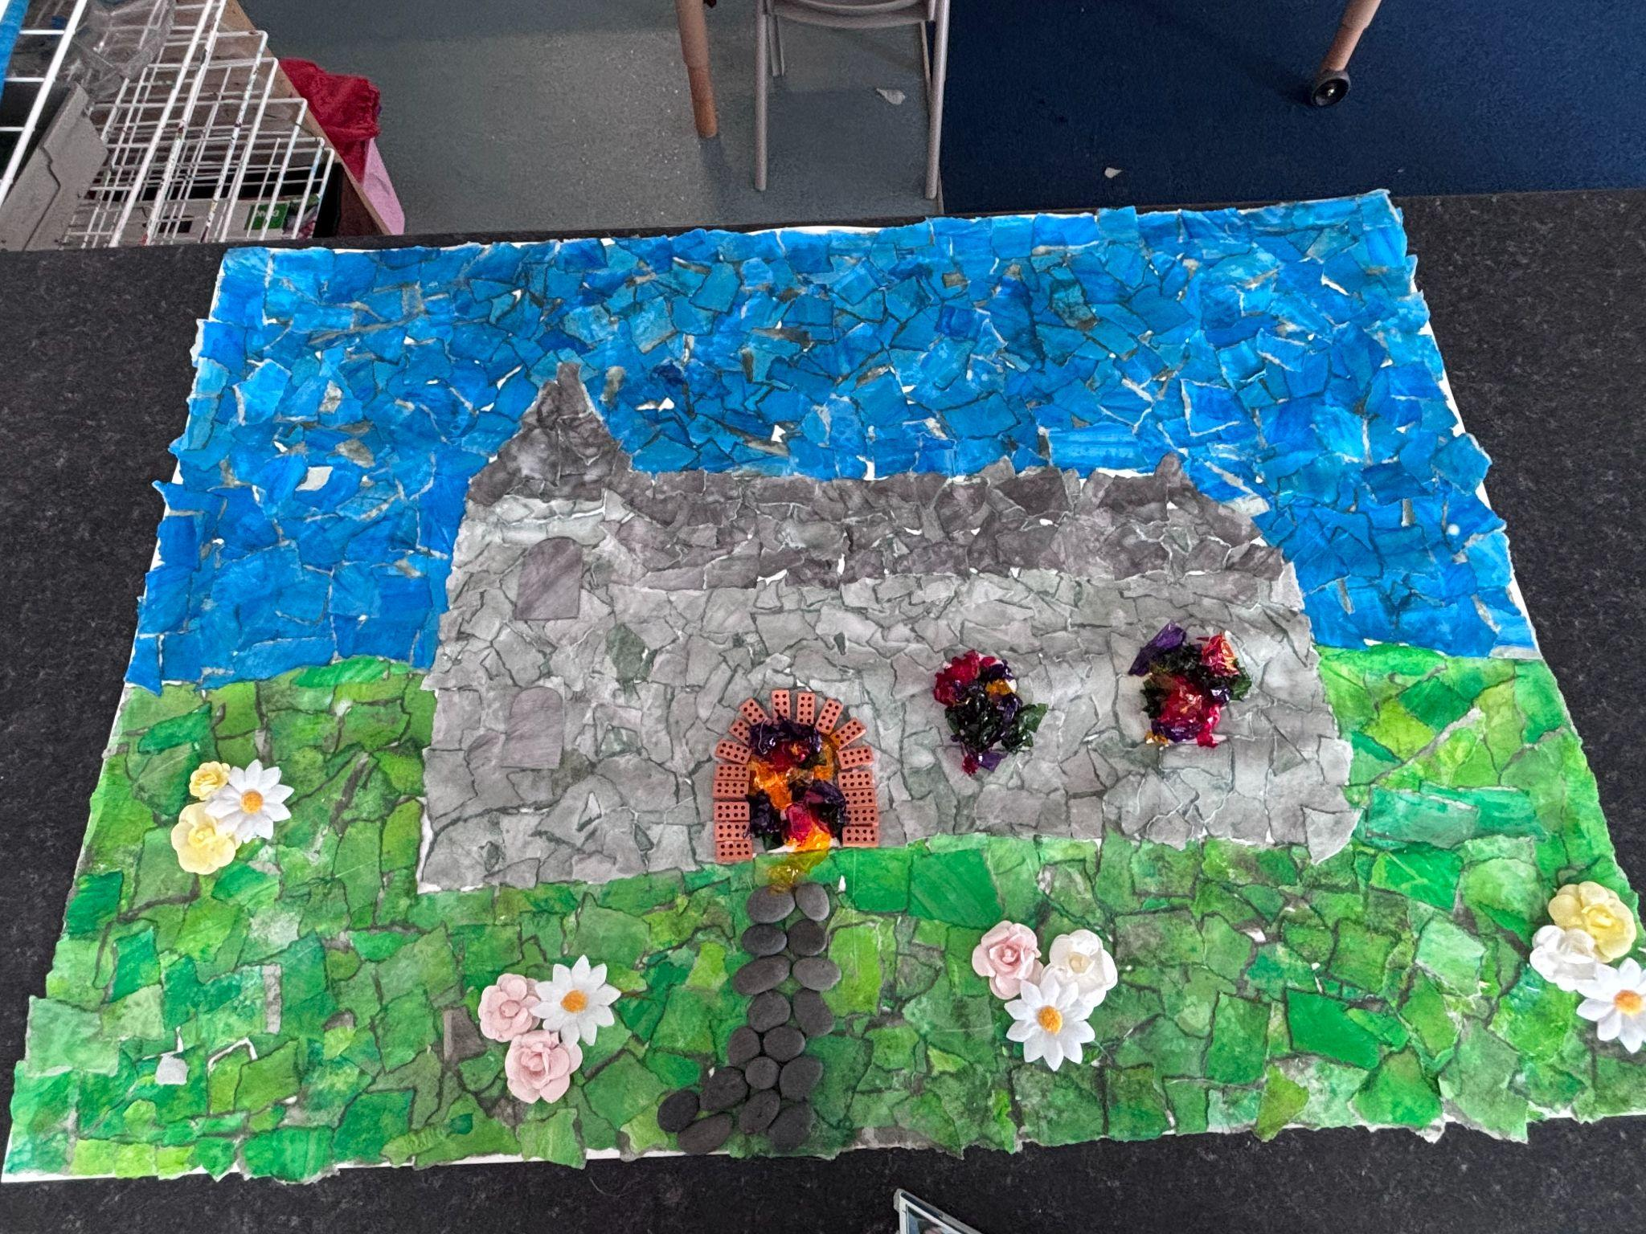
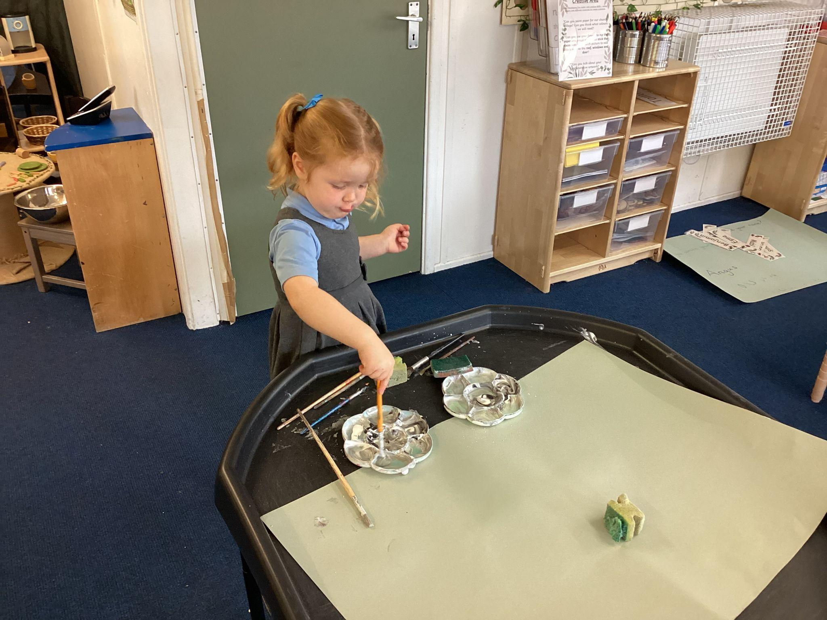
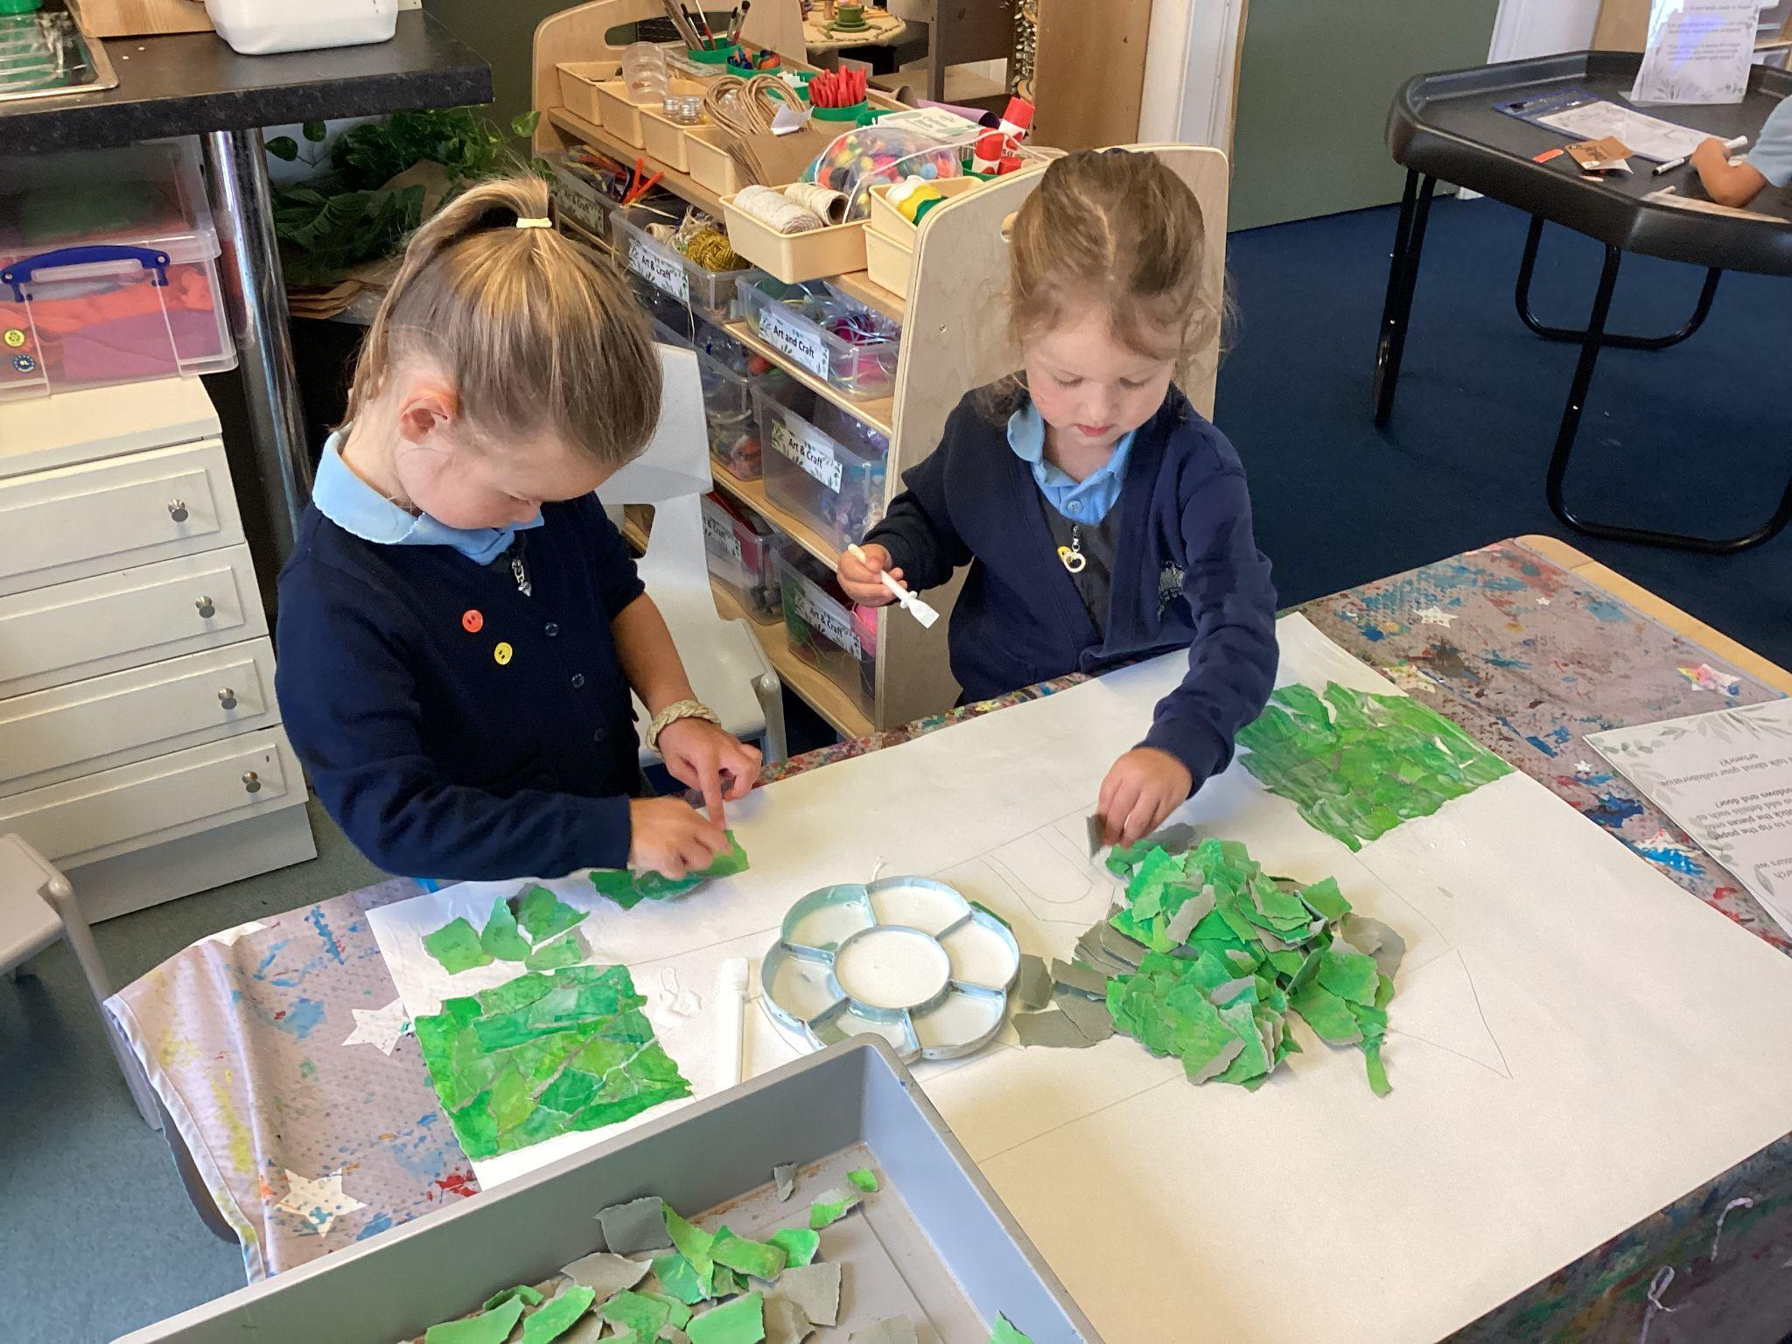
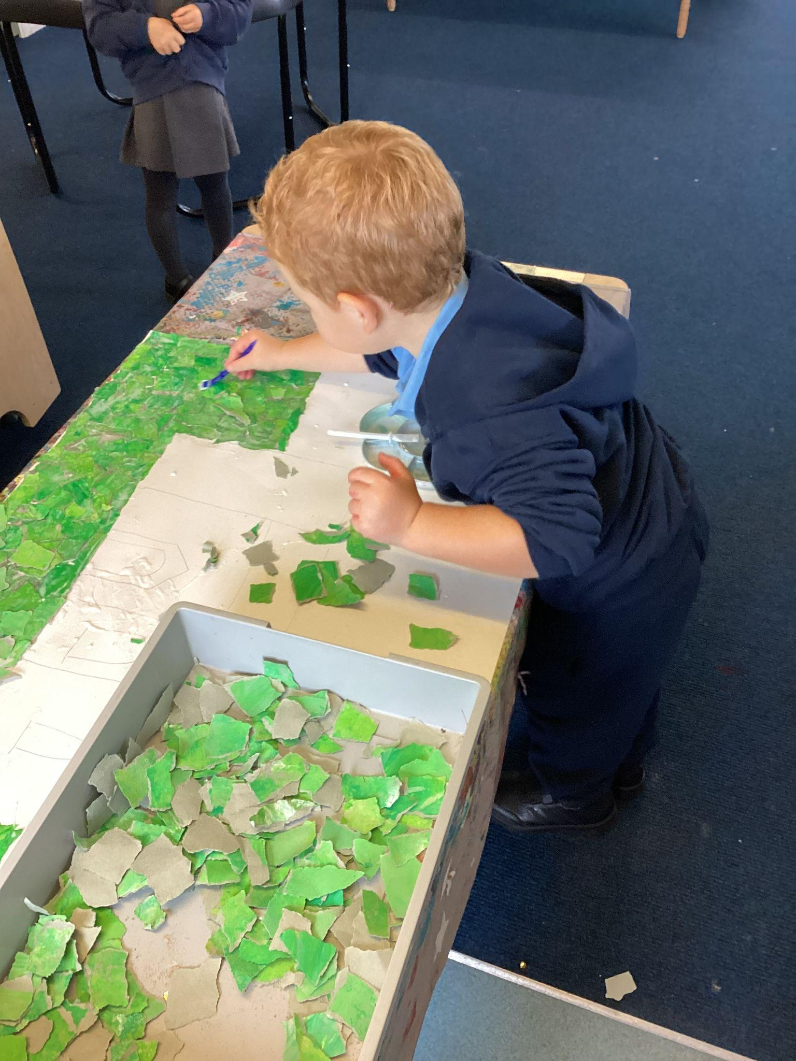
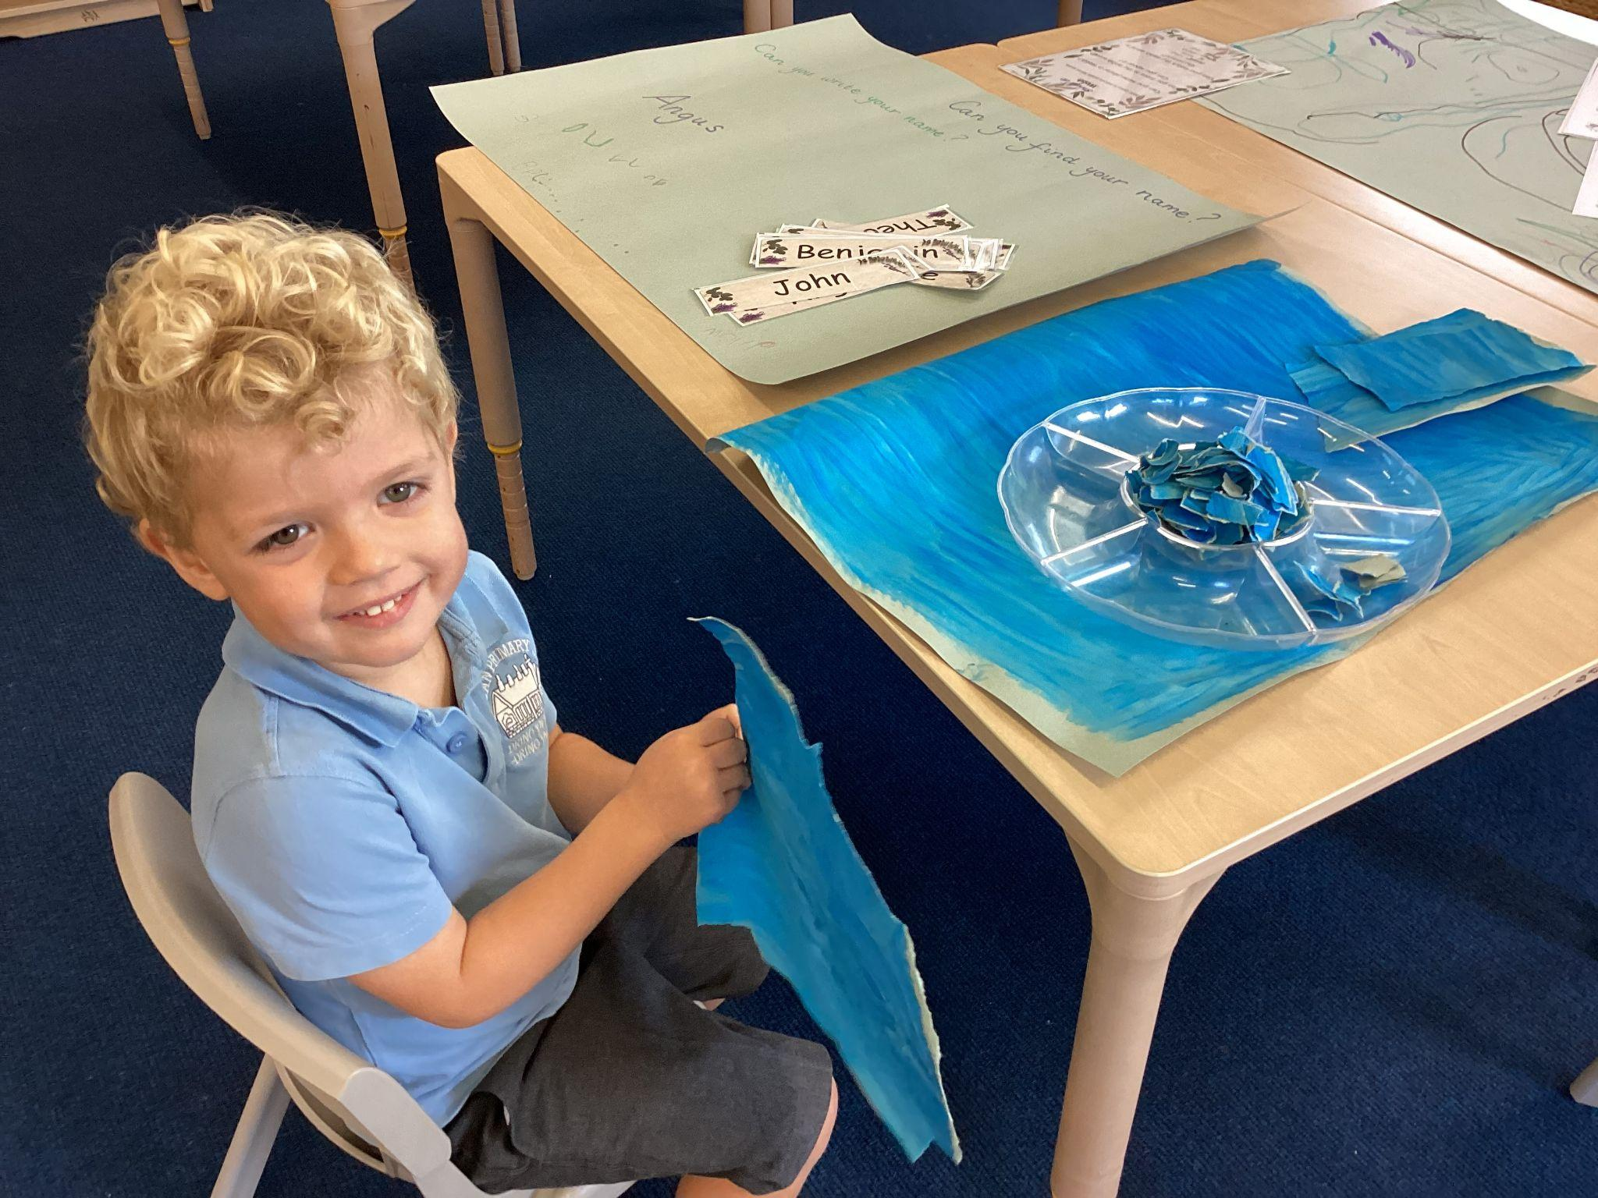
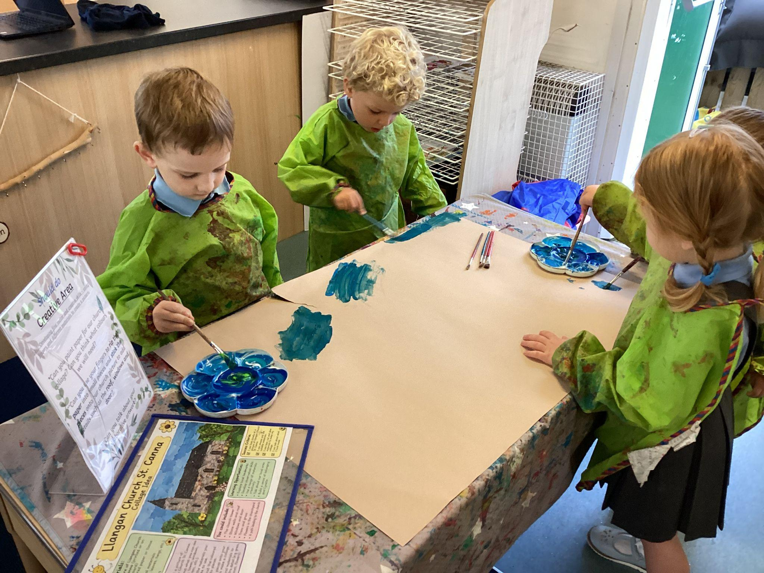
Our Collage Of St Canna’s Church
We have been working together collaboratively towards creating a collage of St Canna’s Church in Llangan which is a landmark in our Cynefin. Together we painting the green grass, blue sky and grey church, we then ripped up the paper to make different shapes and sizes, we then stuck them on with lots of glue and added some bricks around the door, stained glass windows, flowers and a stone path. We had so much fun creating this!

