Slide 1
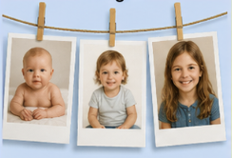
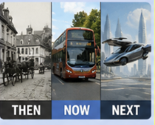
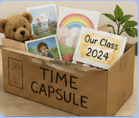
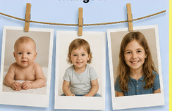
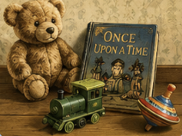

Essential Questions
What has changed and what has stayed the same?
How can we find out about the past?
Why do things change?
How might things change in the future?
Reception/Year 1 Autumn Term Inquiry – Humanities
How do things change?
Tuning In - Look how I’ve changed!
Finding Out - Once Upon a Time...
Sorting Out - Change Detectives
Going Further -
Reflect & Act -
Why am I learning this?
Why am I learning this?
Why am I learning this?
Why am I learning this?
Why am I learning this?
To spark our curiosity about how people, places and things change over time. We will explore clues from the past and begin asking questions about what has changed, what has stayed the same and how we can find out.
To discover how childhood and everyday life have changed over time and compare our lives with different generations. To explore how toys, games, nursery rhymes and traditional tales can be passed down and change over time, and use photographs, objects and memories to identify what has changed and what has stayed the same.
To understand how evidence helps us discover and understand the past. To investigate how our school, homes, transport, technology and local community have changed over time, and consider why some of these changes happened. To develop our understanding of chronology, change and continuity, recognising what has changed, what has stayed the same and how we know.
To use what we have discovered about the past to think more deeply about change. We will explore why things change, consider how changes have affected people’s lives and begin to imagine how familiar objects, places and ways of life might change in the future.
To reflect on what we have learned about change and recognise that we can use evidence to tell stories about the past. We will share our discoveries, explain what has changed and what has stayed the same, and think about how we can record our lives for people in the future.
My experience as a learner
Explore mystery objects and photographs from the past.
Visit St Fagans and look for evidence of how life has changed.
Compare things I see with my life today.
Look for things that have changed and things that have stayed the same.
Share what I already know and ask “I wonder…” questions.
Help decide what we would like to investigate further.
My experience as a learner
My experience as a learner
My experience as a learner
Explore and compare old and modern toys.
Find out about toys, games and childhood in the past.
Learn traditional Welsh and English nursery rhymes.
Explore and compare different versions of traditional tales.
Ask family members about their childhood experiences.
Identify things that have changed and stayed the same.
My experience as a learner
Choose an important discovery from our inquiry and share it with others.
Create a simple timeline showing change over time.
Sort examples into past, present and future.
Explain something that has changed and something that has stayed the same.
Create a class time capsule with objects, photographs, drawings or messages that show what life is like today.
.
Investigate photographs, objects and other clues from the past.
Look closely and notice important details.
Sort evidence into then and now.
Put events and objects in chronological order.
Compare changes in homes, transport, technology and our local community.
Use evidence to explain what I think has changed and why.
Share my ideas and listen to the ideas of others.
Explore how homes, schools, transport and technology have changed. Compare photographs and objects from different times.
Talk about which changes have made life easier or different.
Ask questions about why things changed. Design or draw an object from the future.
Explain what I think might change next and why.
Use words such as past, present, future, then, now, before and after.

