Slide 1


Welcome to
Year 2/3
www.llanganschool.co.uk llangan_primary_school

Slide 2
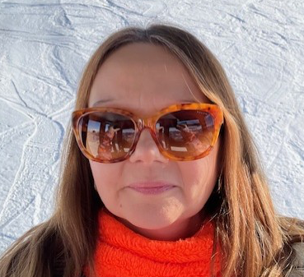
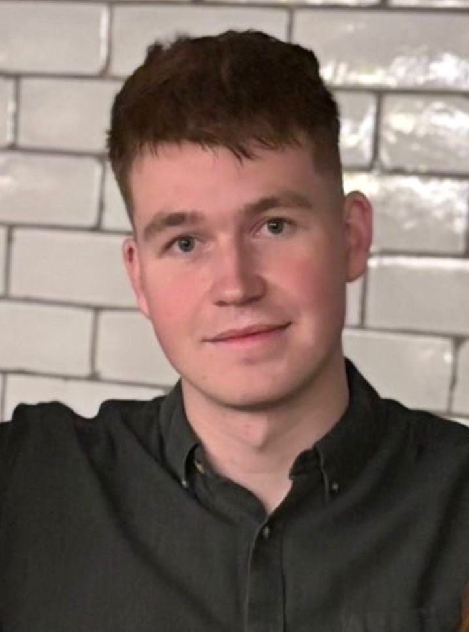
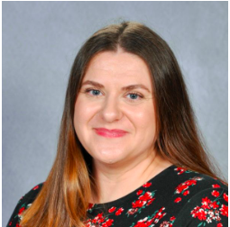
Meet the staff
Mrs Jarman-Davies
Monday, Tuesday, Thursday & Friday
Mr. Rees
Class LSA
Mrs Antoniou
Wednesday

Slide 3
Y2/3 Weekly Timetable
 | Monday | Tuesday | Wednesday All day – LJD out (ALN & PPA) Mrs Antoniou to cover | Thursday | Friday
8:45 - 9:00 | Registers, morning activities & focused readers | Registers, morning activities & focused readers | Registers, morning activities & focused readers | Registers, morning activities & focused readers | Registers, morning activities & focused readers
9:00 - 10:10 | Maths | Maths | Maths | Maths Outdoor Learning with Mrs Stephens | 9:10: Whole school assembly
 |  |  |  |  | Maths Big Maths
10:10 - 10:30 | Snack and Break
10:30 – 11:00 | RWI and GGR
11:00 – 12:00 | English: Writing journey | English: Writing journey | English: Writing journey | English: Writing journey | Numeracy/Literacy Across the Curriculum
12:00 – 1:00 | LUNCH
1:00 – 2:00 | Inquiry | Inquiry | Welsh | Inquiry | Health and Wellbeing
2:00 – 3:00 | Inquiry | Science | PE | IT | Target time / Next steps and Reading Books
3 :00- 3:30pm | Slot Drllio, Finishing Off Time, Story Time, Class Novel, Tidy Up Time

Slide 4
Structure of the day
Breakfast Club
Gates open at 8:05am, 8:25am last entry. Pupils must be registered to use our breakfast club provision.
AM
Gates open at 08:45 and close at 08:55.
Lessons begin at 09:00
Mornings begin with maths and numeracy, moving on to English and RWI and guided group reading.
Break time is at 10:10 – 10:30 am pupils may bring a healthy snack.
PM
Afternoon lessons focus on challenging, rich and open-ended inquiry questions. Pupils also have opportunities to apply the skills they learn in their maths and English lessons in new and broader contexts. Science, Welsh, RE and assemblies also happen in the afternoon.

Slide 5
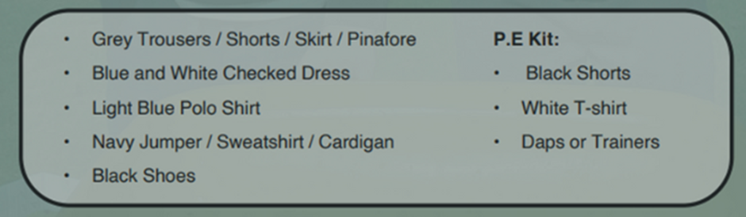
School Uniform
At Llangan primary school we strongly encourage pupils to wear school uniform. It encourages a sense of equality, pride and belonging in our school and local community. Please could parents ensure all children’s belongings are clearly labelled. Our uniform consists of:
Parents can purchase uniform items embroidered with the school’s logo at the following outlets:
• The Pencil Case (Cowbridge)
• Uniform to go (Online)
• My Uniform (Online)
Parent Survey - PE kits

Slide 6

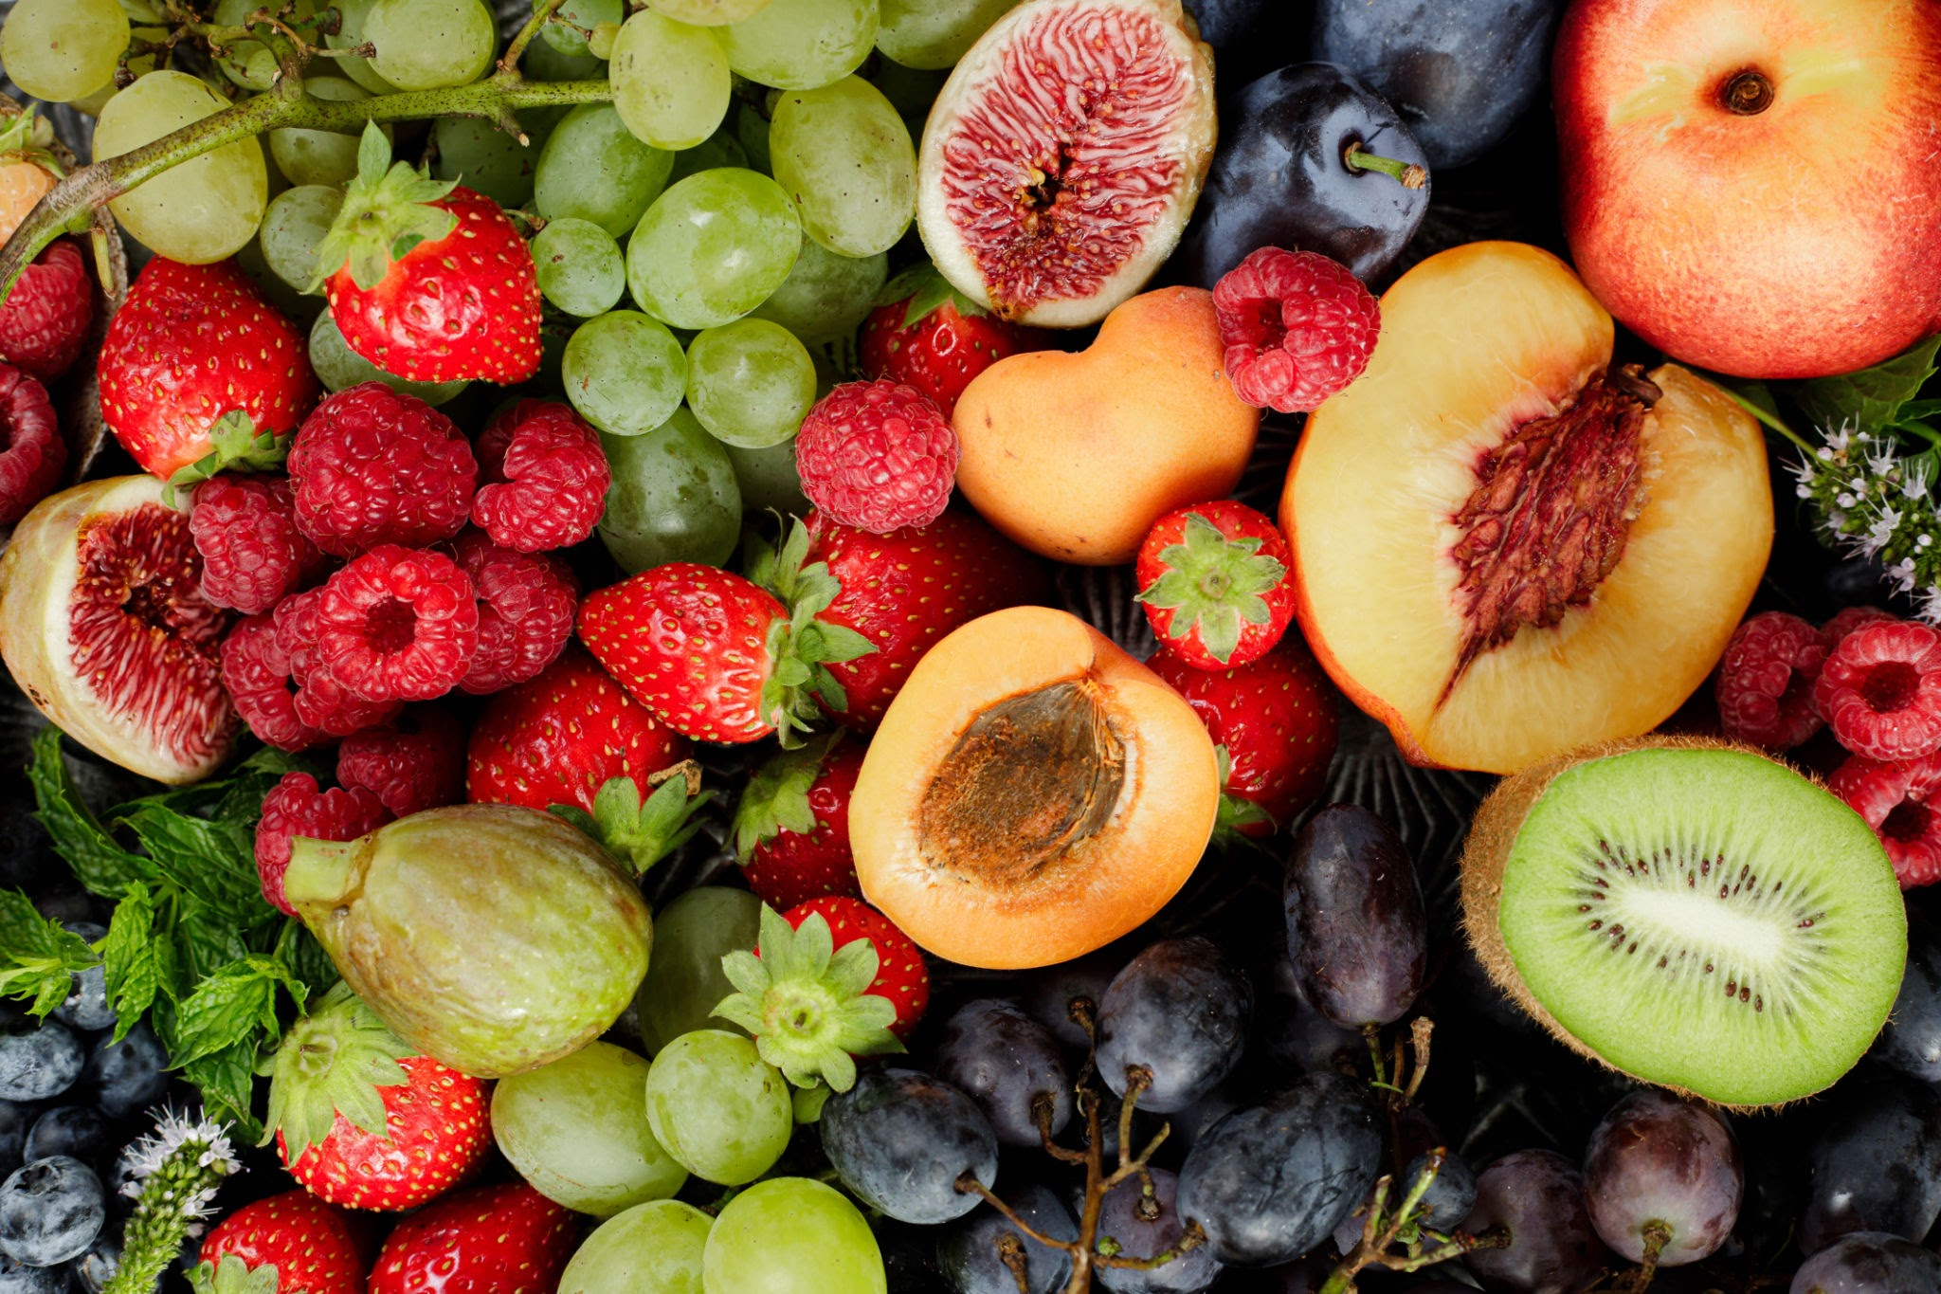
Water & Snack
To help keep pupils healthy and focused throughout the day, please ensure your child brings:
A water bottle filled with water to stay hydrated.
A healthy snack if they would like one for break time (e.g. fruit, vegetables, or a small portion of nuts or seeds).

Slide 7
School Lunches
School meals are free for all pupils at Llangan Primary.
They may be pre-ordered via your ParentPay account.
The menu is set by Big Fresh. As a school, we are unable to change the choices provided each day. If your child does not like anything on the menu, please ensure you provide a packed lunch for your child.

Slide 8
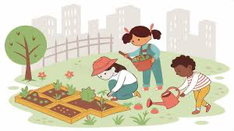
Outdoor Learning
Outdoor learning provision will be provided for all children with Mrs Stevens. This is a weekly session with a group, from each year group. These activities are taking place on a Thursday.
Don’t forget if the weather is wet or cold please could they have suitable clothing to wear, such as a waterproof, warm coat, for their session.

Slide 9
Dates for your Diaries
Harvest Festival – 26th September
INSET DAY – 20th October
Class trip to Roman Legion Museum – 24th October
Half Term: 27th – 31st October
School Photos – 3rd November
Please check the School News app for up-to-date events that will be happening in school.

Slide 10
Ready to Learn
Please make sure your child brings all the appropriate equipment to school each day.
Book bags MUST be brought to school each day. Your child will read every day and the book bag will also be used for storing letters coming home from school.

Slide 11
Maths
Help your child to learn their times tables. Year 2: 3, 4 and 6. Year 3: 6, 7 and 8. Please keep reinforcing other times tables they have learnt.
Recognise relationships between addition/subtraction and multiplication/division.
Learning skills in a concrete way, moving on to independently applying them.
Continue to use Maths in everyday situations – e.g. cooking, shopping, timetables
Mathletics
We use Mathletics to support our learning in school. Challenges are set according to the skills we are covering in class. Mathletics logins are needed and will be available in the front of their homework Learning Logs.

Slide 12
Literacy
All pupils are working at the level that is appropriate to where they are.
Reading at home is vital.
Year 2/3 pupils will be following a writing journey where they will have the opportunity to discover different genres and begin to build confidence and independence in their writing abilities.
They will begin to use tools such as a dictionary and a thesaurus to help independence.
Check Edshed, Oxford Owl website and Giglets for extra resources to support literacy at home. Log-ins for these will be provided and stuck in the front of their Homework Learning Log.

Slide 13
Spelling
Children will be allocated their spelling depending upon whether they are in a RWI or Guided Reading group.
RWI children will have a spelling check weekly on a Thursday according to their group. Their spellings will be available through their class page on the school website. They are called ‘Red words’. Which colour RWI group your child is in will be written on their homework Learning Log.
GGR spelling words will be issued every Friday; they will be published on the school website class page. These will be accessible through Edshed. These will be tested on a Thursday.
Please support your child to learn their spelling words, including being able to write them in a sentence.

Slide 14
Inquiry based learning
Each term, our learners focus on a specific area of the curriculum. This ensures that at Llangan, we spend plenty of time accessing exciting learning opportunities and we become experts in these areas.
The curriculum is split into six areas of learning and experience (AoLEs).
Language, Literacy and Communication
Maths and Numeracy
Humanities
Science and Technology
Expressive Arts
Health and Wellbeing
This term, we will be working on inquiries in the Humanities area of the curriculum. In Year 2/3 we will be focusing on the Celts and the Romans. Specifically asking ‘how did the Romans change life in Wales?’

Slide 15
Weekly events for Y2/3
Mrs Antoniou is in class for a whole day on a Wednesday.
Our PE day is on a Wednesday. Please ensure your child has the correct PE kit.
New spelling words are issued and tests carried out on Fridays.
Homework will be issued every two weeks, on a Friday. Homework is to be handed in a week and a half later, on a Wednesday, so it can be marked. Homework will be explained to the children and will be explained on the class page on our school website.
Each child will have a Home Learning Log Book. Please support us in our quest for excellence in presentation by insisting your child completes their learning to the highest standards.

Slide 16
Attendance
Pupils should be aiming for 100% attendance!
Research consistently shows a direct link between attainment and attendance.
Communication with parents if attendance levels become a concern.
Term-time holidays are recorded as unauthorised absences in line Vale of Glamorgan expectations.
If your child is absent from school, it has to be reported via phone or an email to the office.

Slide 17
Punctuality
Registration closes at 9:00am.
Please aim for your child to be in by this time in order to avoid your child missing out on being introduced to their learning day. Also being punctual helps other children from being disturbed.

Slide 18
Keeping in Touch
If you need to speak to a member of staff, please contact the school office via phone or email and we will get back to you as soon as possible.
Please do not pass on messages at the school gate; all absences and messages must be reported to the school office via e-mail or a phone call.
Staff are available at the end of each day (except Wednesdays) to chat through informal and brief issues.
Weekly newsletter via the school website.
Please download the School News App.

Slide 19
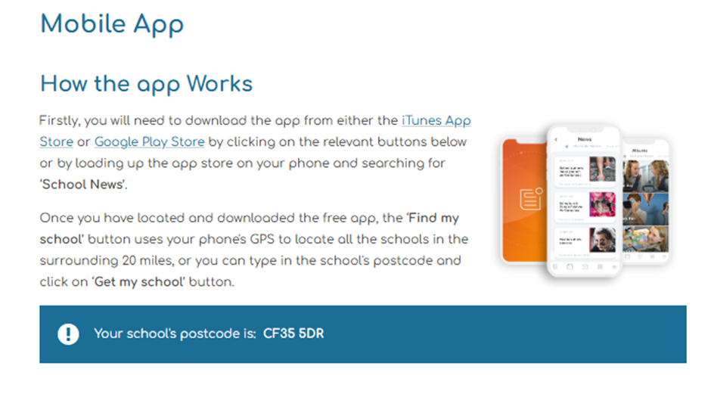
School News App

Slide 20
Handbook
Copies of our school Handbook are available to take away from today’s meeting.
All important information is located here.

Slide 21
Questions…
Please feel free to look around our classroom where we will be available to answer any questions you might have about life in Year 2 and 3.

