Slide 1


Welcome to
Year 4
www.llanganschool.co.uk llangan_primary_school
This presentation will be available on the school website > Year Group page

Slide 2
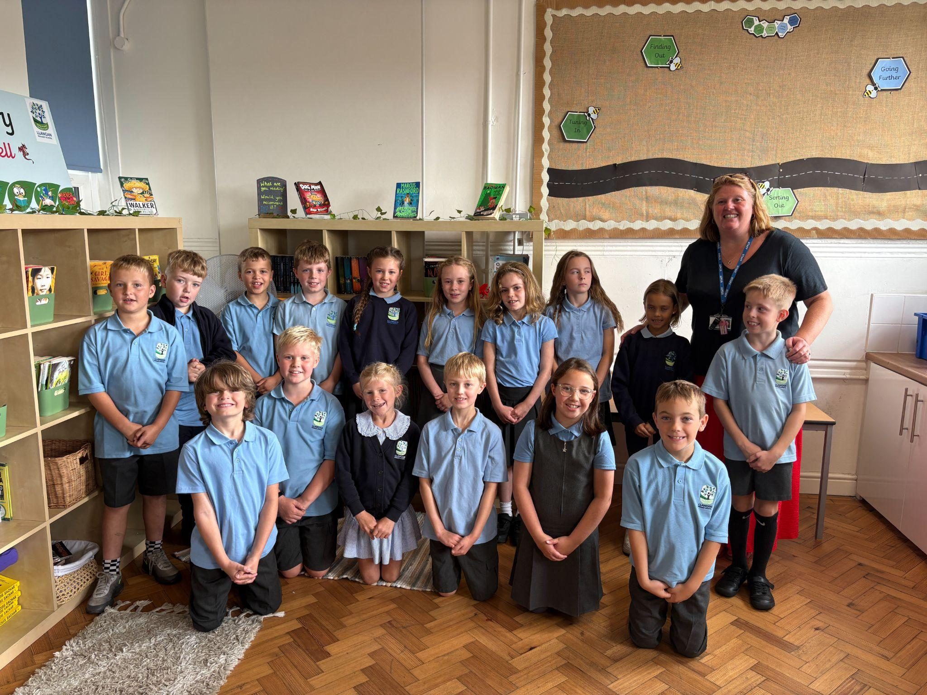
Meet the staff
Mrs Heavyside
Mrs Jarman-Davies
Tuesdays

Slide 3
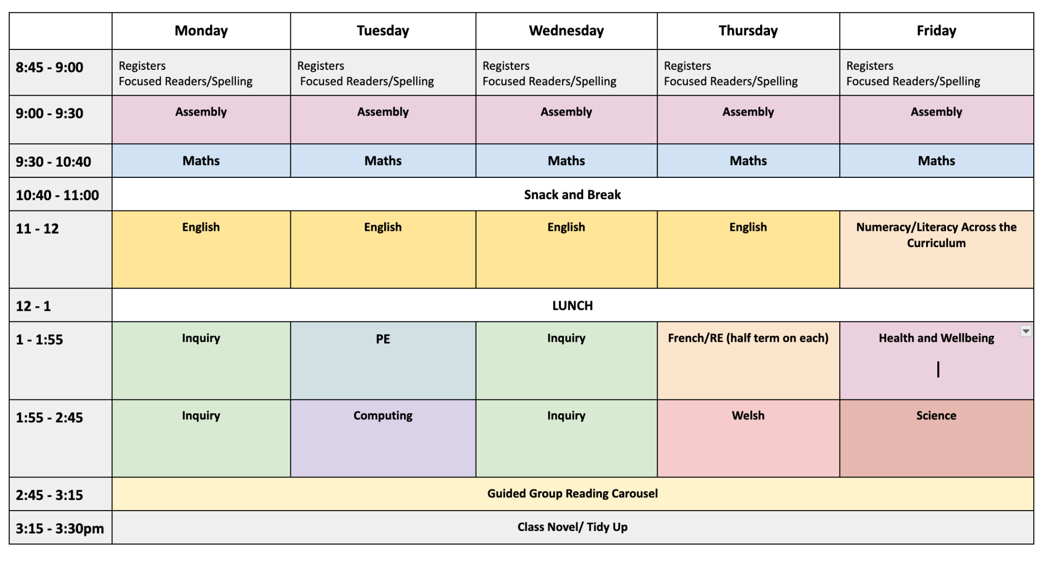
Y4 Weekly Timetable

Slide 4
Structure of the day
Breakfast Club
Early, paid breakfast club, 8am. Free breakfast club, 8:25am. Pupils must be registered to use our breakfast club provision. Speak to the office for further information.
AM
Gates open at 08:45 and close at 08:55.
Lessons begin promptly at 09:00
Mornings begin with assemblies, maths and literacy.
Break time is at 10:40 – 11:00, pupils may bring a healthy snack.
PM
Afternoon lessons focus on challenging, rich and open-ended inquiry questions. Pupils also have opportunities to apply the skills they learn in their maths and English lessons in new and broader contexts. Science, PE, Welsh, RE, French and computing also happen in the afternoons.

Slide 5

Outdoor Learning
Outdoor learning provision will be provided for all children with Mrs Stevens.This will take place for Year 4 in the second half term, on a Thursday.
Don’t forget, if the weather is wet or cold we still go outdoors! Please provide suitable clothing to wear, such as a waterproofs, a warm coat and wellies for the session.
We will inform you of any
specific requirements via
weekly class blogs.

Slide 6


Water & Snack
We are a healthy, and nut free school.
To help keep pupils focused throughout the day, please ensure your child brings:
A refillable water bottle with their name clearly marked. Water only please.
An optional healthy snack for break time, fruits and
vegetables only please.

Slide 7
School Lunches
School meals are free for all pupils at Llangan Primary. They may be pre-ordered via your ParentPay account.
There is a daily choice of:
a hot meal, a filled jacket potato or a filled wrap
dessert or yoghurt
A daily salad bar and bread basket and fruit are also available.
The menu is set by Big Fresh. As a school, we are unable to change the choices provided each day. If your child does not like anything on the menu, please ensure you provide a packed lunch for your child.

Slide 8
School Uniform
At Llangan primary school we strongly encourage pupils to wear school uniform. It encourages a sense of equality, pride and belonging in our school and local community. Please could parents ensure all children’s belongings are clearly labelled. Our uniform consists of:
Uniform | PE Kit
Grey trousers/shorts/skirt/skorts/pinafore Blue and white checked summer dress Light blue polo shirt Navy jumper/sweatshirt/cardigan Black shoes | Black/navy shorts T-shirt: White OR house colour (red/green/white) NO football/sports kits please
Parents can purchase uniform items embroidered with the school’s logo at the following outlets:
• The Pencil Case (Cowbridge)
• Uniform to go (Online)
• My Uniform (Online)

Slide 9

Dates for your Diaries
Mon 14th Sept: Roald Dahl Day - dress as a favourite character
Thurs 24th Sept: MacMillan Coffee Morning 9am
Fri 25th Sept: European Day of Languages (dress up details to follow)
Tues 29th Sept: Flu immunisations
Mon 5th Oct: Individual school photographs
Fri 9th Oct: Harvest Festival 2pm - 3:30pm
Thurs 15th Oct: Parents’ Evening
W.b. 19th Oct: Trip to St Fagans date TBC
Tues 20th Oct: Parents’ Evening
Weds 18th Nov: Jump out day (approx. 2pm)
Thurs 19th Nov: Residential - Cardiff Bay
Please check school calendar on our website!

Slide 10
Maths
Challenge increases in Year 4 to prepare for upper juniors, but pupils are given tasks that meet them at their current point of learning.
We will learn all times tables throughout the year
Numbers to 100,000
Developing competency and fluency in all four operations
Applied maths in real contexts: geometry, measures, statistics etc.
Focus on problem-solving and reasoning
Pupils will learning new skills in a concrete way, supported as needed before moving on to independently applying them.
Continue to support your child by using maths in everyday situations – e.g. budgeting, discounts, weights and measures, timetables.
Mathletics is assigned for homework but is also a great revision tool for times tables.

Slide 11
Literacy
Reading at home is still vital!
Books and new book bags will go home this week.
Y4 pupils will need increased independence and maturity as pupils begin to extend their writing. We will learn to join handwriting, use pen and write at length in different genres.
Use of tools such as a dictionary and a thesaurus to help independence.
Independently applying basic skills such as checking for full stops and capital letters.

Slide 12
Spelling
From next week, children will be put into spelling groups. Their spelling groups are to be found in the front cover of their Home Learning Logs.
New spelling words will be issued every Friday; they will be published on the school website class page.
Please support your child to learn their spelling words, including being able to write them in a sentence.
Children will be tested on their spelling words every Friday.
Spellings can also be found on Edshed.

Slide 13
Inquiry based learning
Each term, our learners focus on a specific area of the curriculum. This ensures that at Llangan, we spend plenty of time accessing exciting learning opportunities and we become experts in these areas.
The curriculum is split into six areas of learning and experience (AoLEs).
Language, Literacy and Communication
Maths and Numeracy
Humanities
Science and Technology
Expressive Arts
Health and Wellbeing
This term, we will be working on inquiries in the Humanities area of the curriculum. In Year 4, we will be focusing on ‘Kings, Queens and Presidents. Who decides who gets the power?’
A particular look at Tudors and modern day rulers.

Slide 14
Jump In/Jump Out
As part of our inquiry-based learning approach, each inquiry begins with a ‘Jump In’ Day and ends with a ‘Jump Out’ Day.
Jump In Day
A Jump In Day is an immersion day designed to spark curiosity and excitement about a new inquiry. Pupils take part in creative, hands-on activities that introduce the theme, explore big questions, and set the purpose for learning.
Jump Out Day
A Jump Out Day is a chance to celebrate learning at the end of an inquiry. Pupils share what they have discovered, created, and achieved. Parents and families are invited to join us, though each Jump Out Day looks different depending on the inquiry. It might be a performance, an exhibition, a presentation, or a practical activity.

Slide 15
Weekly events for Y4
Mrs Jarman-Davies on Tuesdays.
PE day is on a Tuesday. Your child may wear correct PE kit to school.
Spelling words are issued and tests carried out on Fridays.
Homework will be issued every two weeks, on a Friday. Homework is to be handed in a week and a half later, on a Wednesday, so it can be marked.
Homework will be explained to the children and will always be explained on the class page on our school website.
Each child will have a Home Learning Log Book. Please support us in our quest for excellence in presentation by insisting your child completes their learning to the highest standards.
Reading books in school every day please.

Slide 16
Attendance
Our new attendance target for each pupil is now 95.5%, but pupils should be aiming for 100% attendance!
Research consistently shows a direct link between attainment and attendance.
The local authority monitors the attendance of each child. Communication with parents if attendance drops below 90%. Possible referrals to the attendance team if poor attendance does not improve.
Term-time holidays are recorded as unauthorised absences in line with the Vale of Glamorgan expectations and our cluster school attendance policy.
If your child is absent from school, it must be reported via phone or an email to the office.

Slide 17

Punctuality
School opens at 08:45.
School starts at 08:55.
Registration closes at 9:00am.
Please aim for your child to be in on time everyday in order to avoid your child missing out on being introduced to their learning day.
Being punctual also helps other children from being disturbed.

Slide 18
Sign in/out
If you need to access the school site during the
day, please use the buzzer at the gate and
someone will assist you.
If you are late to school, or returning your child to
school after an appointment, you must report to the foyer and sign your child in to school using the iPad.
Similarly, if you need to collect your child early for an appointment, or if they are unwell, you will need to report the foyer and sign them out using the iPad.

Slide 19
Keeping in Touch
If you need to speak to a member of staff, please contact the school office via phone or email and we will get back to you as soon as possible.
Please do not pass on messages at the school gate; all absences and messages must be reported to the school office.
Staff are available at the end of each day (except Wednesdays) to chat through informal and brief issues. If you require to speak to a class teacher for a longer period, please make an appointment via the school office.
Please read the weekly class blog. It is linked in the Headteacher’s newsletter, and also available on the Year Group area of the school website. This is an important way of keeping up to date with what’s going on in class.
Important messages will be emailed.
School events are shared on our private Instagram account.
School News App.

Slide 20
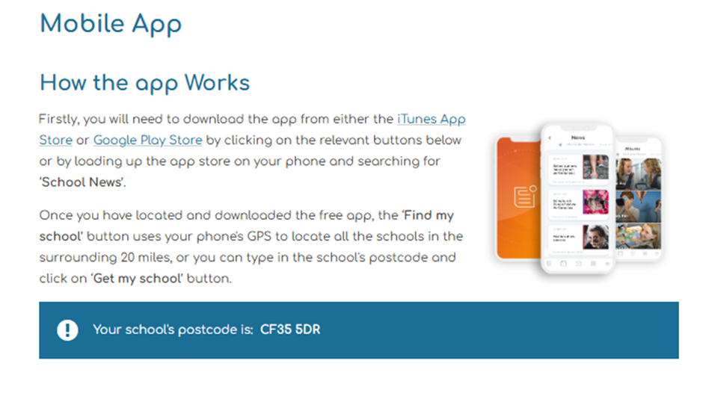
School News App

Slide 21
Questions…
Please feel free to look around our classroom where I will be available to answer any questions you might have about life in Year 4.
Diolch!

