Slide 1


Welcome to
Year 5
www.llanganschool.co.uk llangan_primary_school

Slide 2
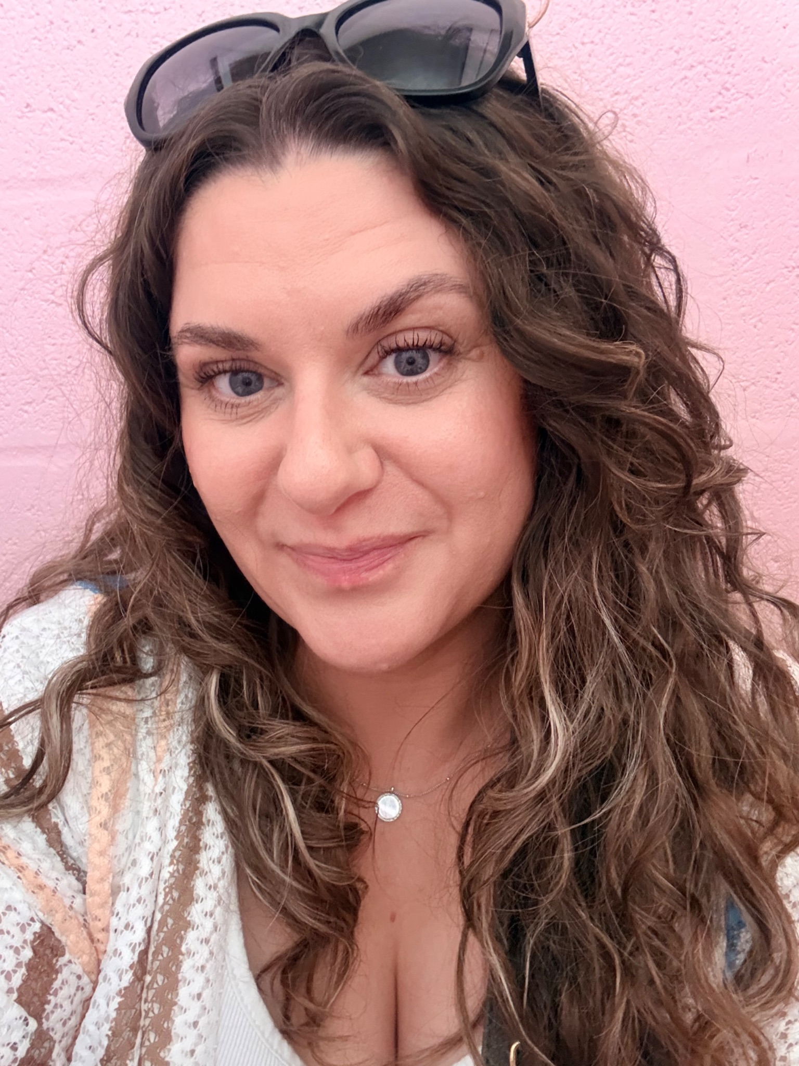
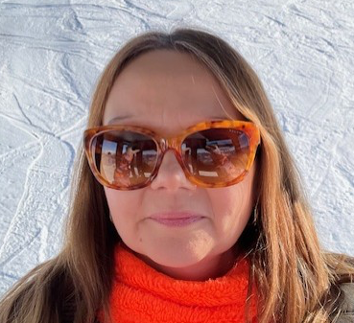
Meet the staff
Mrs Antoniou
Monday, Tuesday & Wednesday
Mrs Jarman-Davies
Thursday & Friday

Slide 3
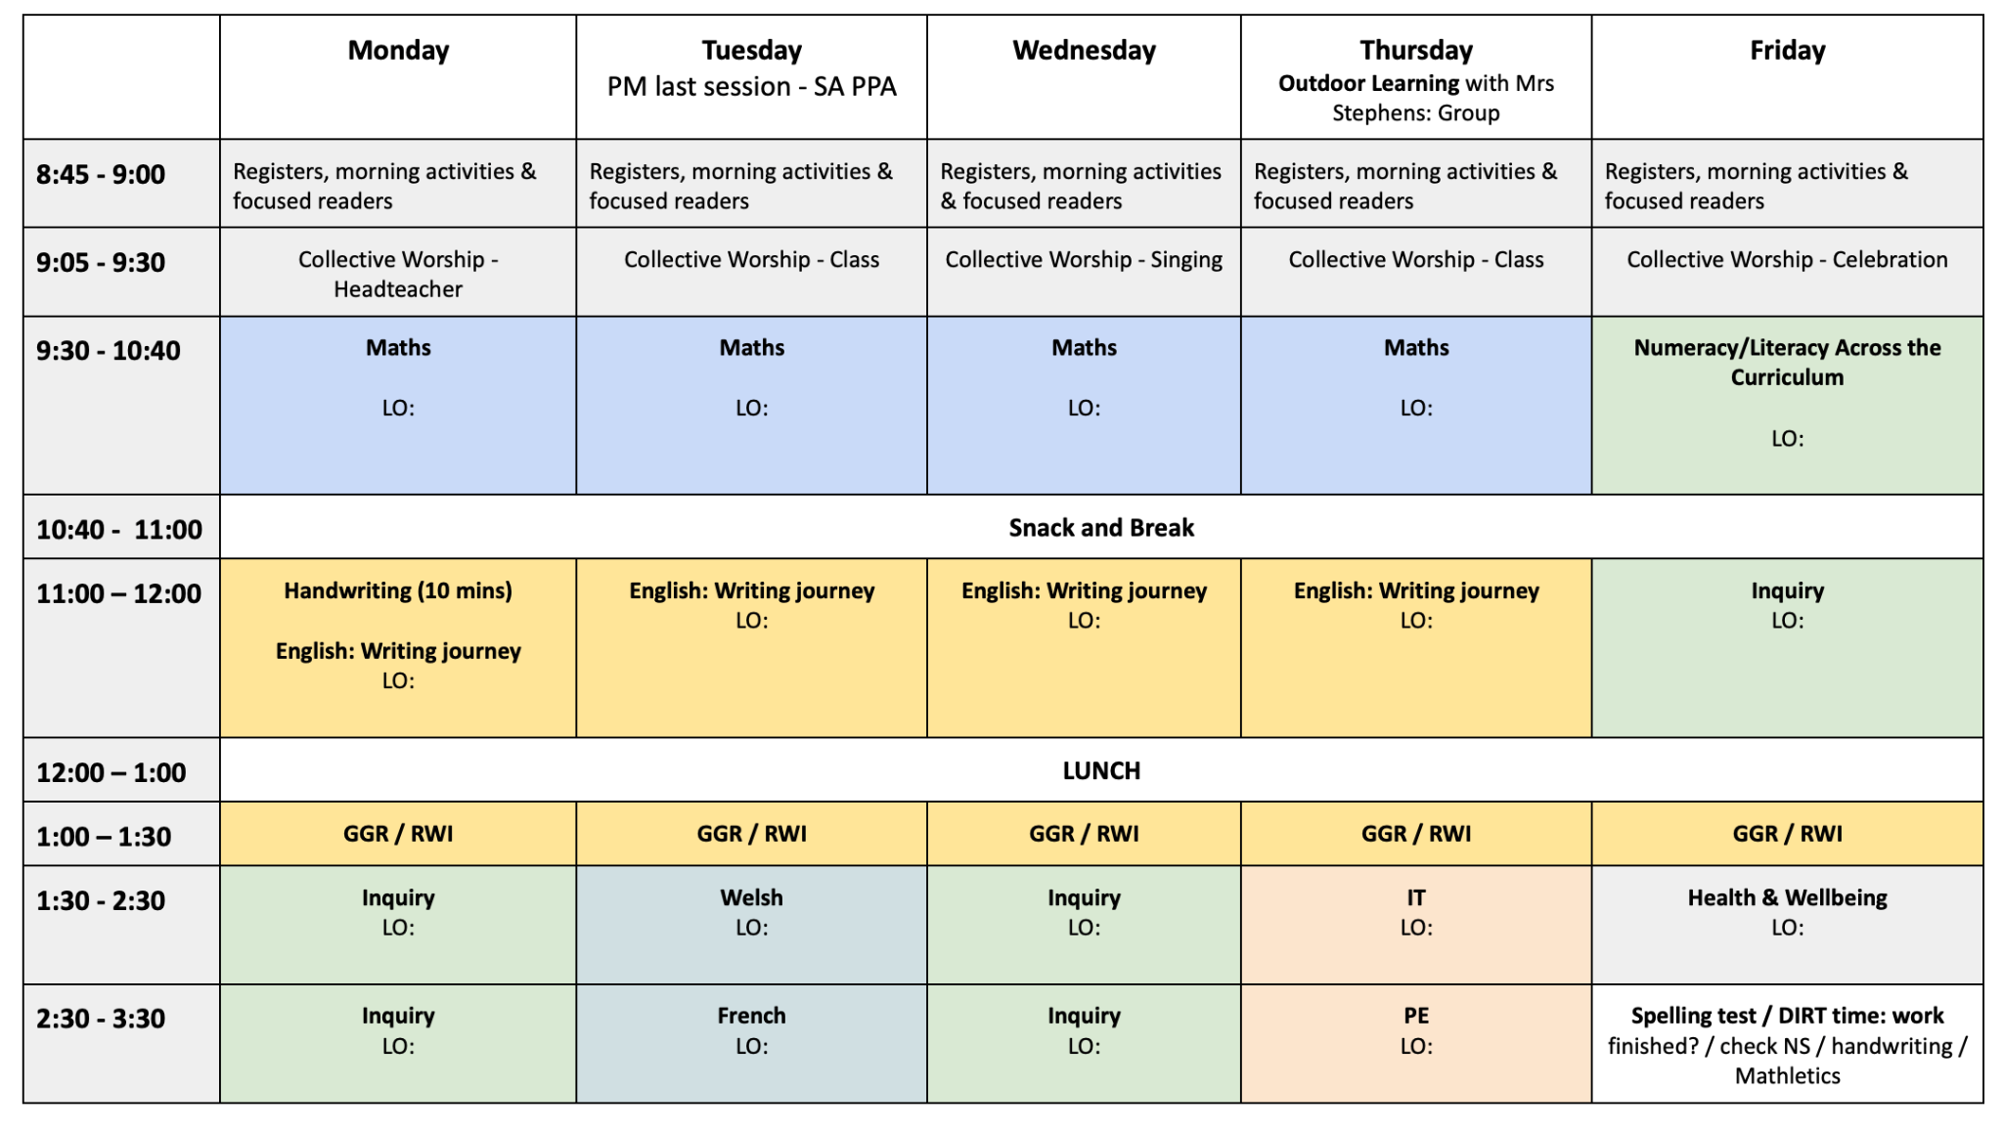
Y5 Weekly Timetable

Slide 4
Structure of the day
Breakfast Club
Gates open at 8:00am - 8:25am for paying pupils. Breakfast club is open for non-paying pupils between 8:25 - 8:45am. Pupils must be registered to use our breakfast club provision. Please speak to the office for more information on breakfast club.
AM
Gates open at 08:45 and close at 08:55.
Lessons begin at 09:00
Mornings begin with assembly, maths and numeracy, moving on to our writing journey
Break time is at 10:40 – 11:00 am, pupils may bring a healthy snack.
PM
Afternoons start with Guided group reading session. Followed by lessons which focus on challenging, rich and open-ended inquiry questions. Pupils also have opportunities to apply the skills they learn in their maths and English lessons in new and broader contexts. Science, Welsh, RE, ICT and PE also happen in the afternoon.

Slide 5
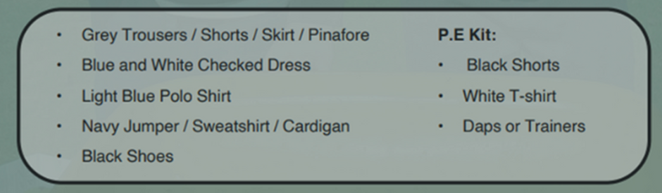
School Uniform
At Llangan primary school we strongly encourage pupils to wear school uniform. It encourages a sense of equality, pride and belonging in our school and local community.
Please could parents ensure all children’s belongings are clearly labelled. Our uniform consists of:
Parents can purchase uniform items embroidered with the school’s logo at the following outlets:
• The Pencil Case (Cowbridge)
• Uniform to go (Online)
• My Uniform (Online)

Slide 6

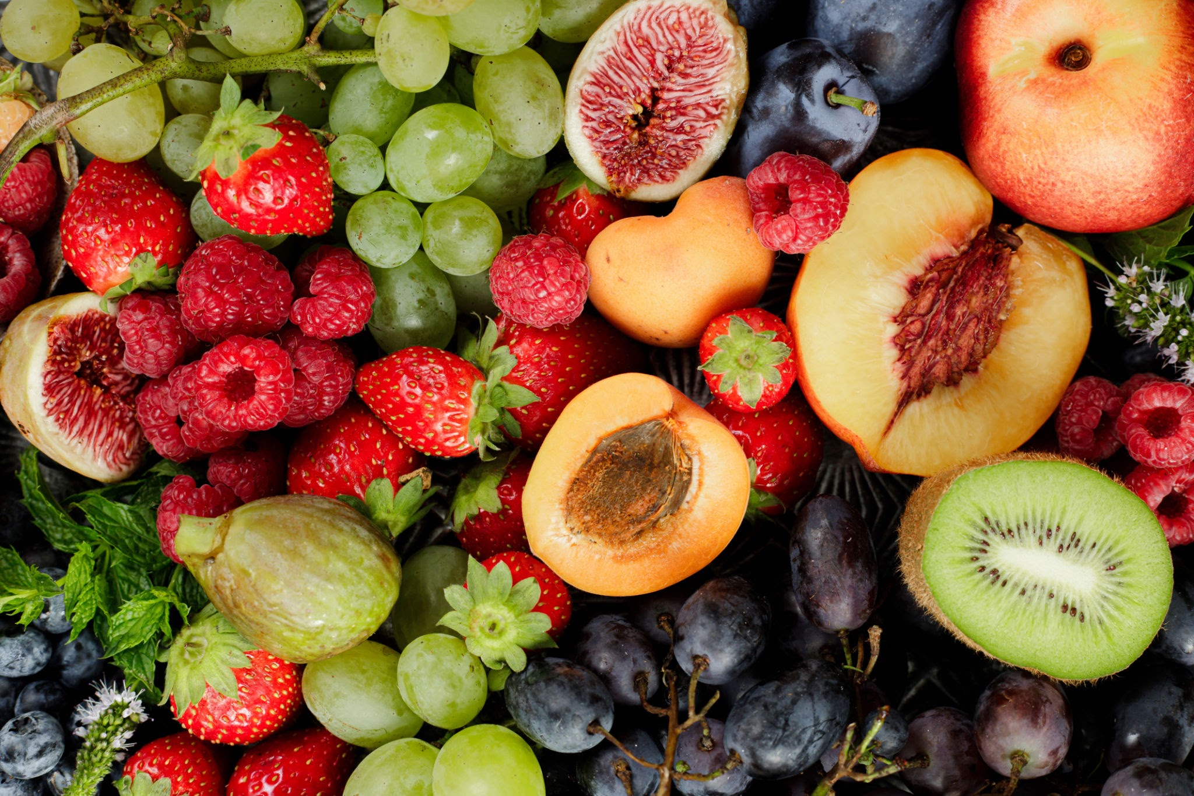
Water & Snack
To help keep pupils healthy and focused throughout the day, please ensure your child brings:
A water bottle filled with water to stay hydrated.
A healthy snack if they would like one for break time (e.g. fruit, vegetables, or a small portion of nuts or seeds).

Slide 7
School Lunches
School meals are free for all pupils at Llangan Primary.
They may be pre-ordered via your ParentPay account.
The menu is set by Big Fresh. As a school, we are unable to change the choices provided each day. If your child does not like anything on the menu, please ensure you provide a packed lunch for your child.

Slide 8

Outdoor Learning
Outdoor learning provision will be provided for all children with Mrs Stevens. This is a weekly session with a group, from each year group. These activities are taking place on a Thursday
Don’t forget if the weather is wet or cold please could they have suitable clothing to wear, such as a waterproof, warm coat, for their session.

Slide 9
Dates for your Diaries
Year 5 residential to Morfa Bay - Wednesday 9th - Friday 11th September
European Day of Languages - Friday 25th September
Harvest Festival – Friday 9th October
Parents evening – Thursday 15th October & Tuesday 20th October
Half Term: Monday 25th - Friday 30th October
Individual School photos - Monday 5th November
Please check the School News app for up-to-date events that will be happening in school.

Slide 10
Ready to Learn
Please make sure your child brings all the appropriate equipment to school each day. They are welcome to bring in a pencil case if they wish. Each child is allocated a tray. Their belongings are their responsibility.
Book bags MUST be brought to school each day. Your child will be reading every day and the book bag will also be used for storing letters coming home from school.

Slide 11
Maths
Help your child to learn their times tables. Please keep reinforcing other times tables they have learnt.
Recognise relationships between addition/subtraction and multiplication/division.
Learning skills in a concrete way, moving on to independently applying them.
Continue to use Maths in everyday situations – e.g. cooking, shopping, timetables
Mathletics
We use Mathletics to support our learning in school. Challenges are set according to the skills we are covering in class. Mathletics logins are needed and will be available in the front of their homework Learning Logs.

Slide 12
Literacy
All pupils are working at the level that is appropriate to where they are.
Reading at home is vital.
All pupils will be following a writing journey where they will have the opportunity to discover different genres and begin to build confidence and independence in their writing abilities.
They will use tools such as a dictionary and a thesaurus to help independence. As well as class supports such as word mats and word banks for sentence openers,
Check Edshed and Giglets for extra resources to support literacy at home. Log-ins for these will be provided and stuck in the front of their Homework Learning Log.

Slide 13
Spelling
Children will be allocated their spelling depending upon their latest Single word spelling test data.
Spelling words will be issued every Friday; they will be published on the school website class page and accessible through Edshed. These will be tested on a Friday.
Please support your child to learn their spelling words, including being able to write them in a sentence.

Slide 14
Inquiry based learning
Each term, our learners focus on a specific area of the curriculum. This ensures that at Llangan, we spend plenty of time accessing exciting learning opportunities and we become experts in these areas.
The curriculum is split into six areas of learning and experience (AoLEs).
Language, Literacy and Communication
Maths and Numeracy
Humanities
Science and Technology
Expressive Arts
Health and Wellbeing

Slide 15
Weekly events for Year 5
Mrs Antoniou is in class Monday to Wednesday. Mrs Jarman-Davies is in class on Thursday and Friday.
Our PE day is on a Thursday. Please ensure your child has the correct PE kit.
New spelling words are issued and tests carried out on Fridays.
Homework will be issued every two weeks, on a Friday. Homework is to be handed in a week and a half later, on a Wednesday, so it can be marked. Homework will be explained to the children. It will also be written on the class page on our school website and in their Home learning log.
Each child will have a Home Learning Log Book. Please support us in our quest for excellence in presentation by insisting your child completes their learning to the highest standards. This is work we want them to be proud of.

Slide 16
Attendance
Pupils should be aiming for 100% attendance!
Research consistently shows a direct link between attainment and attendance.
If attendance levels become a concern then this is communicated with parents by the Vale.
Term-time holidays are recorded as unauthorised absences in line Vale of Glamorgan expectations.
If your child is absent from school, it has to be reported via phone or an email to the office, not on the school gate or via a child.

Slide 17
Punctuality
Registration closes at 9:00am.
Please aim for your child to be in by this time in order to avoid your child missing out on being introduced to their learning day. Also being punctual helps other children from being disturbed.

Slide 18
Keeping in Touch
If you need to speak to a member of staff, please contact the school office via phone or email and we will get back to you as soon as possible.
Please do not pass on messages at the school gate; all absences and messages must be reported to the school office via e-mail or a phone call.
Staff are available at the end of each day (except Wednesdays) to chat through informal and brief issues.
Weekly newsletter and class blog is via the school website.
Please download the School News App.

Slide 19
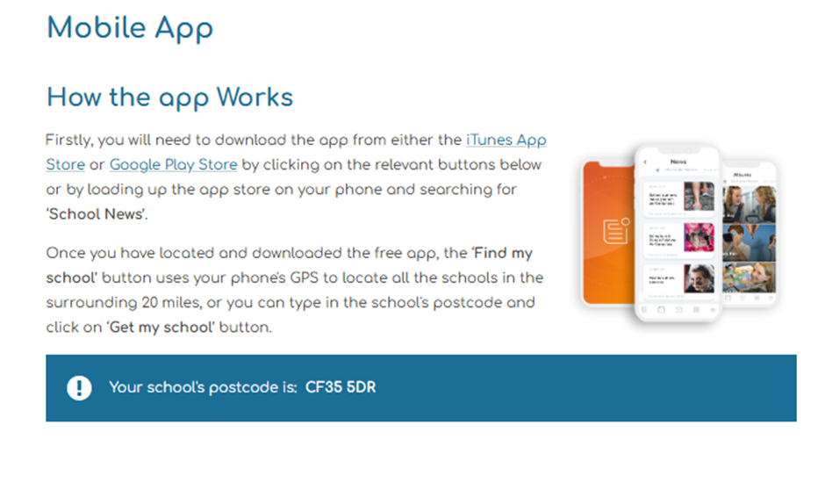
School News App

Slide 20
Handbook
Copies of our school Handbook are available to take away from today’s meeting.
All important information is located here.

Slide 21
Questions…
Please feel free to look around our classroom where we will be available to answer any questions you might have about life in Year 5.

