Slide 1
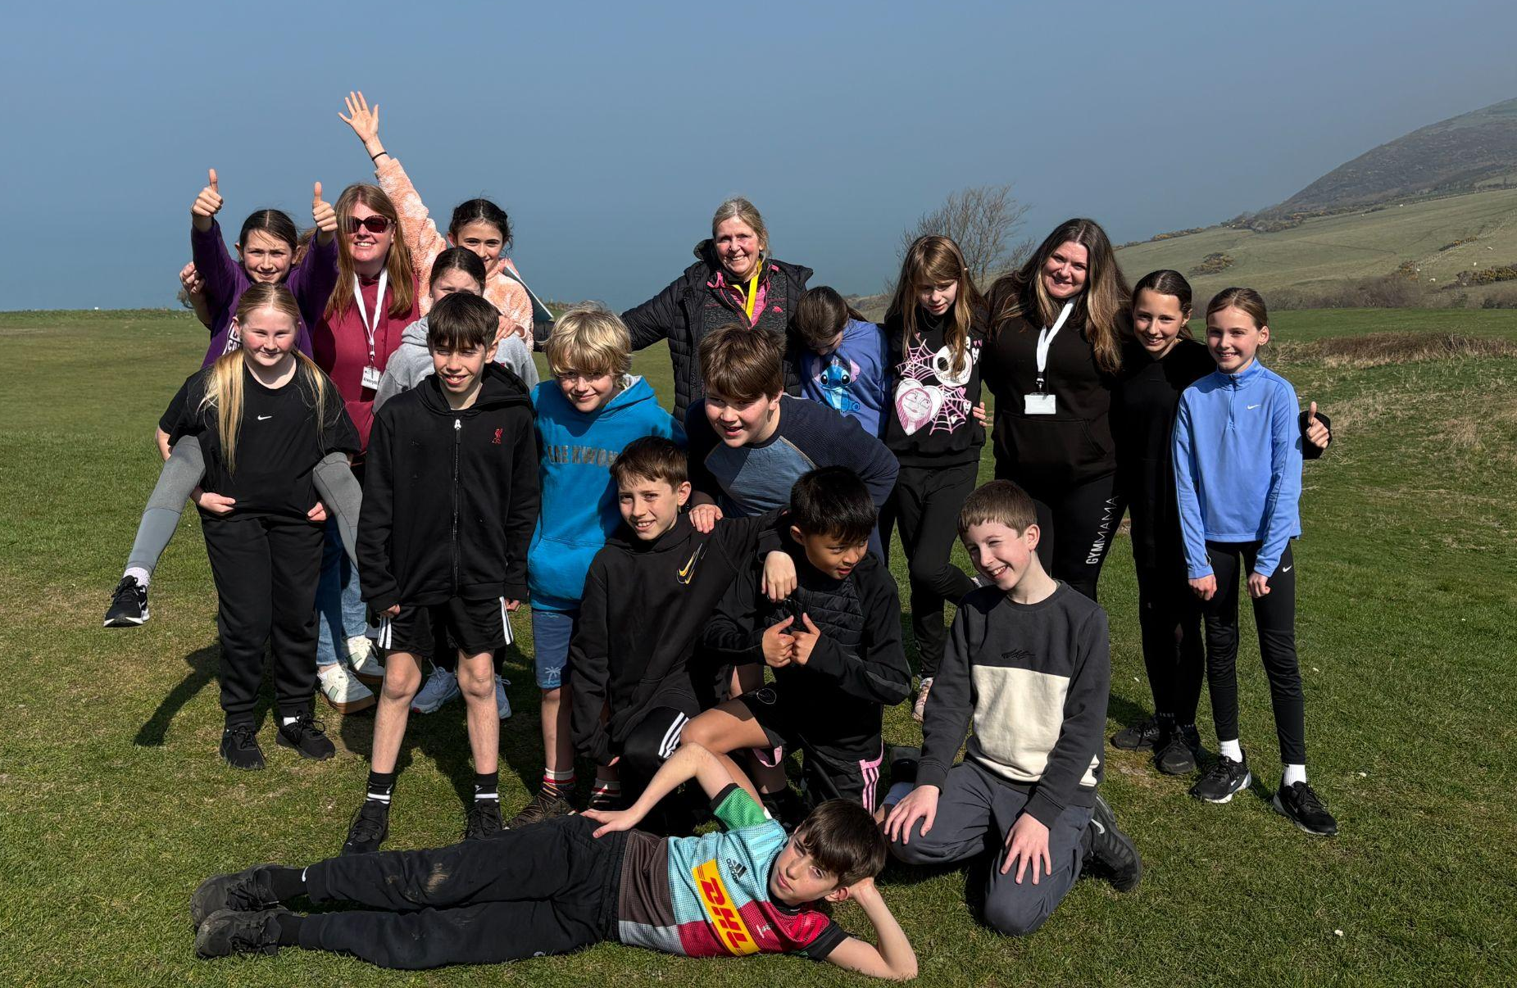

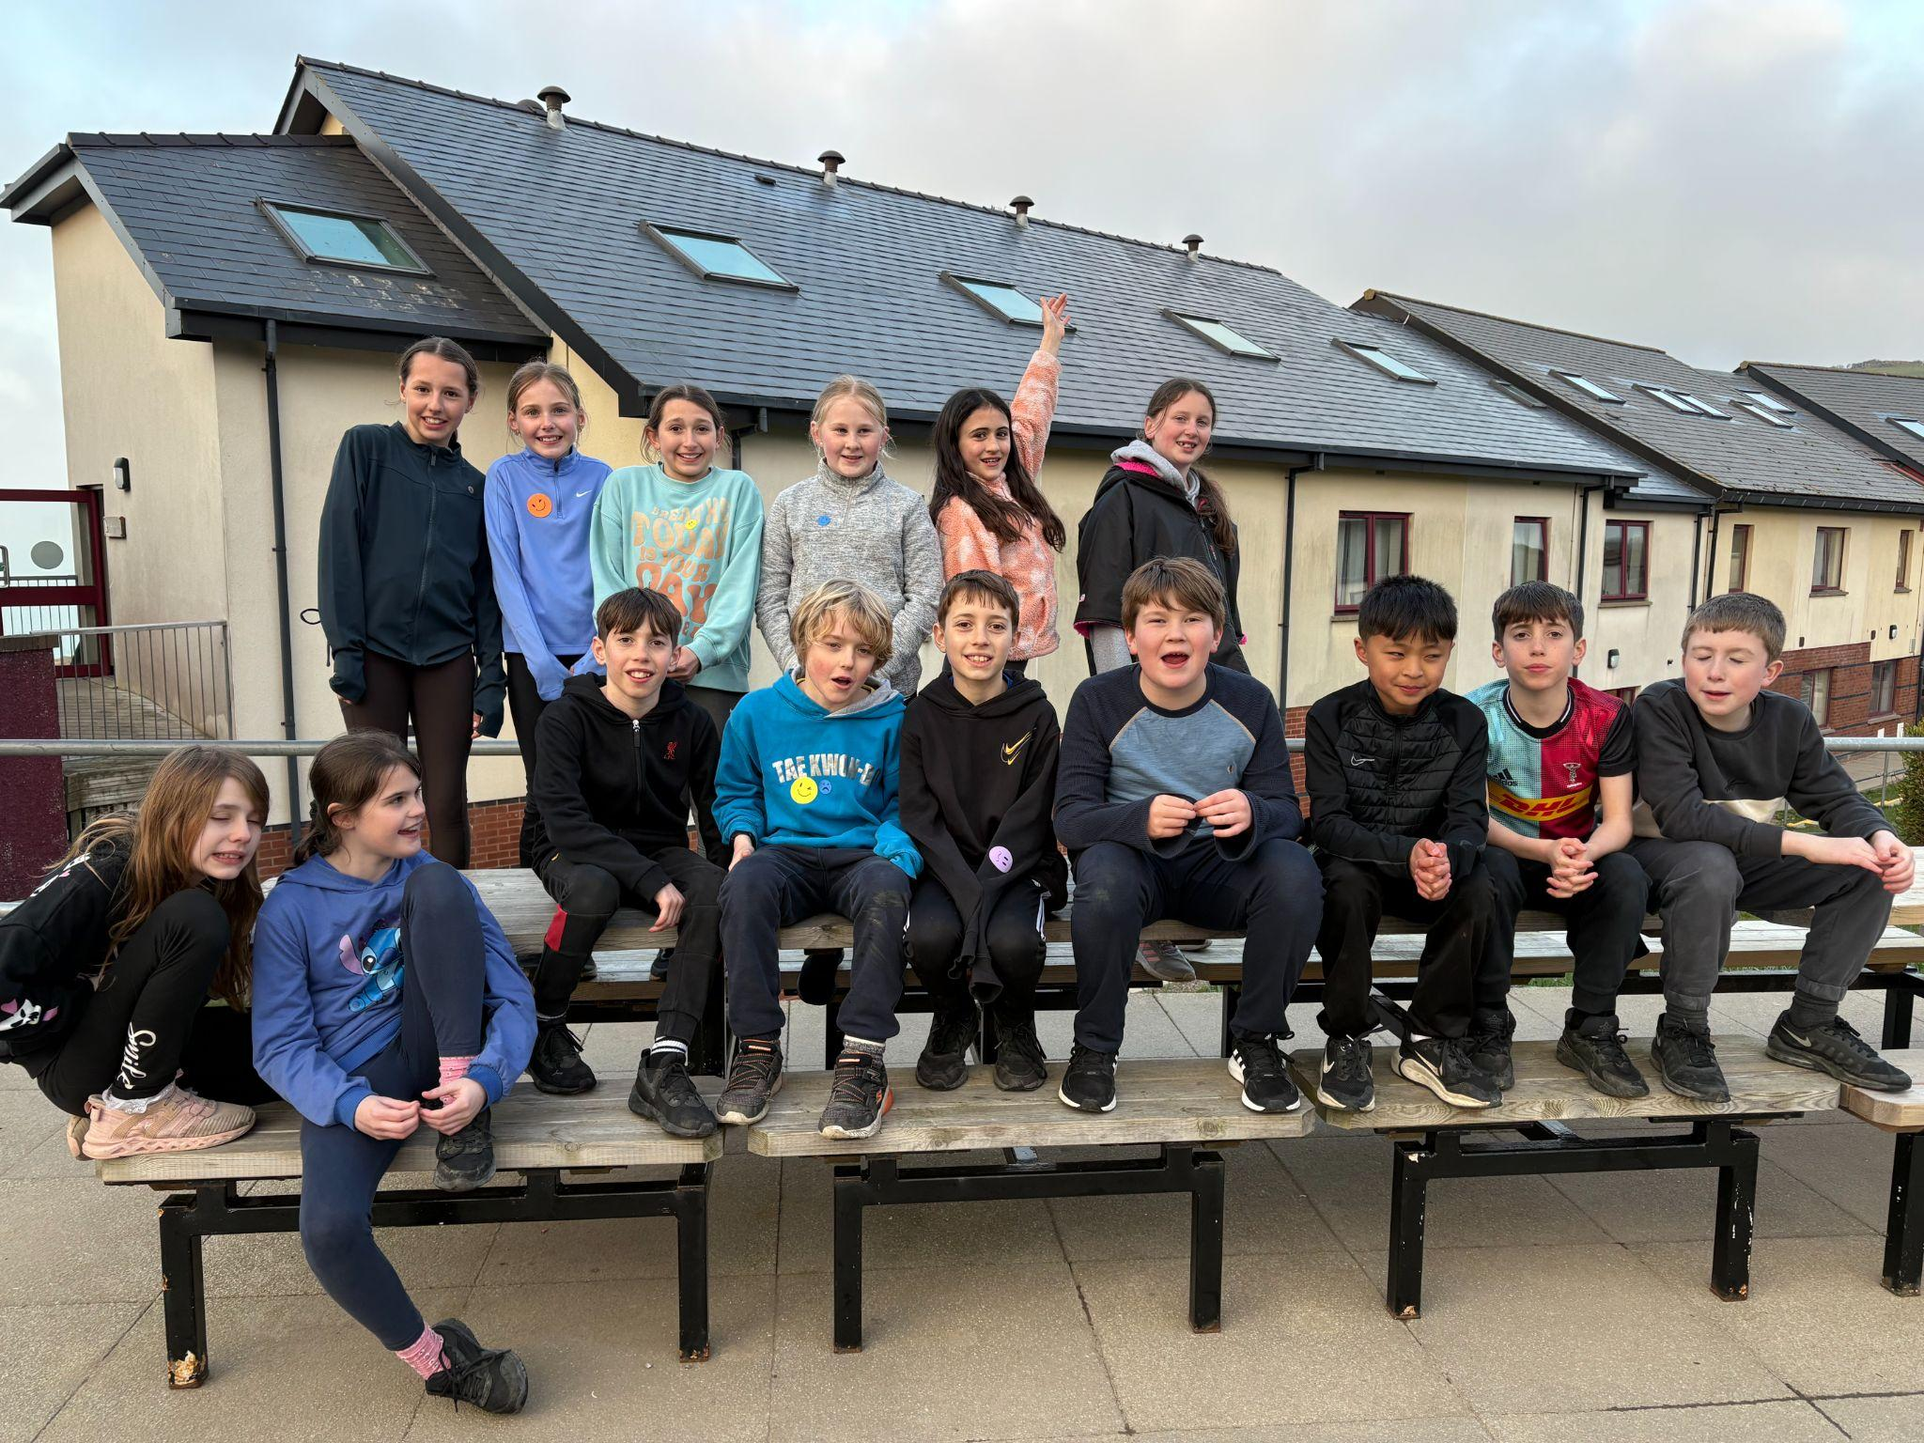
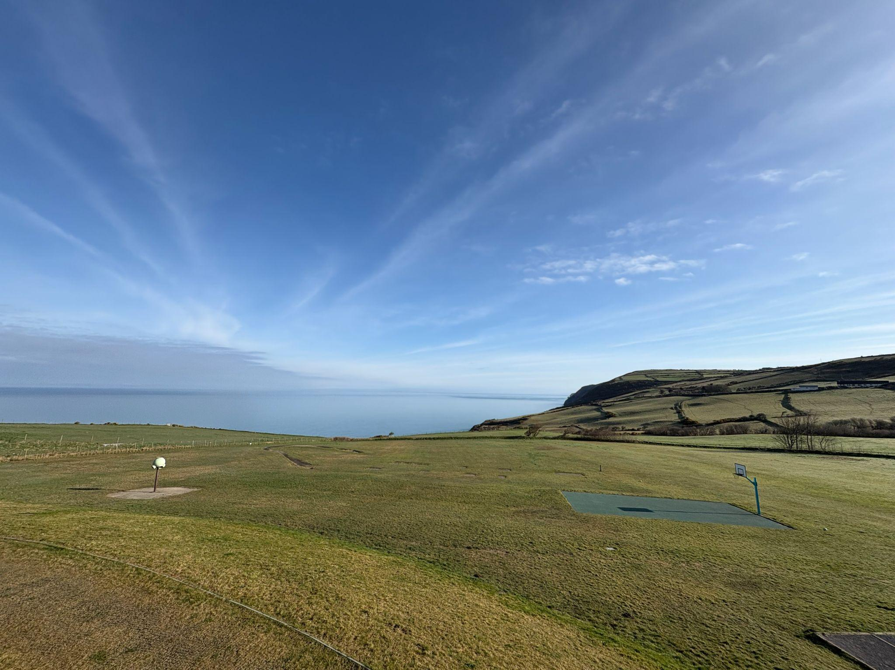
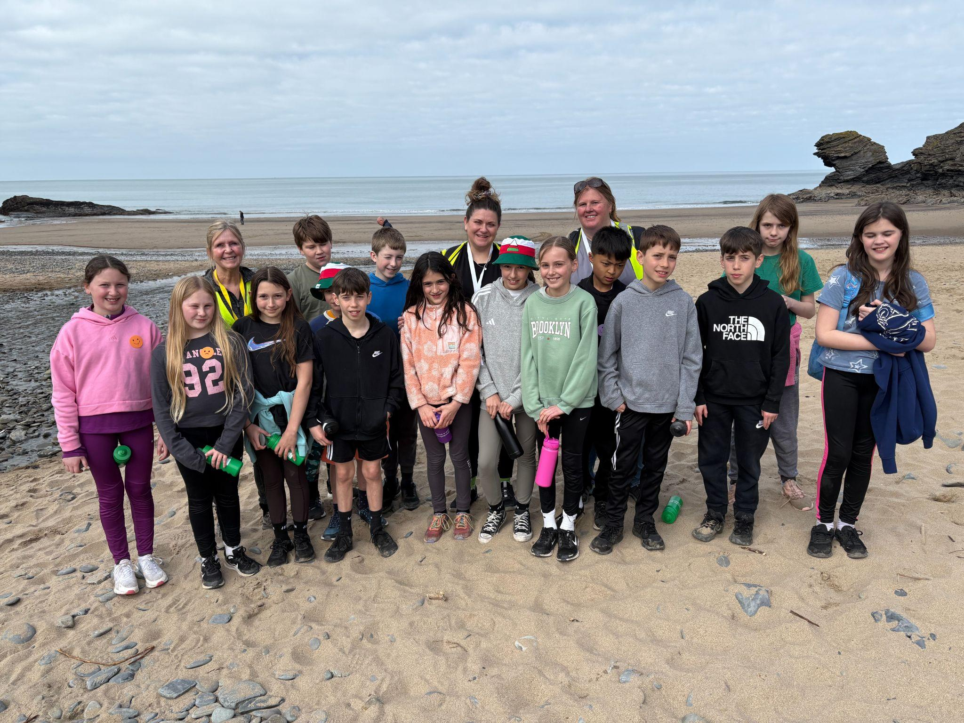
Llangan School
Year 6 Residential
Llangrannog
Parents Meeting 2026

Slide 2
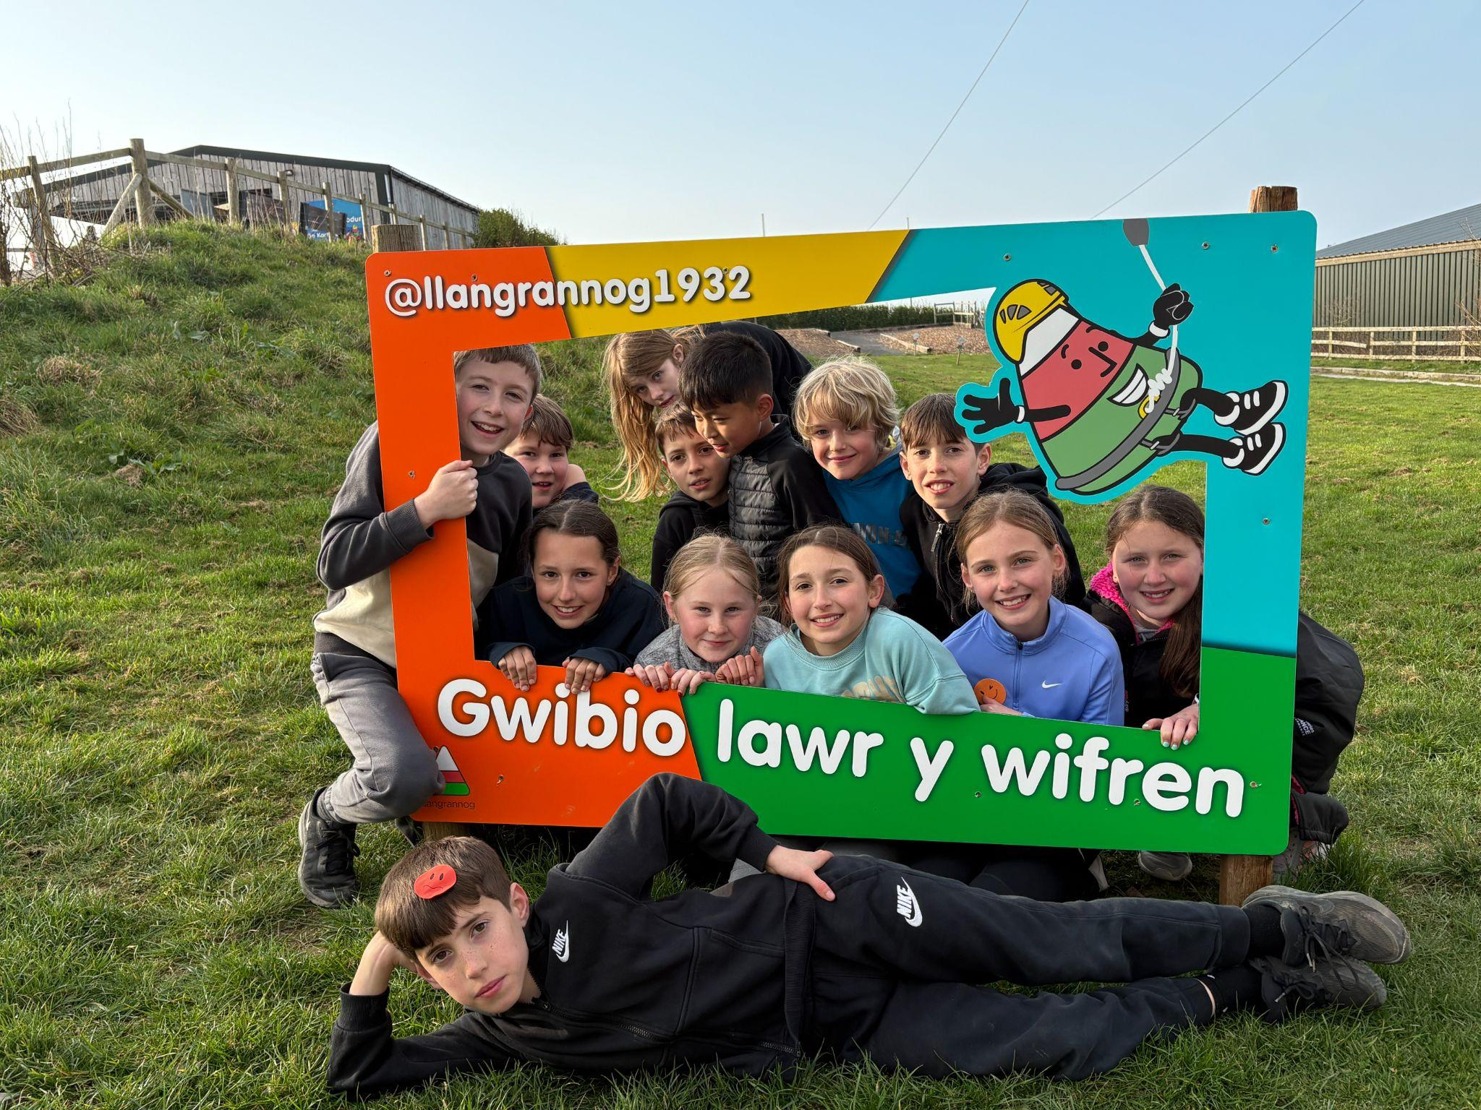
Residential aims
& benefits to you child
Aims of the Residential:
Encourage independence and resilience
Develop teamwork and communication skills
Build confidence through new challenges
Foster a love for outdoor learning and adventure
Create lasting memories with friends
Benefits for the Children:
Experience a range of exciting outdoor activities
Strengthen friendships and social skills
Learn problem-solving and leadership in real-life settings
Step out of their comfort zone in a safe, supportive environment
Have fun while developing key life skills
Notes:
When conducting research, it is easy to go to one source: Wikipedia. However, you need to include a variety of sources in your research. Consider the following sources:
Who can I interview to get more information on the topic?
Is the topic current and will it be relevant to my audience?
What articles, blogs, and magazines may have something related to my topic?
Is there a YouTube video on the topic? If so, what is it about?
What images can I find related to the topic?

Slide 3
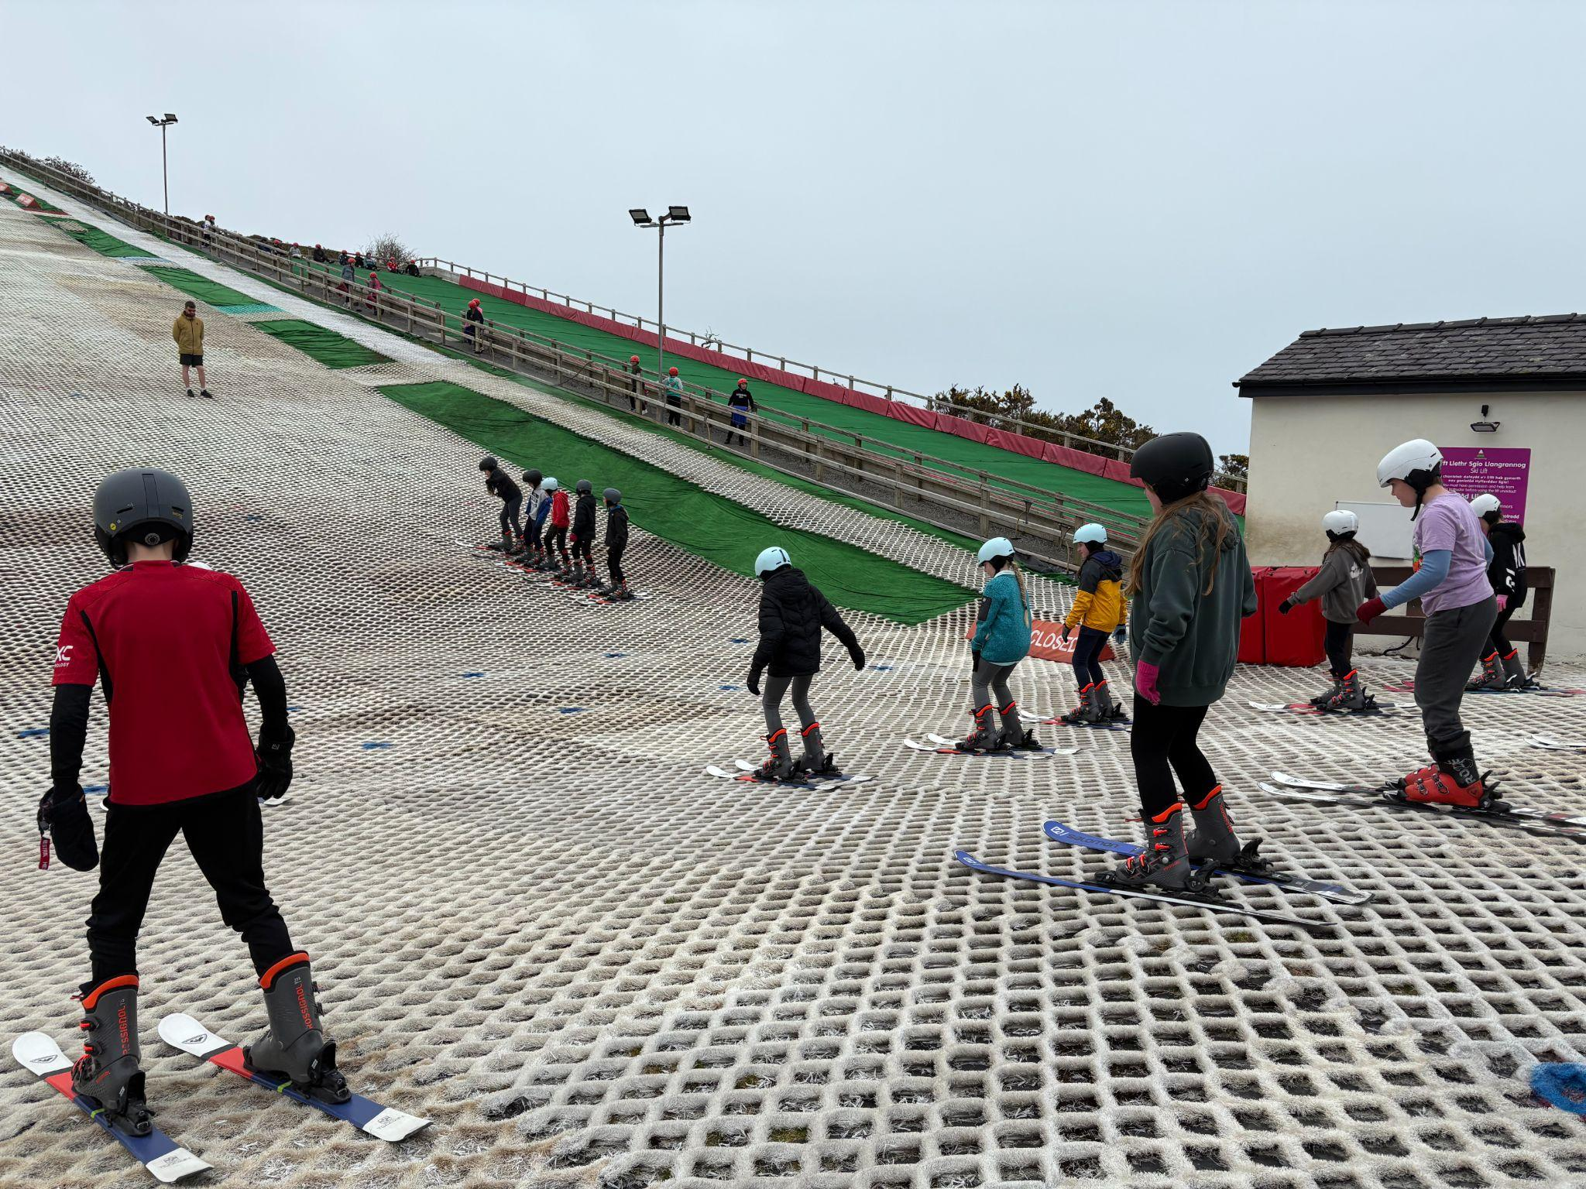
Llangrannog is an excellent opportunity for the children in Year 6 to meet with other children in their year group from other Cowbridge Comprehensive feeder schools.
The residential visit gives the children the opportunity to build friendship groups between the schools, and ease some of the apprehensions they may have about starting high school.
Notes:
.
The pre-reading stage
The first stage of development is the pre-reading stage. The responsibility of the teacher is to encourage reading interest with enjoyable experiences and activities, with an emphasis on oral expression. The principal goal at this stage is to ensure that the learner is socially, mentally, emotionally and physically ready to learn to read. Spatial development is important at this stage. The pupil is taught to recognize spaces between words and the descending order of the lines in a text. He or she learns to read from left to right. Oral expression is the focus of instruction, and the development of sight vocabulary which is taught using sentences, signs, labels, etc. Simple ideas are expressed and organized in order to create sentences. The formation of words, starting with consonants, and the recognition of rhymes by word endings, are all taught.
Beginning reading
At this stage of development, the learner must acquire an ability to recognize the letters of the alphabet, but not to memorize them. This is accomplished through a phonic approach, learning the sounds of the letters not just the names of them. A card with a picture of an ant on it and the letter ‘a’ helps to give meaning to the sound ‘a’. A child must have a natural ease with the alphabet in order to learn letter sounds and word spellings comfortably, and exercises that are fun as well as instructive can facilitate learning it. In Llangan we use Ben and betty phonics in nursery and follow the ‘’RWI’ through Foundation Phase into lower KS2. Pupils are placed into the phonics group appropriate for their stage.
Developing reading fluency
The third stage of reading development is reading fluency. At this stage of development, the pupil is prepared to identify words that he or she cannot pronounce and find the pronunciation independently, read simple stories and feel comfortable learning new concepts. Pupils begin to use context clues, using information in the story to guess the meaning of certain unknown words or ideas. In Llangan we use the 8 reading behaviour approach to develop fluency:
Activate prior Knowledge
Visualise
Question
Self-monitor
Analyse and connect
Analyse and infer
Analyse and evaluate
Analyse and summarise
Materials need to be very diverse. Thee pupil is better able to make use of various texts, such as travel brochures, pictures, stamps from countries around the world and washing directions on clothes labels. It is very important, therefore, to make sure that the materials challenge the pupils and are relevant to the lessons, and that they continue to reflect the images and the interests of the children.

Slide 4

Y6
Residential
Travel Arrangements
The coach will depart from Llangan Primary School Wednesday 11th March at 8am PROMPTLY.
Please be in school at 7:50am at the latest.
We leave Llangrannog at 1pm, with the aim of arriving at Llangan Primary School at roughly 4pm on Friday 13th March. We will keep you updated via the usual channels if this changes.

Slide 5
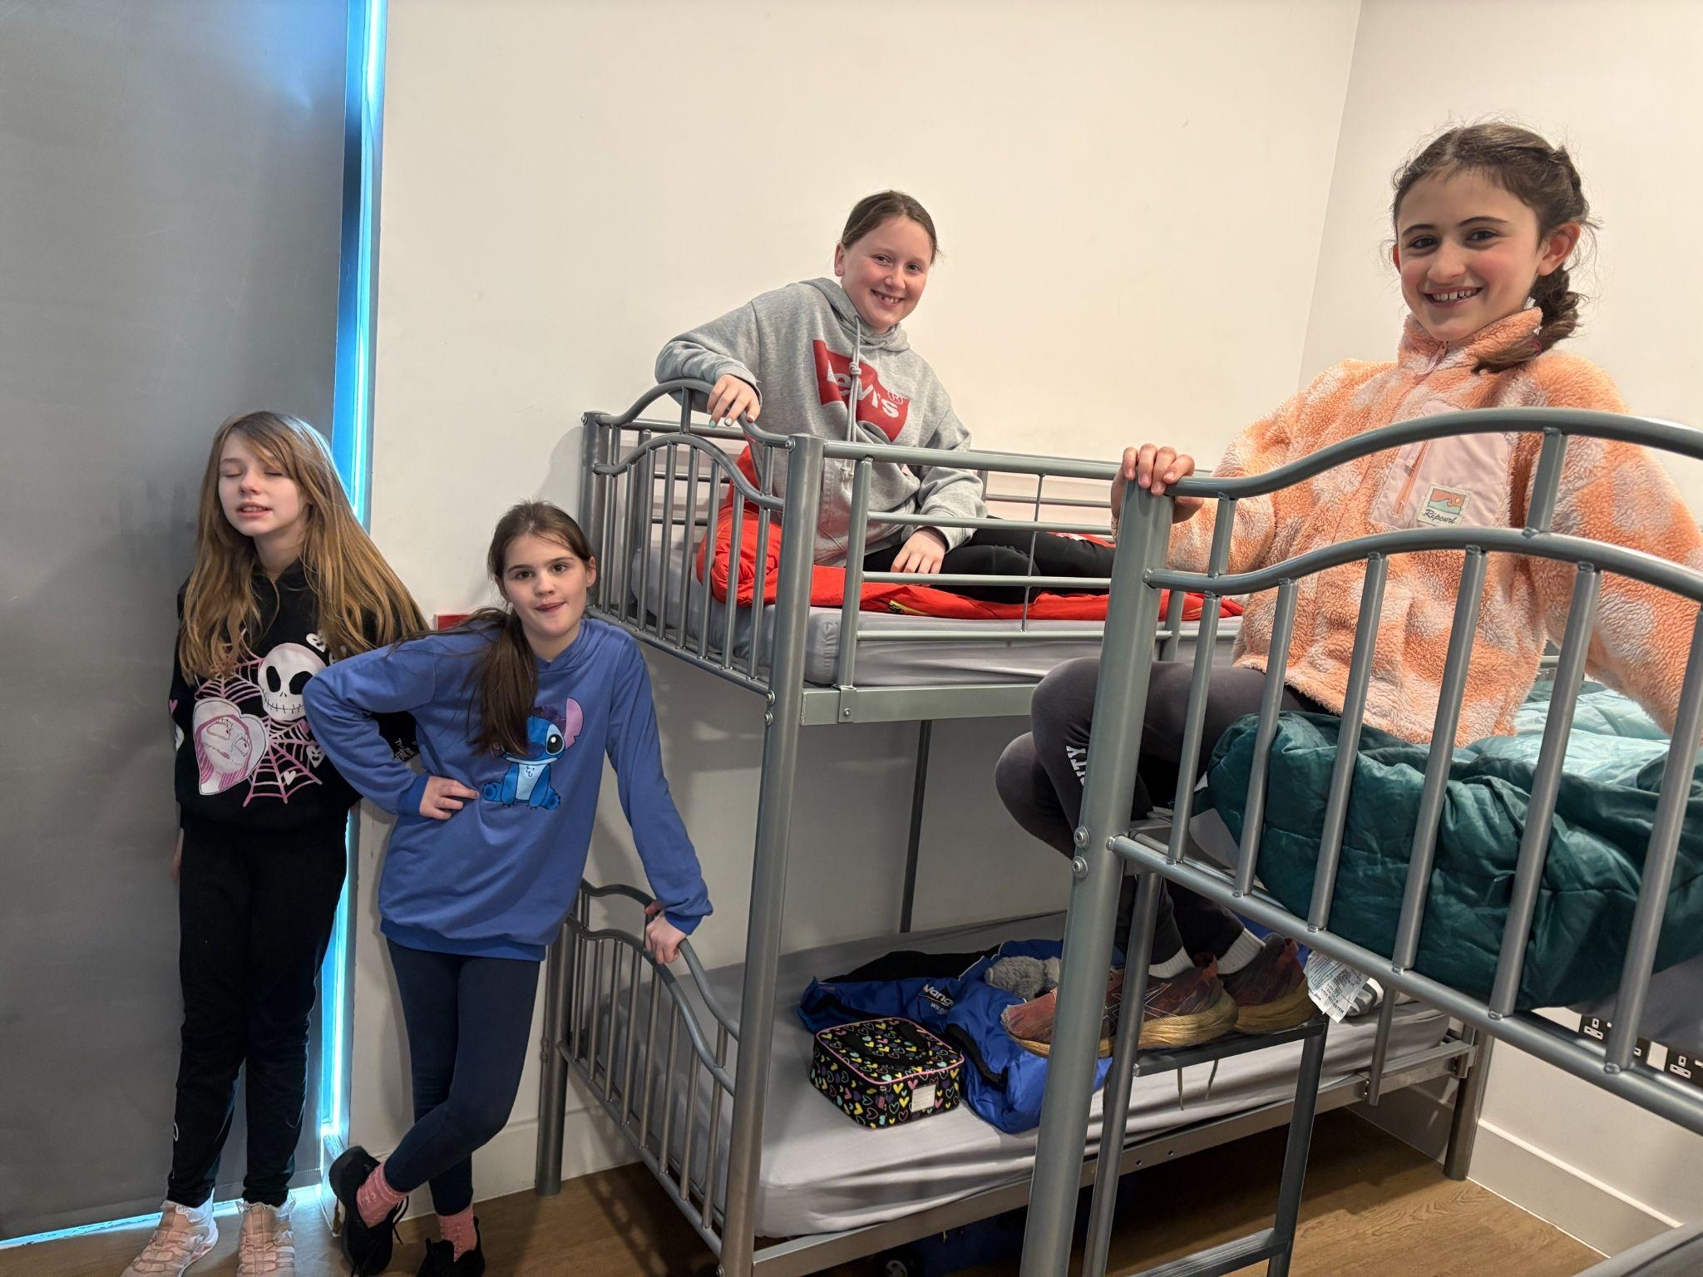
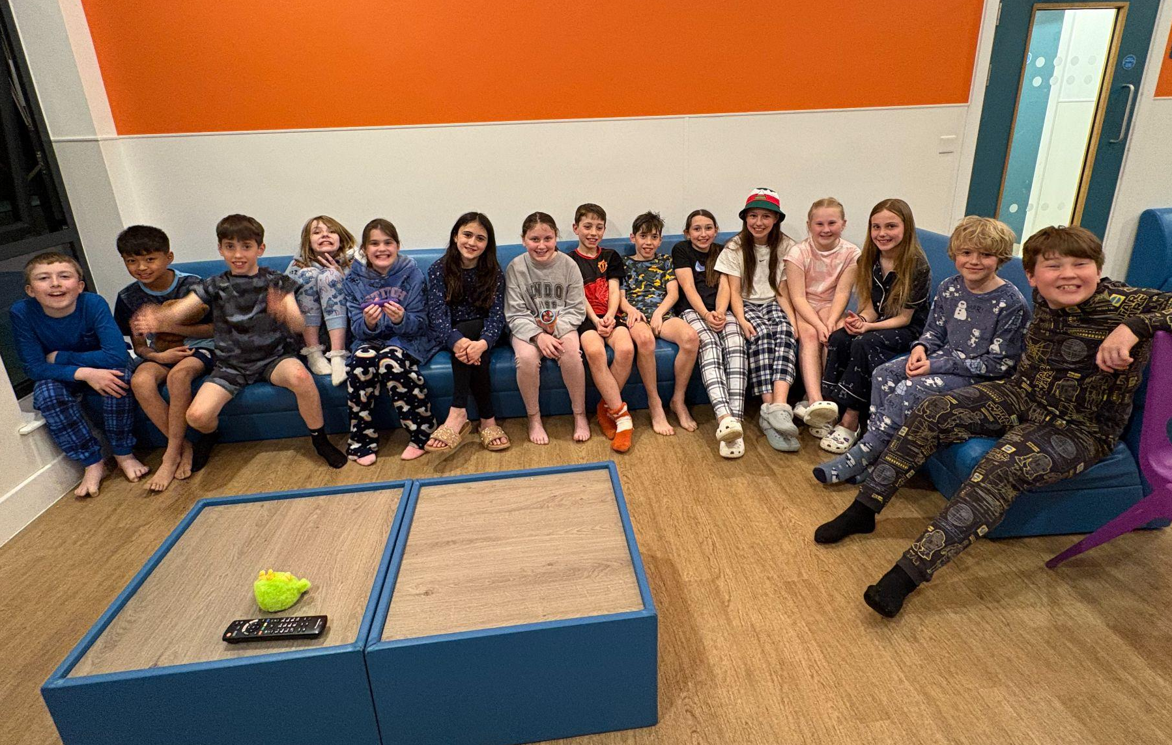
Sleeping Arrangements
Rooms and sleeping
Separate secure rooms for Llangan boys and girls. Only our staff and the children have access to the sleeping accommodation.
Each room has an en-suite bathroom.
Rooms have an occupancy of 4, 6 or 8.
There will be 2 rooms for the boys, 1 room for the girls.
We will ensure children are in a room with their friends and are happy with who they are sharing with.
Staff rooms are nearby, and children can access support overnight.
Mattresses and pillows are provided, sleeping bags are needed.
We have a nightly ‘Team Llangan meeting’ where we wind down together and reflect on the day before bed.
Llangan staff are very experienced with helping children on residential trips and are on hand 24 hours to ensure everyone is settled and has enough sleep.

Slide 6
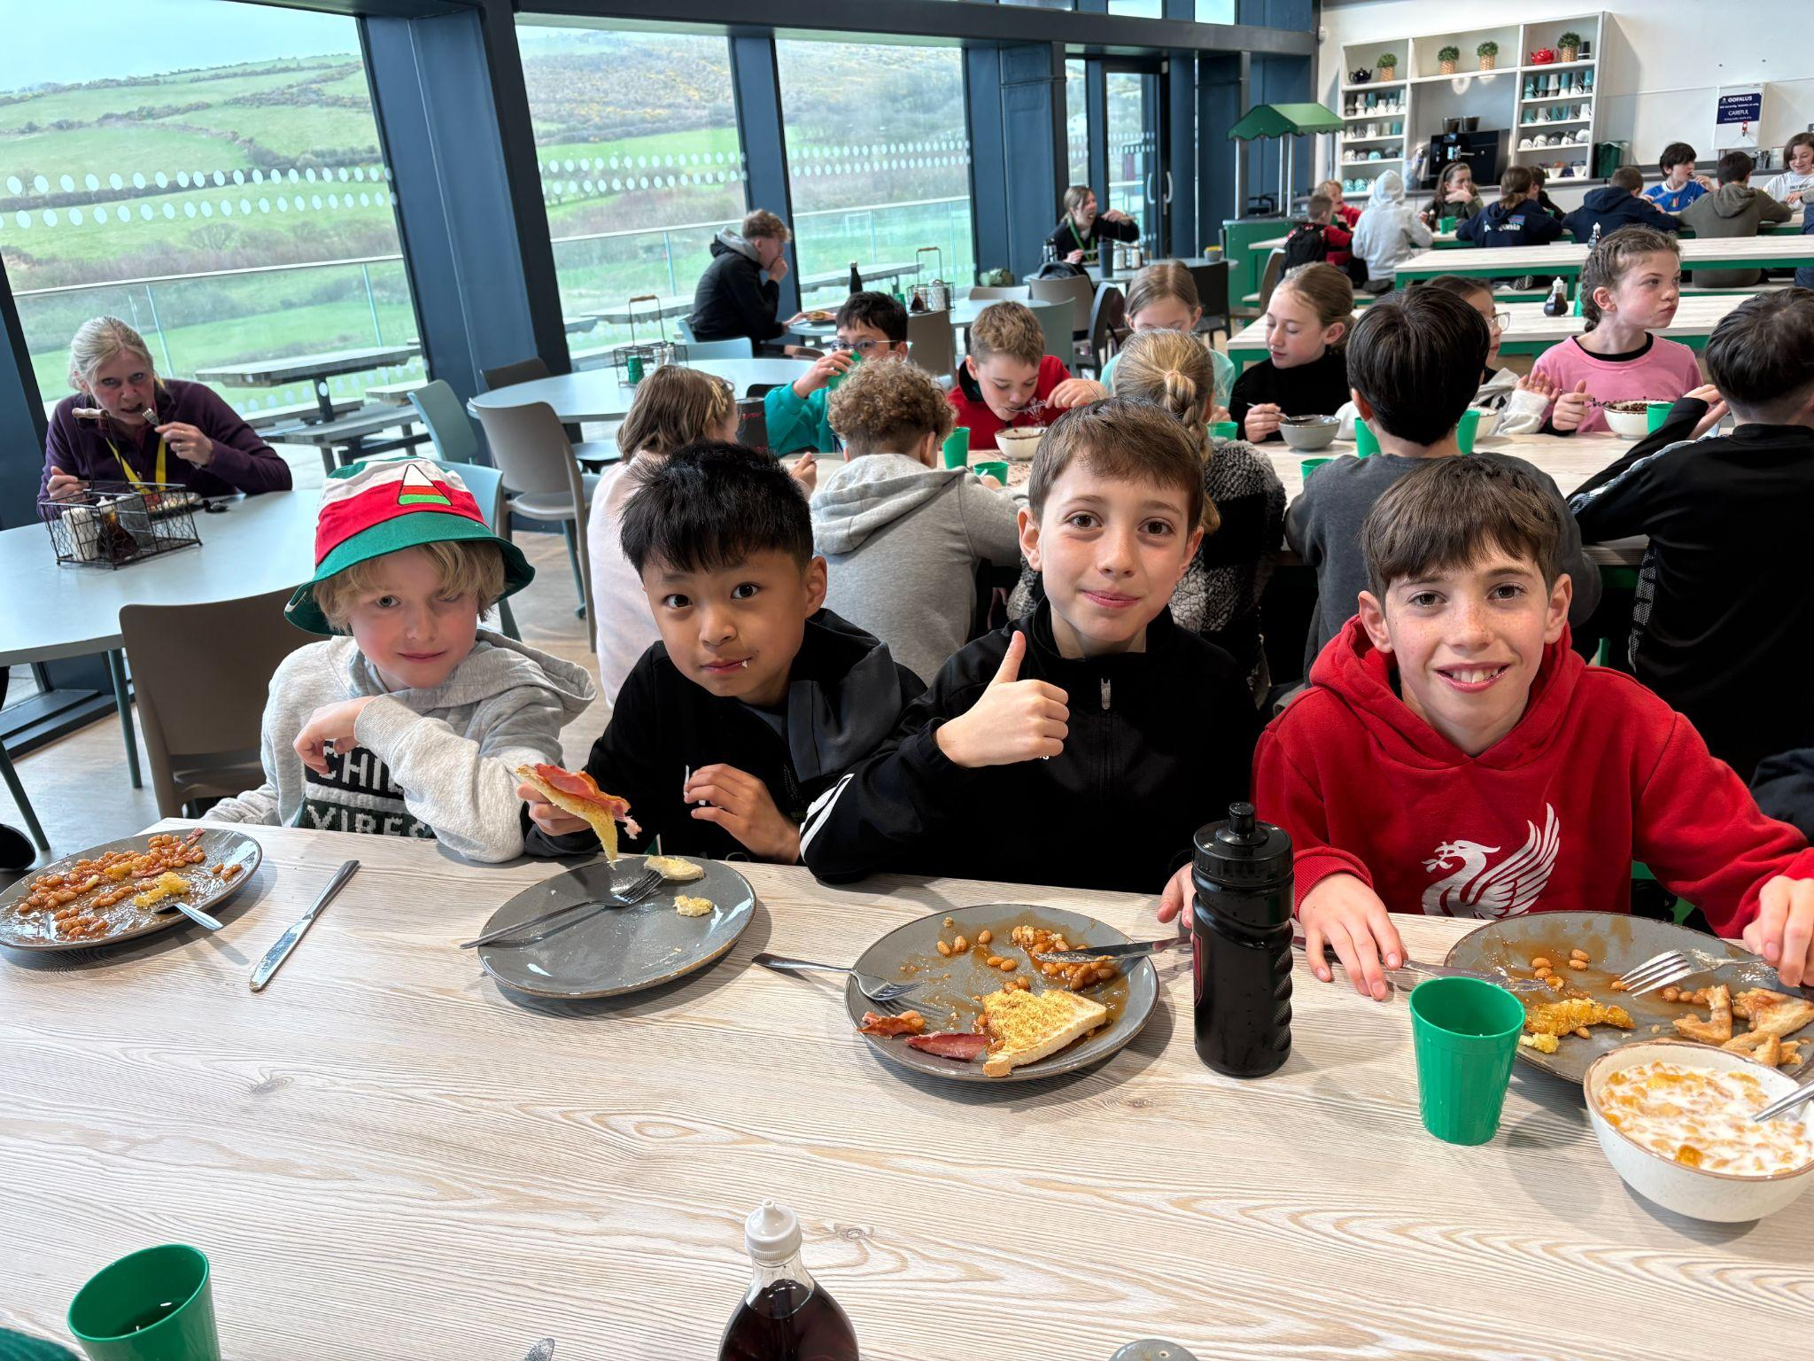
Food and Mealtimes
Meals & Dietary Requirements
Four daily meals: breakfast, dinner, tea, and supper, with healthy options for all. Salad bar available at every meal.
Canteen style with several options and choices available at each meal. Really is something for everyone.
Catering staff are amazing at Llangrannog, they will make toast/sandwiches/chips etc. for anyone that is struggling with food choices.
Food Hygiene Rating: 5 (Food Standards Agency).
Special dietary needs (e.g., allergies, gluten-free, diabetic) are catered for - please inform us at least a week in advance and ensure this is noted on your Llangrannog forms.
Vegetarian options are always available.
Squash and water are freely available throughout our stay.

Slide 7
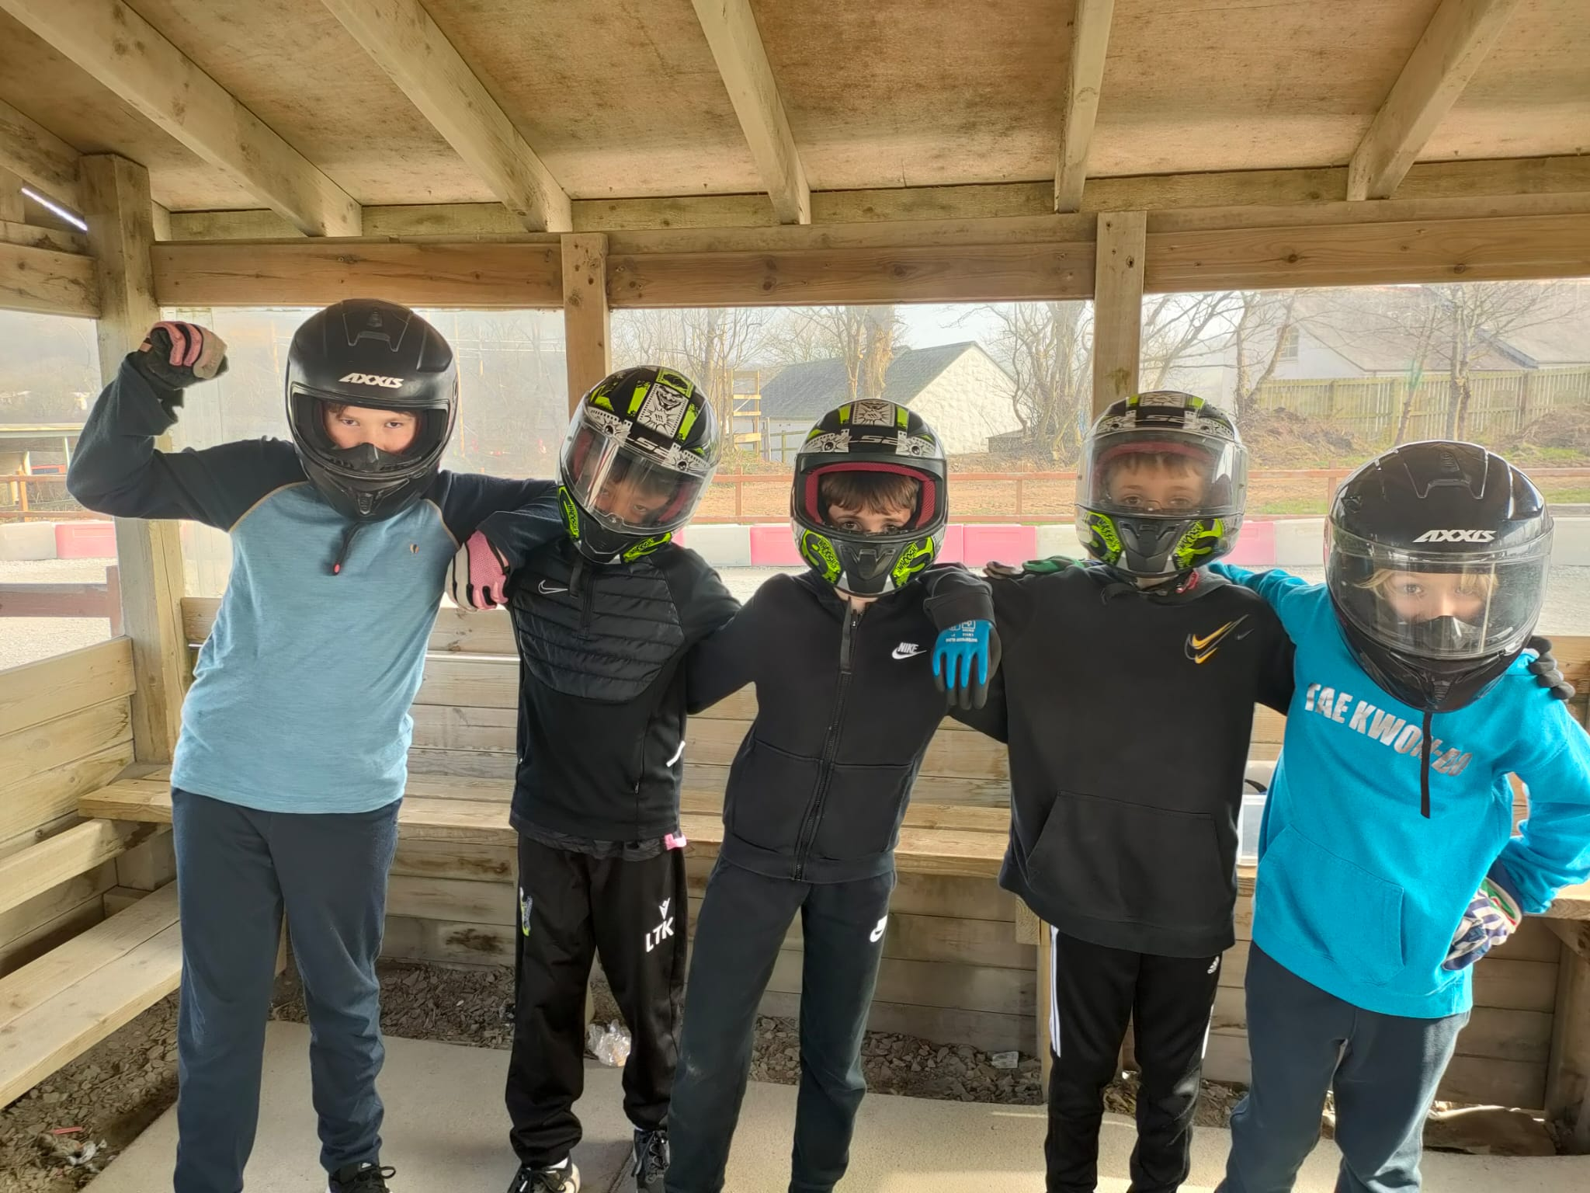
Safety and Security
Accompanying staff: Mrs Antoniou, Mrs Jones, Mrs Heavyside
Llangan children children are with Llangan staff at all times.
Llangrannog is a secure, monitored site, ensuring children’s safety at all times.
24 hour security on site.
All risk assessments are in place and have been approved by the Local Authority.
All Llangrannog staff are DBS checked and have appropriate health and safety training and certification.
All appropriate safety equipment and specialist equipment is provided.
In case of emergency:
  we will make contact. Staff have access to all emergency numbers and will call you if there are any concerns at all.
  basic first aid (including calpol/antihistamine etc.) will be administered on site.
  pupils will be taken to A&E locally if necessary

Slide 8
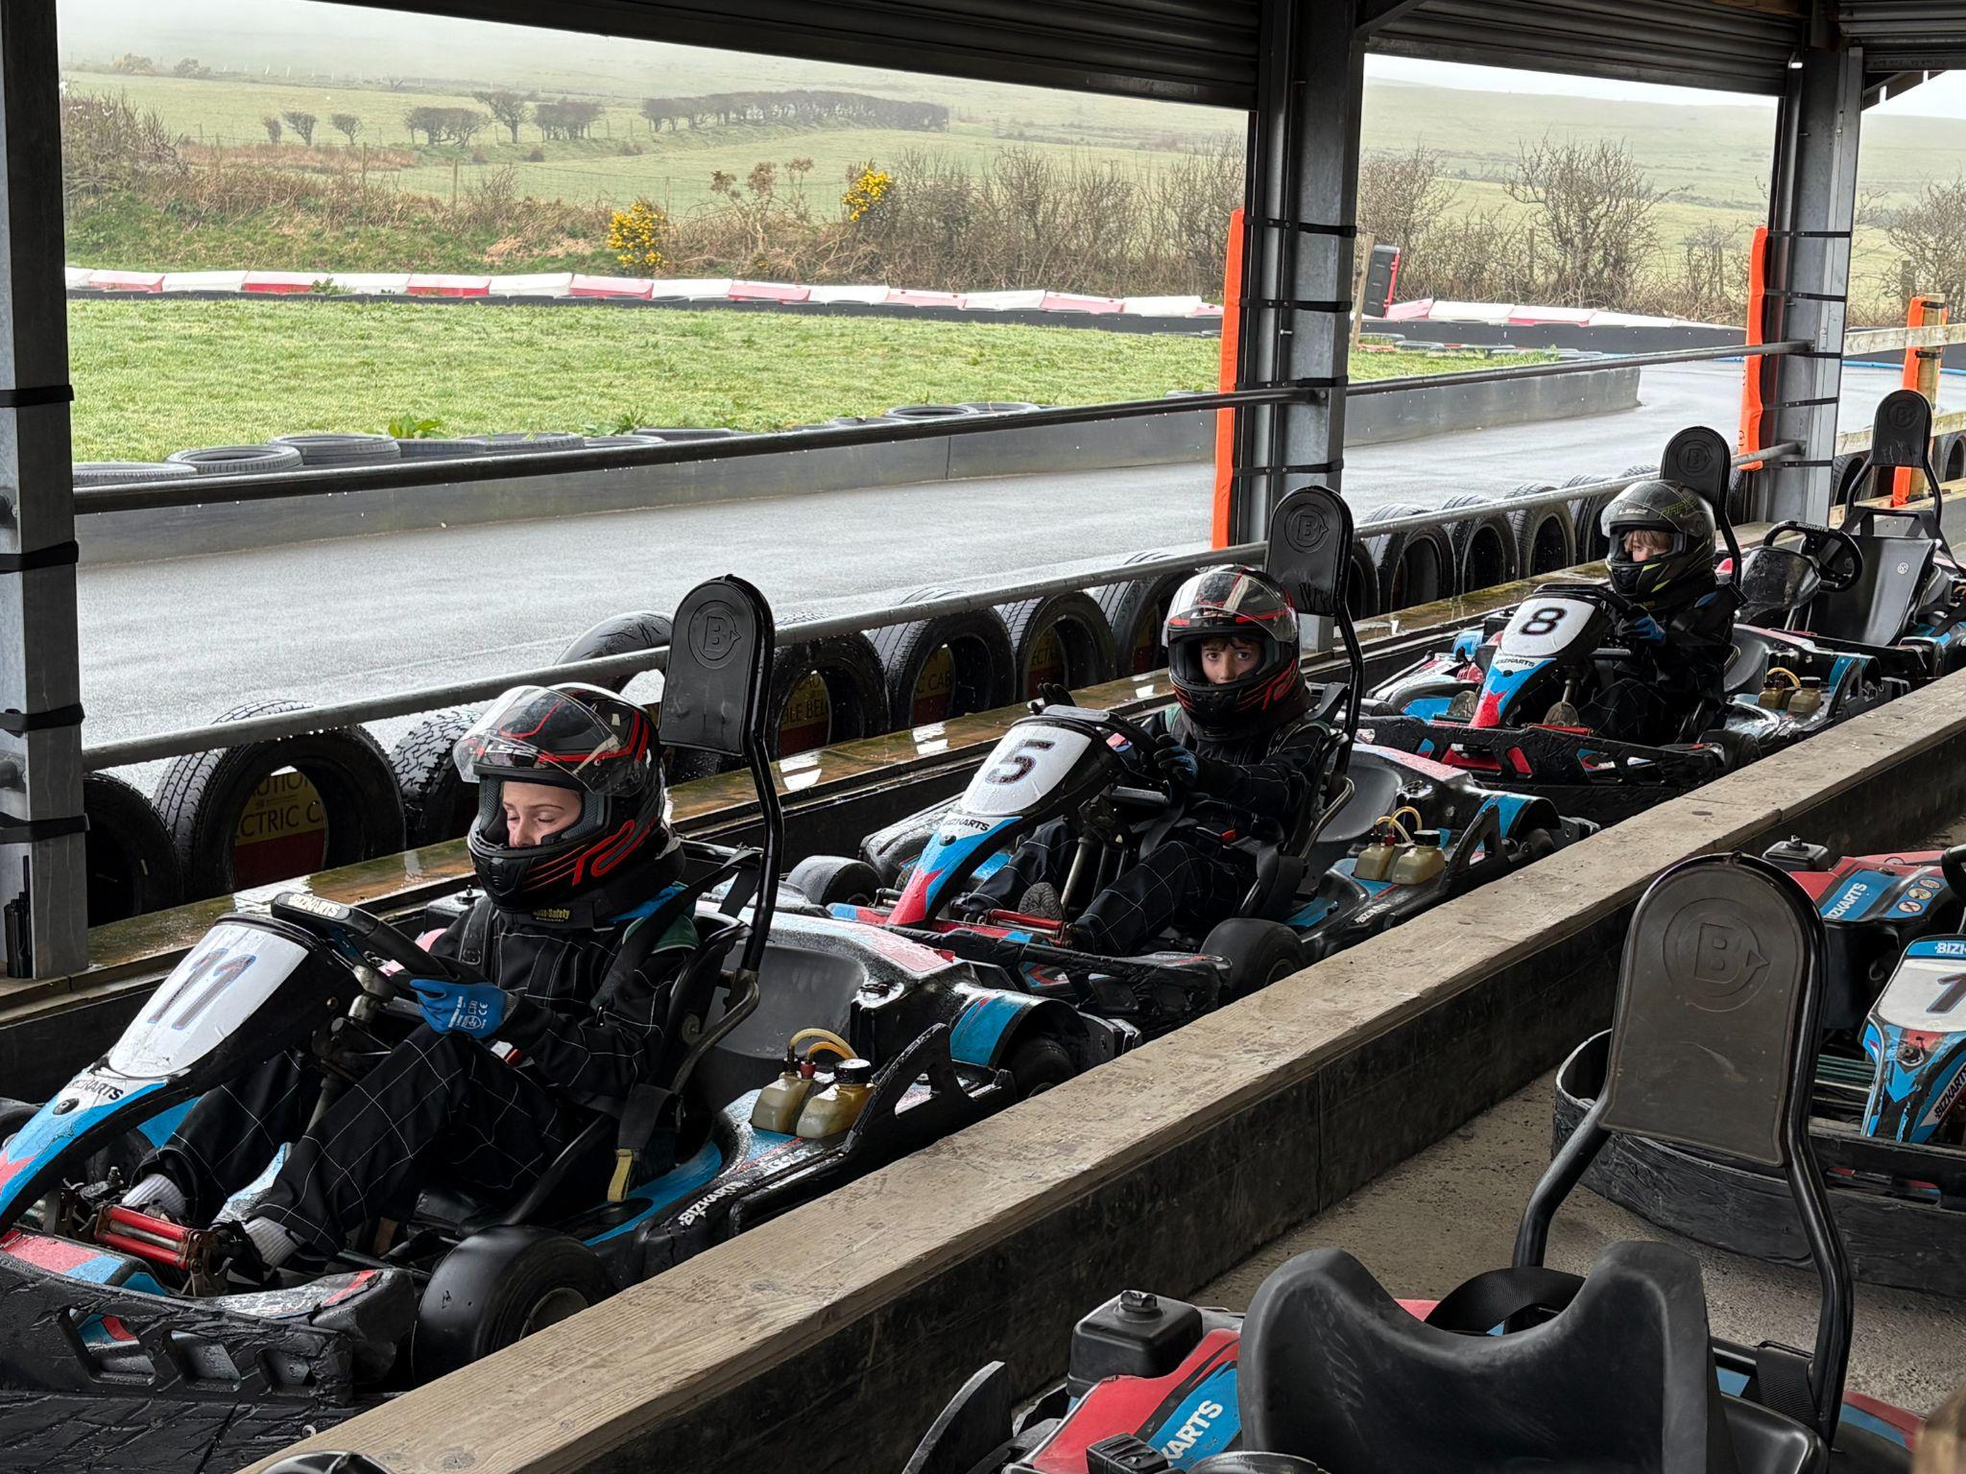
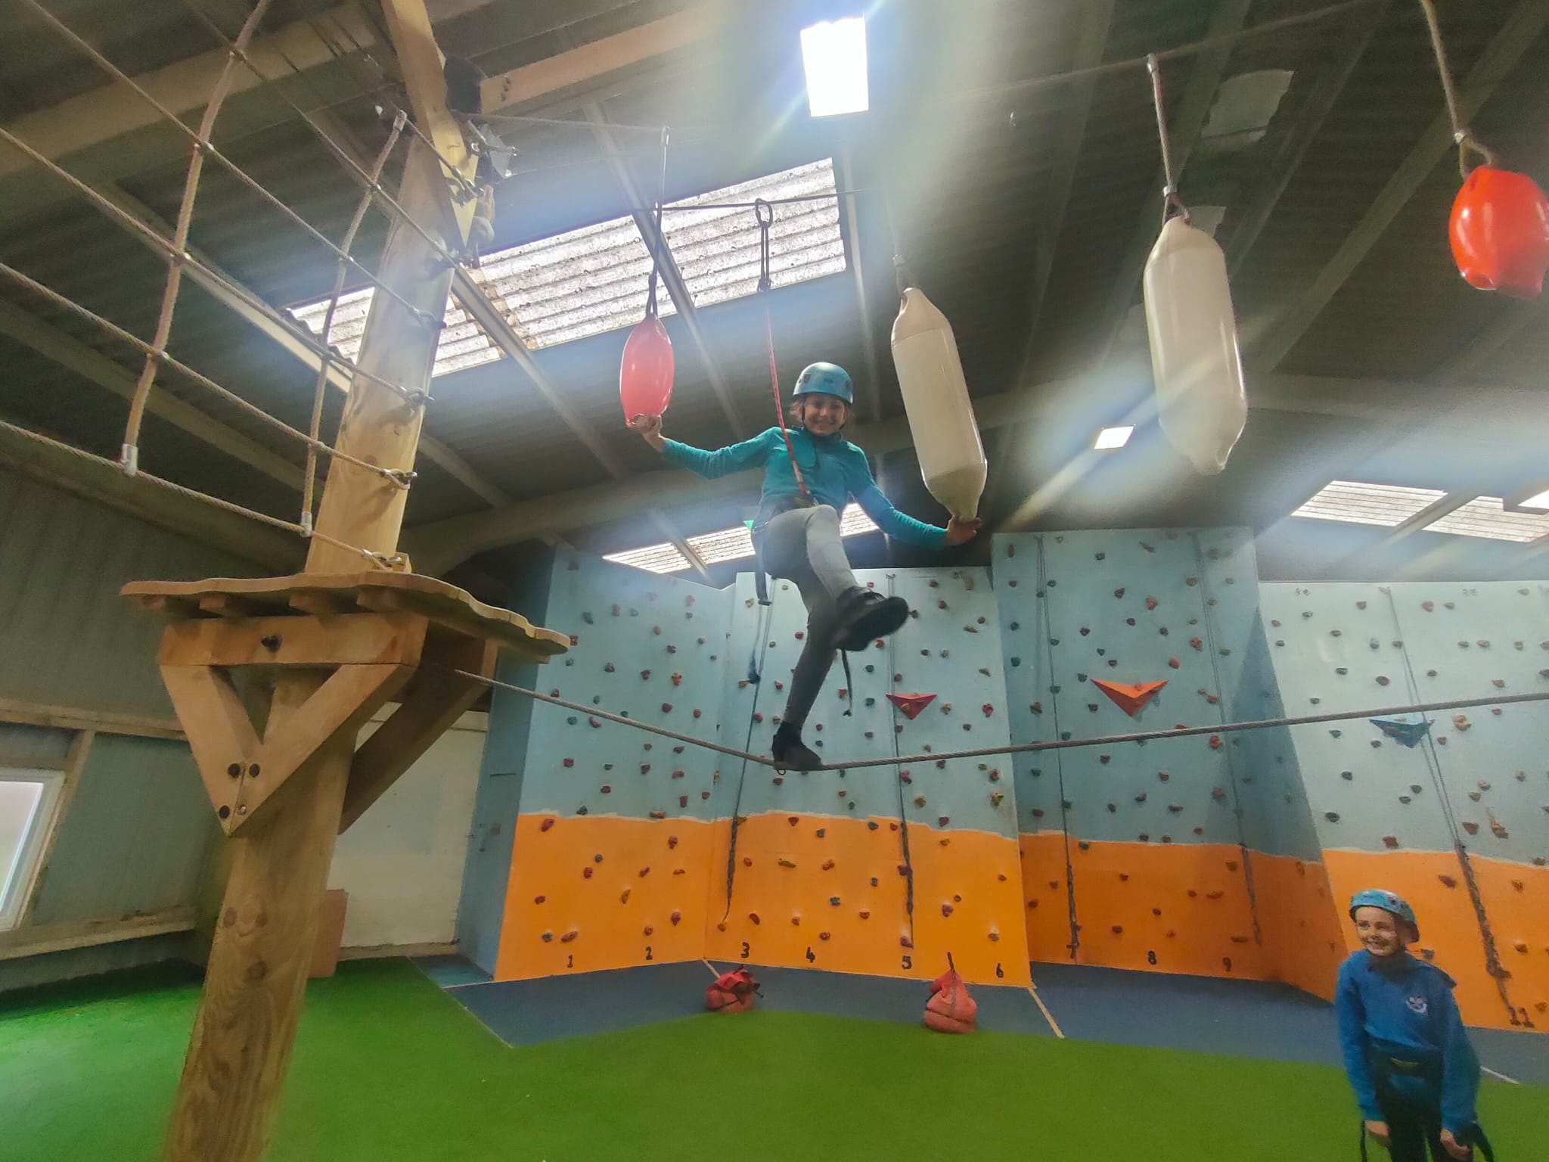
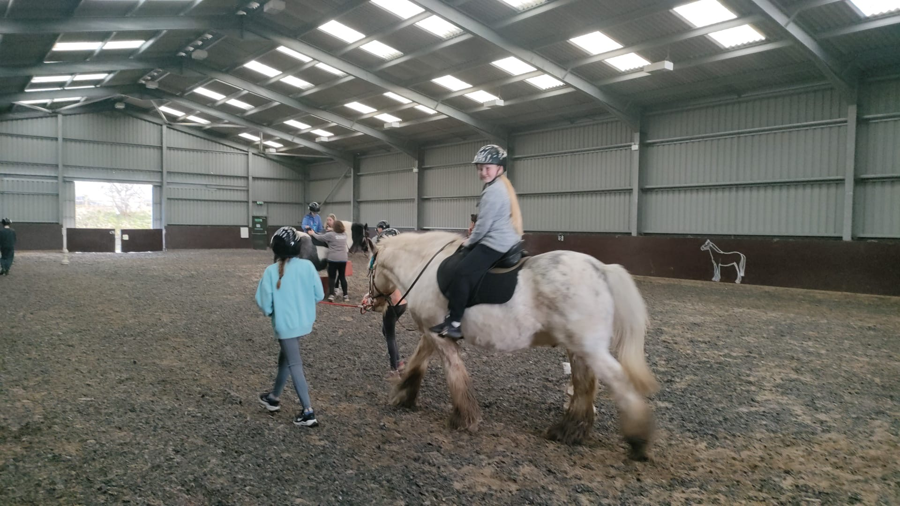
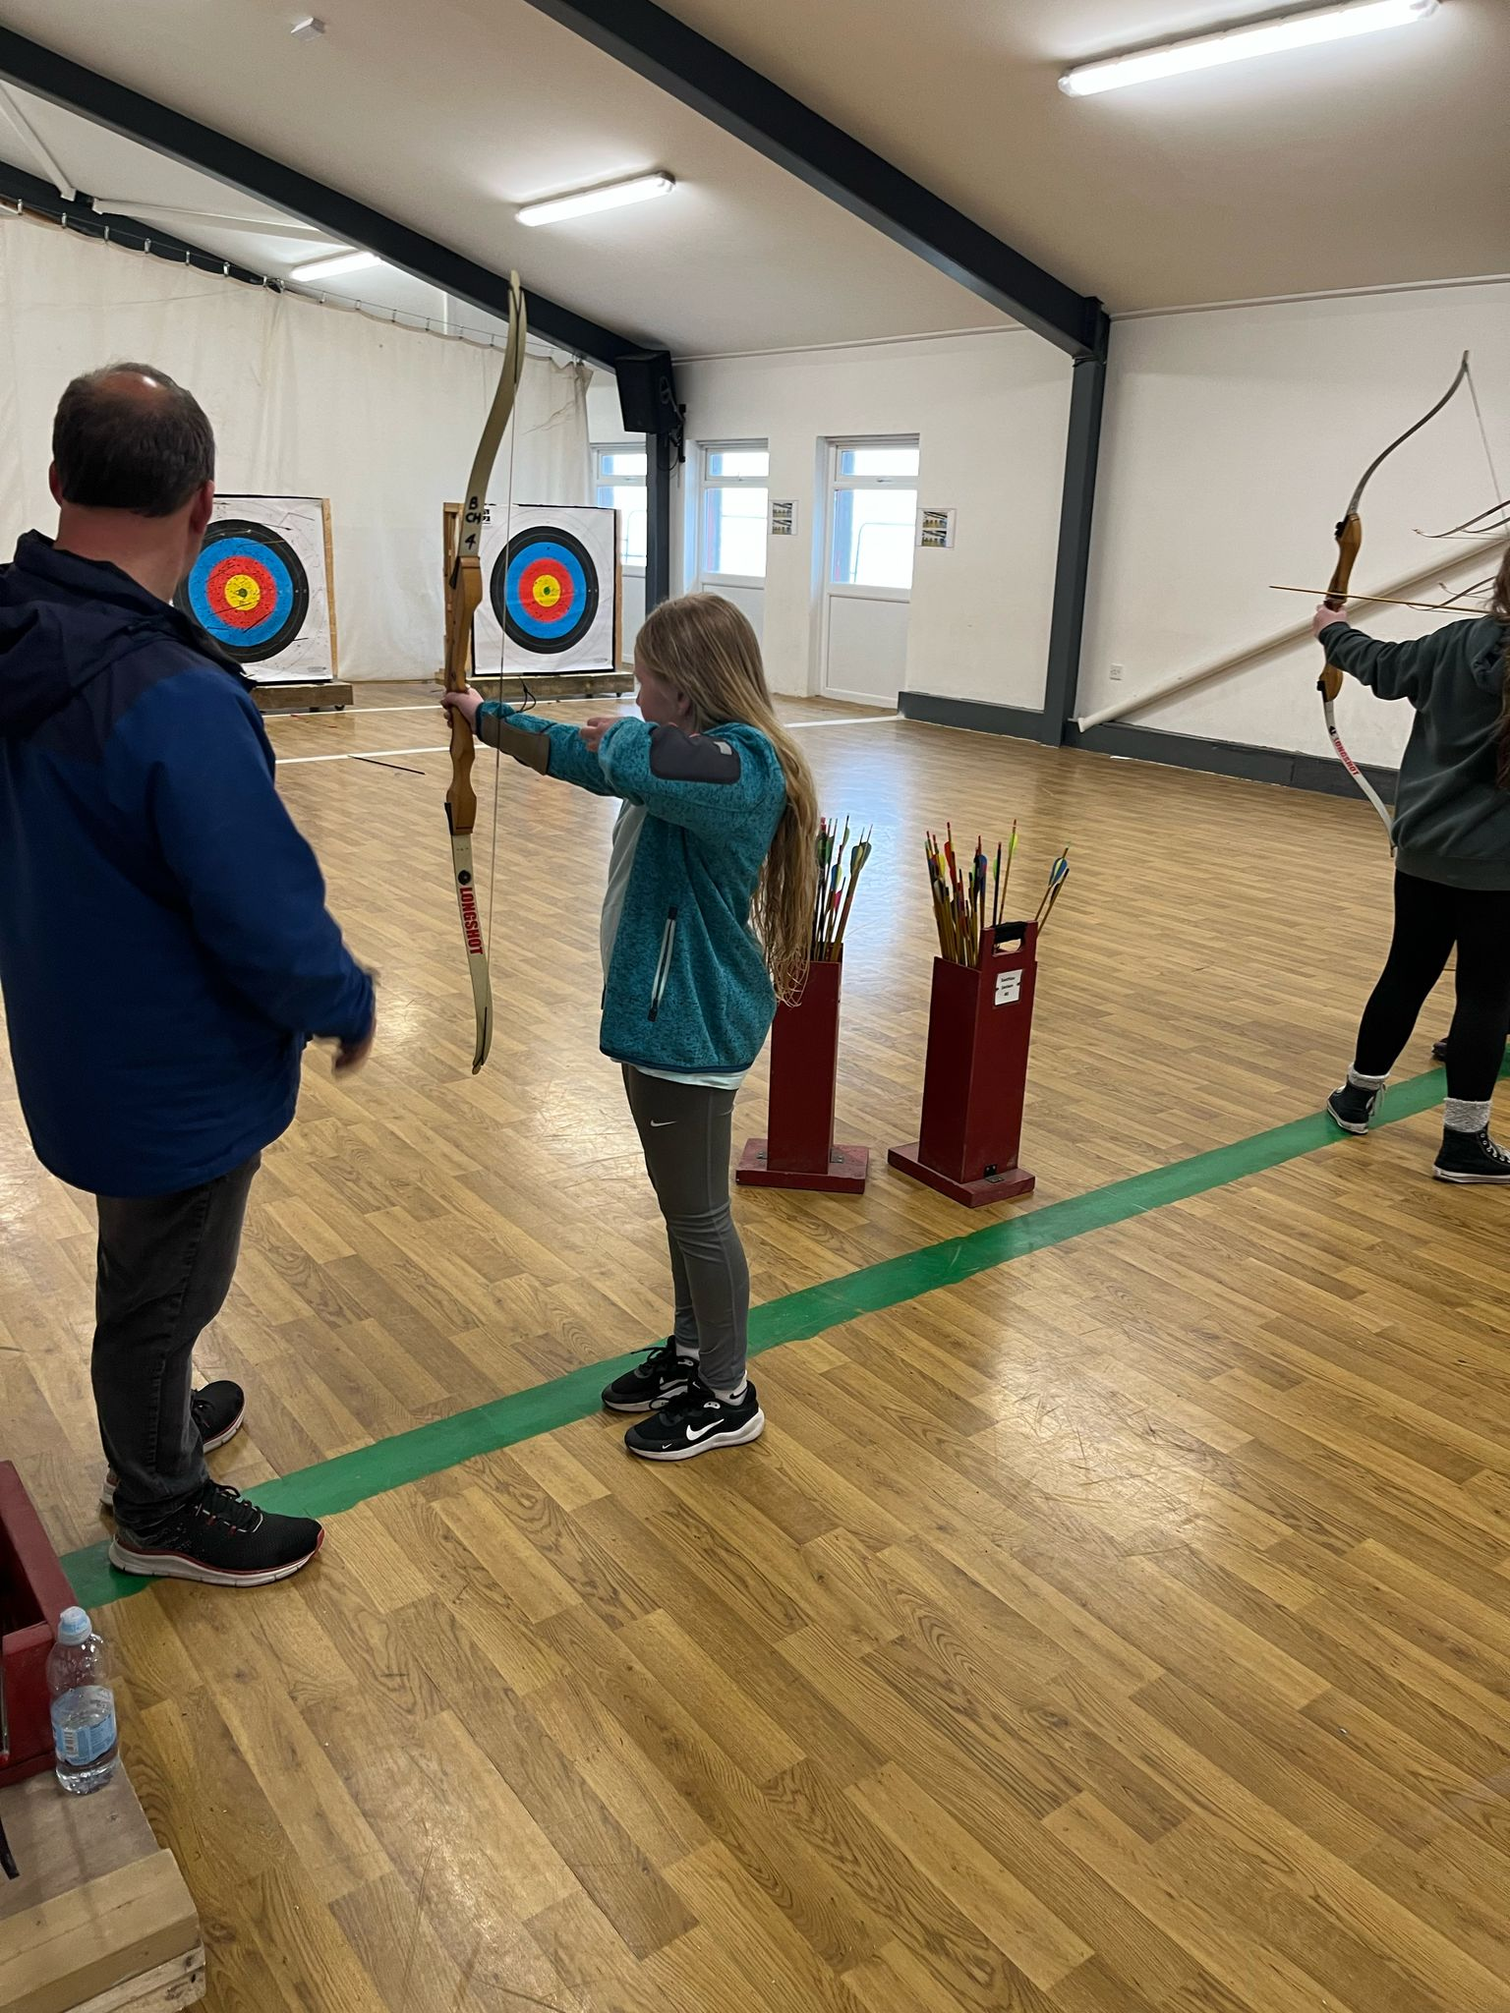
Activities & Itinerary*
*subject to change
WEDS
arrive Llangrannog 11:30am approx. and lunch
safety briefings/fire drills completed
team building, skiing, tobogganing, go karts
dinner
twmpath, quiz
bed
THURS
breakfast
walk to the beach (if weather bad - indoor sports)
low ropes
lunch
bushcraft, high ropes, swimming, zip lines
dinner
visit shop
disco
bed
FRIDAY
breakfast
jumping bag, climbing wall, archery, horse riding, trampolining
lunch
depart Llangrannog 1pm
arrive Llangan 4pm approx.

Slide 9
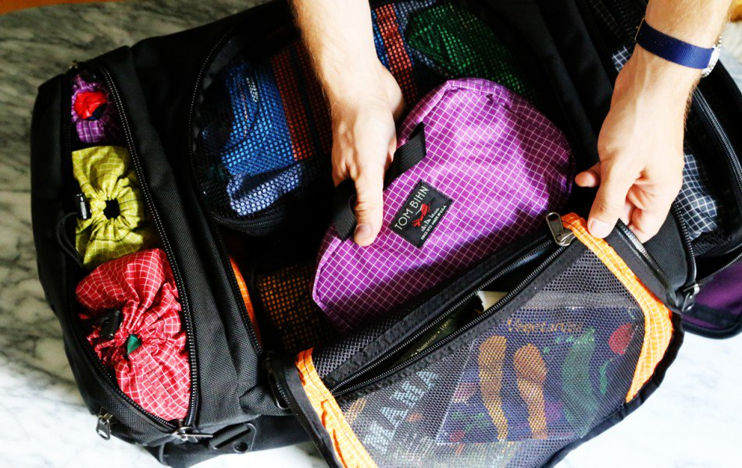
Packing
Sleeping bag - stuff bag
2x towels
Approx. 5 sets of clothes (not best!)
Warm jumper/hoodie
Pyjamas
Sleep mask (optional - rooms are lit by a safety light at night)
Waterproof,warm coat
Swimming - costume/trunks/shorts/t-shirt
2 x plastic bags for wet things
Trainers for walking (not best!)
Old pair of trainers or wellies for horse riding
Gloves, hat and scarf if weather is due to be cold
Toiletries – toothbrush, toothpaste, shower gel, shampoo, hairbrush and suncream
Rucksack for coach journeys
Refillable water bottle
Book/small games/notebook etc.
Teddy (optional)
Wallet/purse - £10
Limited amount of snacks! Please do not send the children with huge amounts of sugary things!
Pack with your child
Must be able to carry bag/suitcase
OLD clothes please! Nothing expensive.
NAME on everything.

Slide 10
What Not To Bring
Please don’t allow your child to bring:
any electrical equipment
no phones
no digital cameras
no tablets/computers
no hair dryers
chewing gum
energy drinks
THEY CAN BRING A DISPOSABLE CAMERA- WE WILL TAKE LOTS OF PHOTOS AND ENSURE THESE ARE UPLOADED TO INSTAGRAM.

Slide 11
Contact
Llangrannog:
01239 652140
llangrannog@urdd.org
Email:
office@llanganschool.org.uk
We will have access to this inbox during our stay.
Instagram - although Wifi and signal can be a bit patchy.
If there are any problems at all, Mrs Heavyside will call you.

Slide 12
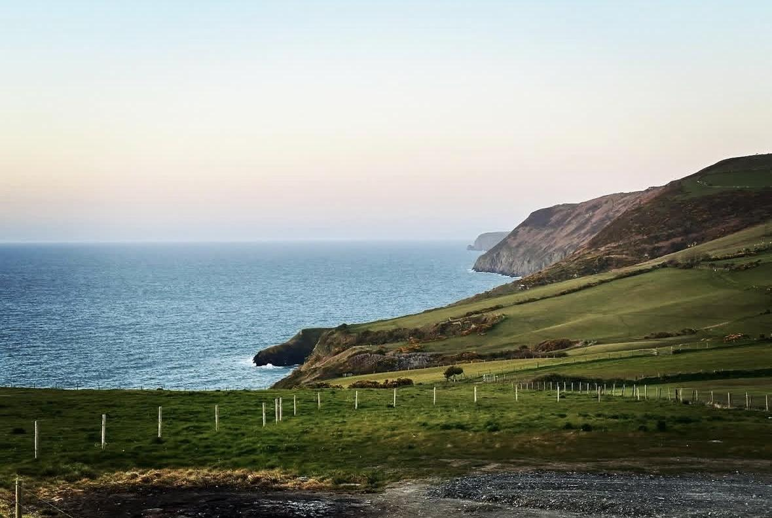
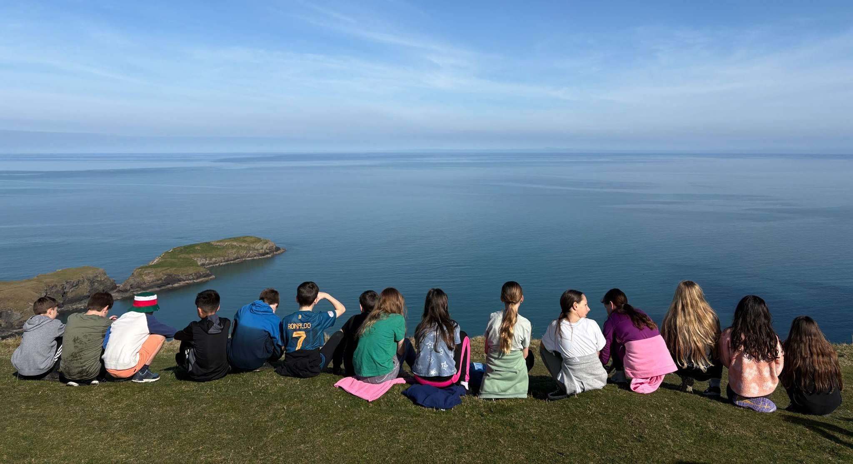
Any Questions?
Llangrannog Forms!
Please ensure that all forms are completed. Hard copies available here today.
Any medication at all needs to be logged on a form in order for us to administer any medicines.
Notes:
You can use this slide as your opening or closing slide. Should you choose to use it as a closing, make sure you review the main points of your presentation. One creative way to do that is by adding animations to the various graphics on a slide. This slide has 4 different graphics, and, when you view the slideshow, you will see that you can click to reveal the next graphic. Similarly, as you review the main topics in your presentation, you may want each point to show up when you are addressing that topic.
Add animation to images and graphics:
Select your image or graphic.
Click on the Animations tab.
Choose from the options. The animation for this slide is “Split”. The drop-down menu in the Animation section gives even more animations you can use.
If you have multiple graphics or images, you will see a number appear next to it that notes the order of the animations.
Note: You will want to choose the animations carefully. You do not want to make your audience dizzy from your presentation.

